Slide 1
Chapter 28 Section 4, B
The war in Europe
Ends
By. Sun Ah Hwang

Slide 2
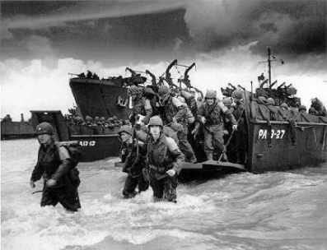
The situation in Europe at that time
Cause : The Allies invaded Normandy(=the mark of the beginning of the end for Hitler)
Result: Germany had to fight the war on two sides- a western front in France& an eastern front in the Soviet Union
The German forces became weak
/ Allied victory was in sight

Slide 3
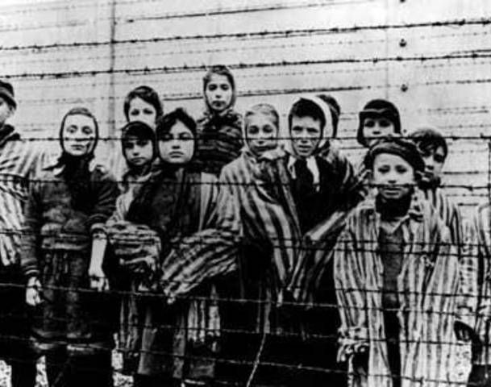
The Horrors of War : the Concentration Camps
As Allied troops fought their way against the Nazis in Europe, the most horrifying part of Hitler’s rule – concentration camps was found
Allied troops found those camps & freed the prisoners

Slide 4
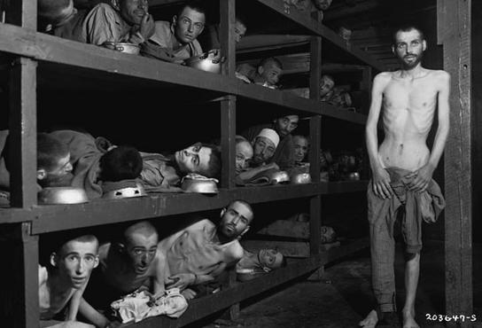
The Concentration Camps
Concentration Camps : inhumane conditioned-places where political prisoners and members of certain racial and ethnic groups (e.g. Jews, Slavs, Gypsies) were sent from all over Europe by Hitler
Mainly located in Poland, and Buchenwald and Dachau in Germany
To carry out Hitler’s policy of genocide
– killing an entire group of people

Slide 5
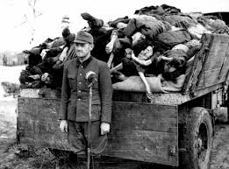
What happened in the camps?
a. The prisoners were killed in gas chambers and their bodies reduced to ashes in special ovens
b. They were forced to work as slaves under harsh environments, with little food and medical care
Result: Thousands died from starvation, disease and physical abuse by the Nazis. (known as Holocaust)

Slide 6
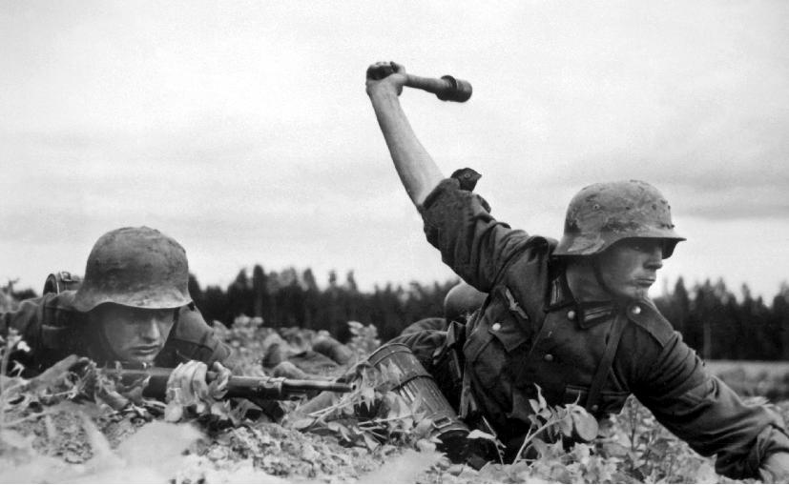
Victory in Europe
The Allies advanced eastward /the Soviet troops made their way westward, pushing the Germans back to their original position
December 1944, the Germans pushed the Allies back (the Battle of Bulge)
January 1945, U.S. tanks came to help the Allies regain their earlier positions.

Slide 7
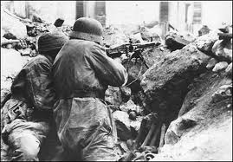
Victory in Europe
Mid-September 1945, the Allies got the most of France territories back
April 1945, the city of Berlin was surrounded by the Soviet troops/ Hitler refused to surrender
April 12 1945, U.S. president Franklin Roosevelt “unfortunately” died
April 30 1945, Hitler shot himself & Germany surrendered(the day was called “V-E – Victory in Europe, day”)

Slide 8
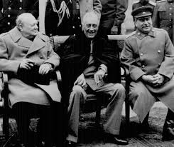
The conference at Yalta
Where : the soviet city of Yalta
When: In February, 1945
By who: Stalin(Russia), Churchill(G.B.), and Roosevelt(U.S.)
Purpose: to discuss plans for ending the war
Addition: Stalin agreed with joining the Asia war in exchange for control of the eastern European nations after Hitler fell

Slide 9
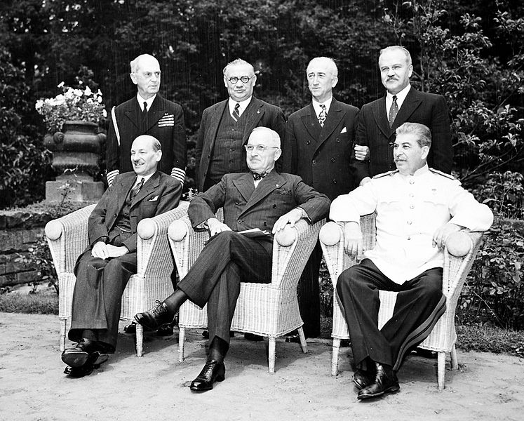
The conference at Potsdam
Where : Potsdam, Germany
When: In July, 1945
By who: Stalin(Russia), Churchill(G.B.), and Harry S. Truman (U.S.)
Purpose: to divide Germany into each four zones that will be administrated by France, U.S., Soviet Union, G.B.
Addition: Truman told Stalin about
using the new weapon – atomic bomb,
in the war with Japanese.

