Slide 1
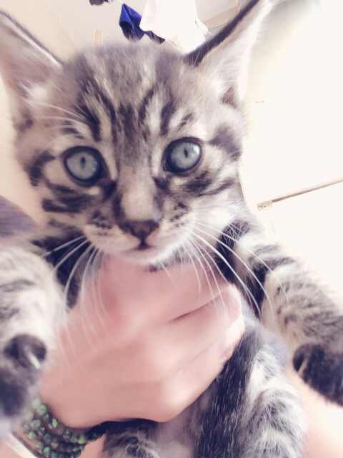
Advisory
If an Upper School student MUST change bus, the student must call parent before 3:00 PM in the Upper School Office in the presence of, and verified by Jessie Li. Jessie will then inform Cady, our transportation coordinator. If there are students who need to change buses in the afternoon....then we need a written or verbal notification from parents.
Lunch: Students are only permitted in the cafeteria, on the basketball courts
or on the soccer field.
No students should be in the building during the lunch period.
Activity: Thursday- VOX POPULI. Students are to choose one of the prompts and write
their outlook for that prompt.

Slide 2
Comparative Government
EQ: What is Comparative Government and why should we study it?
EU: Understand the importance of studying Comparative Government systems.
Agenda:
1. Hand out philosopher packets
2. Discuss What is Comparative Government
3. Assign readings and question sheets
Hw: Complete question sheets due Tuesday

Slide 3
Model United Nations (MUN)
EQ: What is MUN?
EU: Understand the importance of MUN and the efforts it will take to become an exceptional delegate.
Agenda:
1. Review page 7 of MUN manual
2. Review pages 9 and 10 of helpful websites
3. Read and discuss Declaration of Human Rights as a class
Un.org
4. Tour MUNiSQ site
UN Dispatch- Choose one forum you are interested in and review one story from it. Write a brief summary and present to the class.
Hw; Finish summary for Tuesday

Slide 5
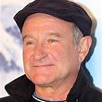
World History III
EQ: What is history and why should we study it?
EU: Students will develop an understanding of what history is and why we study it.
Agenda:
1. Homework review-Chapter of interest
2. Introduce primary/secondary sources-PPT
3. Partner interviews
4. Develop parent questions- questions relating them to a primary source
Hw: Interview parents-interviews presented on Tuesday

