Slide 1
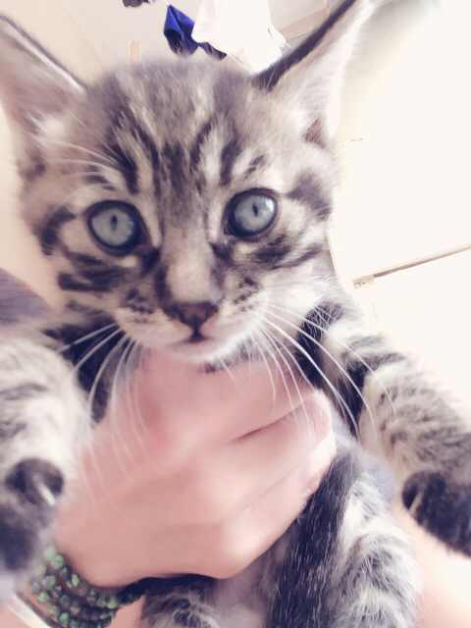
Advisory
If an Upper School student MUST change bus, the student must call parent before 3:00 PM in the Upper School Office in the presence of, and verified by Jessie Li. Jessie will then inform Cady, our transportation coordinator. If there are students who need to change buses in the afternoon....then we need a written or verbal notification from parents.
Lunch: Students are only permitted in the cafeteria, on the basketball courts
or on the soccer field.
No students should be in the building during the lunch period.
QCIE students need to report to Ms. Alejandra and Mr. Tony in the
music room
Activity: Friday- Pictionary-Ms. Nickolas’ room

Slide 2
Asian Studies
EQ: What is the geography of China and how does have an affect on where people live?
EU: Identify geographic and political features of China
Agenda:
1. Collect Hw
Map skills
On one side of your map fill in all the provinces of China as well as adding in geographic features
On the back side dot in the population densities of each region. Lightly shade in climate zones of China
Hw: Complete vocabulary/finish maps

Slide 3
World History III
EQ: What is history and why should we study it?
EU: Students will develop an understanding of what history is and why we study it.
Agenda:
1. Finish partner interviews/introductions
2. Homework review-Parent interviews
3. Introduce Industrial Revolution
Hw: Unit 1 vocabulary, Know your ESLRs, Tell 10B

