Slide 1
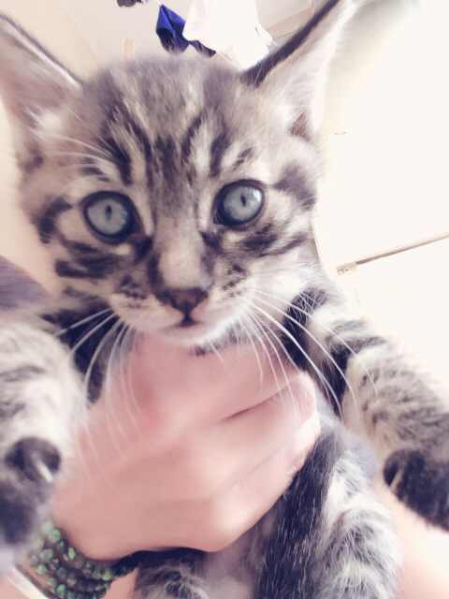
Advisory
Students will be working on portfolios
today and logging into focus.
The way to access your information: If you are returning student your user name and password are the same as last year. New students you will do the following: username is gradyearlastnamefirstname. Eg. 17kimjolie. The password is student. You will then be prompted to change your password.
Goal setting: HOW will you achieve your goals? Don't just say "get better grades"... write how you plan to do this.
Queenie is
Still available
Activity: Monday

Slide 2
Asian Studies
Queenie is
Still available
EQ: What is the geography of China and how does have an affect on where people live?
EU: Identify geographic and political features of China
Agenda:
1. Collect Hw
2. Create a PPT following the rubric provided in class
3. I will assign your headings
4. Work on in class and be ready to present on Wednesday
Hw: Complete presentations

Slide 3
World History III
Queenie is
Still available
EQ: What is history and why should we study it?
EU: Students will develop an understanding of what history is and why we study it.
Agenda:
1. Collect voc.
2. Take ESLRs test
3. Industrial Revolution Pre-test
4. Assign Poster project
Hw: Gather your research to be placed on posters in class on Wednesday.

