Slide 1
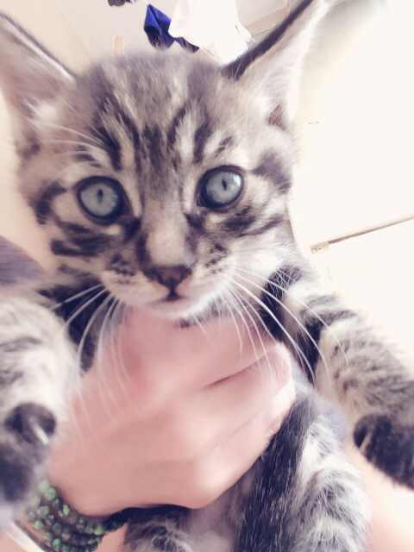
Advisory
Log into focus.
Complete goal setting sheet
The way to access your information: If you are returning student your user name and password are the same as last year. New students you will do the following: username is gradyearlastnamefirstname. Eg. 17kimjolie. The password is student. You will then be prompted to change your password.
Goal setting: HOW will you achieve your goals? Don't just say "get better grades"... write how you plan to do this.
Queenie is
Still available
Activity: Tuesday

Slide 2
Comparative Government
Queenie is
Still available
EQ: What is Comparative Government and why should we study it?
EU: Understand the importance of studying Comparative Government systems.
Agenda:
1. ESLRs test
2. Review questions on the philosophers
3. Discuss What is Comparative Government
4. Democracy word activity
5. US Government and Advanced Democracies pretest?
6. Assign terms
Hw: terms

Slide 3
Model United Nations (MUN)
Queenie is
Still available
EQ: How do I research a delegation?
EU: Develop an understanding of the importance of researching a delegation.
Agenda:
1. Hw turn in-Summary from the U.N. Dispatch site
2. Access websites from reading material to obtain delegation information
2. Research your delegation from the country assigned
3. Use the model from the publication students downloaded
Document information in outline form
Hw: Complete delegation research

Slide 4
World History III
Queenie is
Still available
EQ: What is history and why should we study it?
EU: Students will develop an understanding of what history is and why we study it.
Agenda:
1. Homework review-Present partners, parent and vocabulary
2. Take ESLRs test
3. Industrial Revolution Pre-test
4. Assign Poster Project?
Hw: Research

