Slide 1
A Large and Varied Land
Matthew
&
Michael

Slide 2
Many Regions make Up China
The People’s Republic is divided into 22 provinces, five autonomous regions, and four municipalities.
Five autonomous regions: Guangxi, Inner Mongolia, Ningxia, Tibet, and Xinjiang.
Four municipalities: Beijing, Shanghai, Tianjin, and Shenzhen.

Slide 3
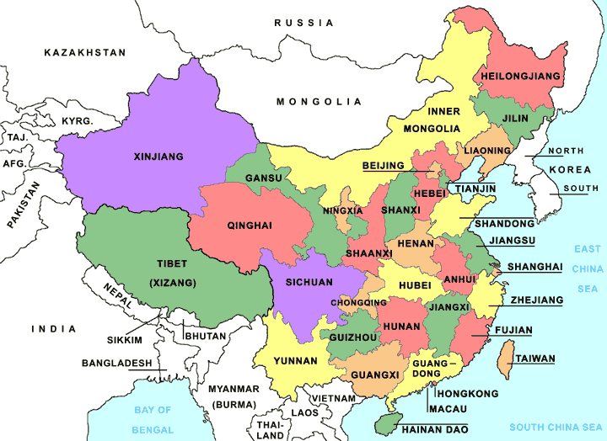
China Political Map

Slide 4
China is often divided into what are called China proper and outer China. China proper is the parts of china occupied by traditional Chinese people. China proper is divided north and south. The dividing lines are the Qinling Mountains and Huai River.
Outer China is where people were not traditionally Chinese. Much of outer China consists of mountains, deserts and steppe land (treeless lands)

Slide 5
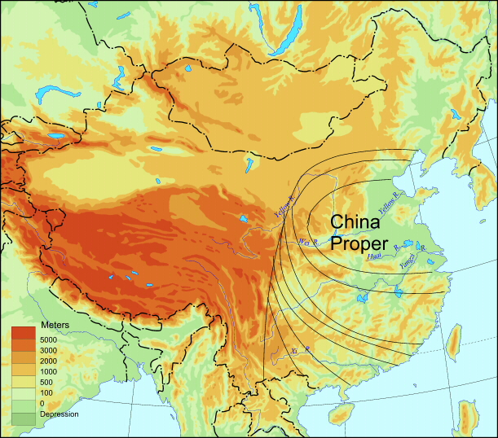

Slide 6
Highlands and Lowlands
Over 60% of the land is more than a mile above sea level.
China slopes downward from west to east.
East of the mountains are Plateaus.
The highest is found it Tibet
The most heavily populated Plateau is Sichuan.
Closer to the coast are plains.
The North China Plain, the Yangzi Plain, the Guangzhou Plain, and the Sichuan plateau are China’s best farming regions and the densest population.

Slide 7
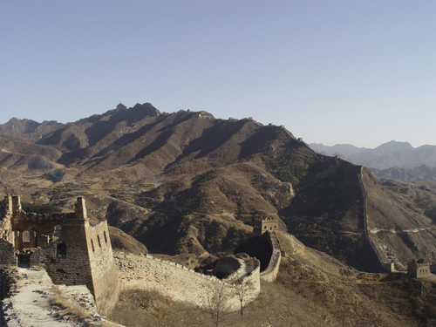
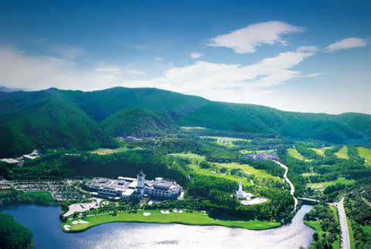
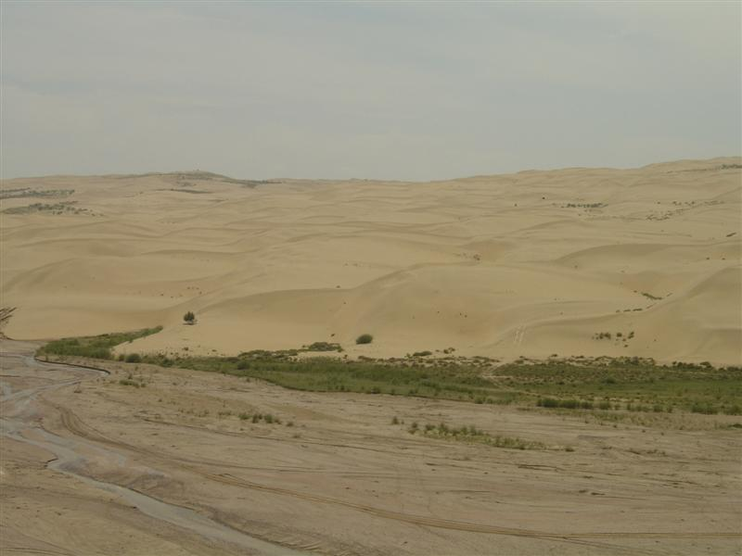
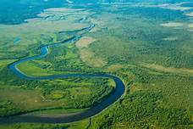

Slide 8
Chinas deserts cross across the north-western part of the country.
Chinas largest desert is the Taklimakan, located in Xinjiang

Slide 9
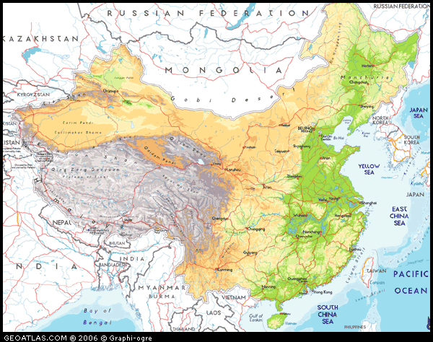

Slide 10
I Love You
Thanks for Listening :*
Teehee :$

