Slide 1
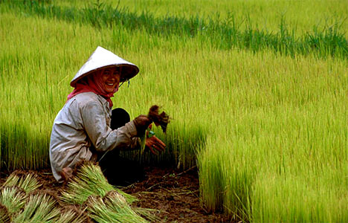
Agriculture in China
Julia
Tony

Slide 2
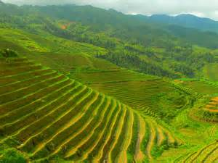
North China Farming
Good soil – loess soil
Growing period 4-6 months
Reshaped loess hills into terraces to make room for crops on the flat edges
Typical crops: wheat, millet, barley, kao liang, beans. Kao liang and millet are cereal grains
Millet is the staple food in the area

Slide 3
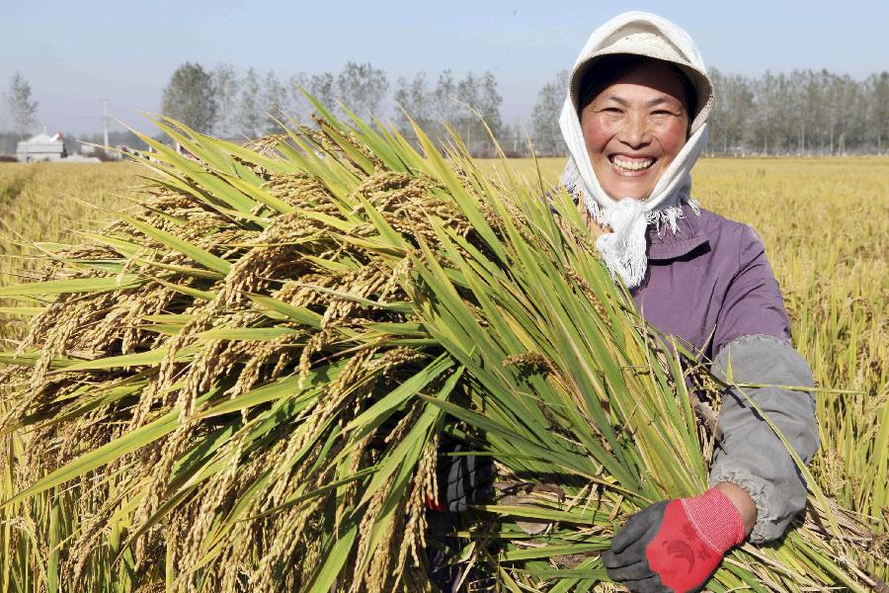
North China Farming
North China is the center of agriculture – large portion of China‘s food comes from here
Soy beans, wheat and cotton are grown
Farming based on soil deposits from Yellow River – largest alluvial (muddy) plain in east Asia
North China Plain bordered in North by Yanshan Mts., Taihang Mts in West, Yangtze plain in South, Bohai Sea in East

Slide 4
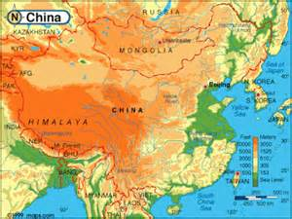
North China Farming

Slide 5
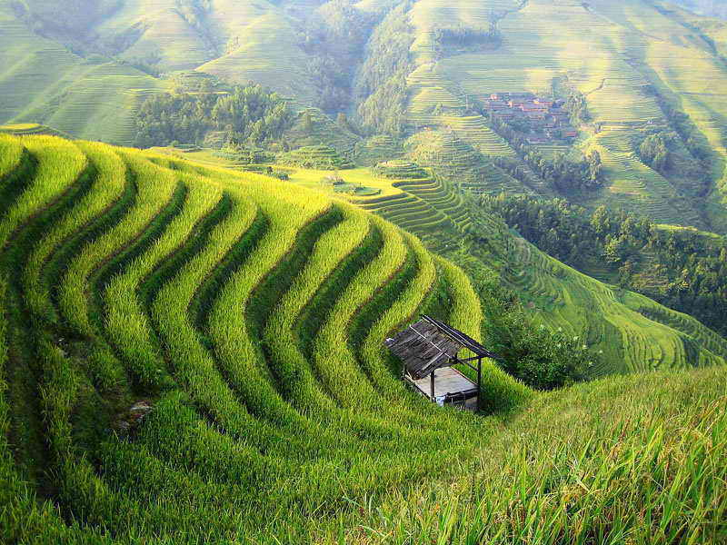
South China Farming
Farming marked by long growing seasons, stable water supply, and poor soil
Rice grown here in Yangtze and West River region
Produces more than 180 metric tons of rice a year
Sichuan and Hunan – the most productive rice producing provinces

Slide 6
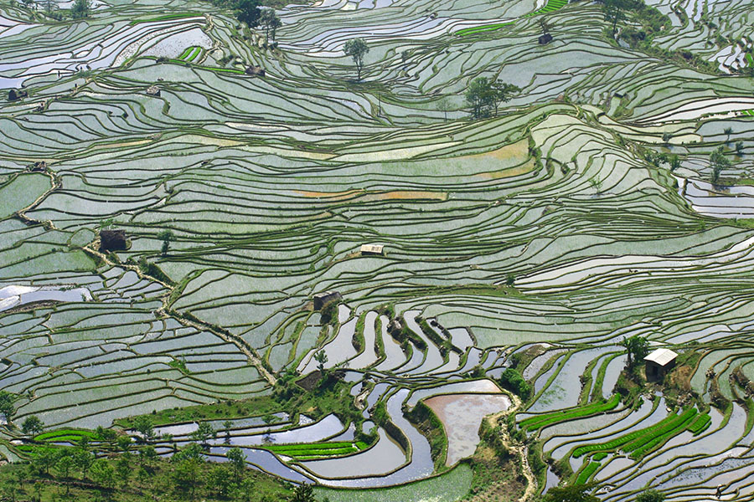
South China Farming
South of the Yangtze River, the growing season lasts from 6months to about a year
Two rice crops a year produced in central China
South China is the tea-growing area
Mulbery trees – leaves feed silk worms
Sugar cane
Fish – primary protein source in South China
¾ of fish grown in ponds

Slide 7
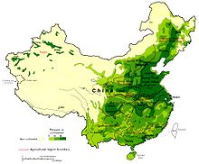
South China Farming

Slide 8
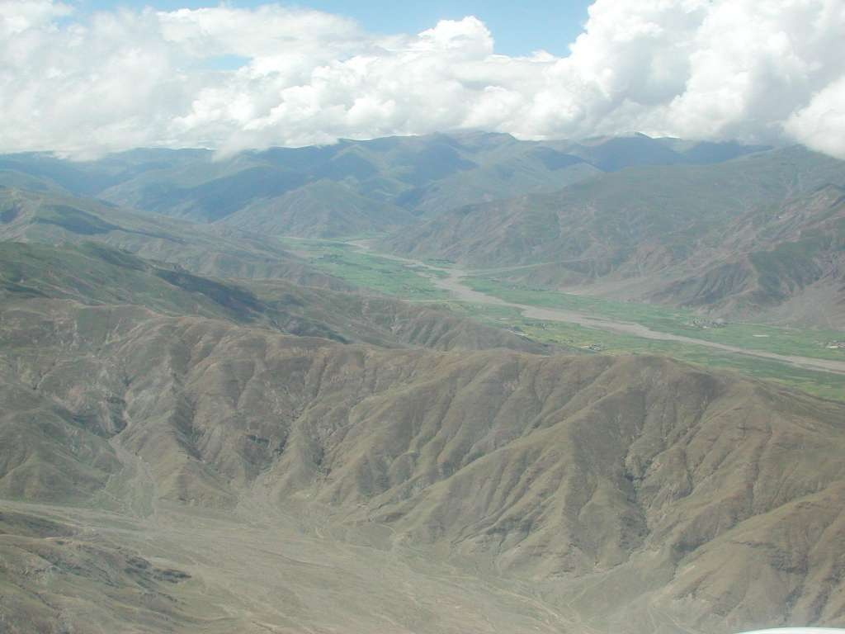
Outer China Farming
Manchurian Plain is fertile
Population grown significantly
Chinese moving here because of area‘s high productivity and natural resources
Growing conditions similar to North China
Soy beans, millet, wheat – important food crops. Cotton is major cash crop
In western provinces, farming only happens around water sources
Which there are not alot of

Slide 9
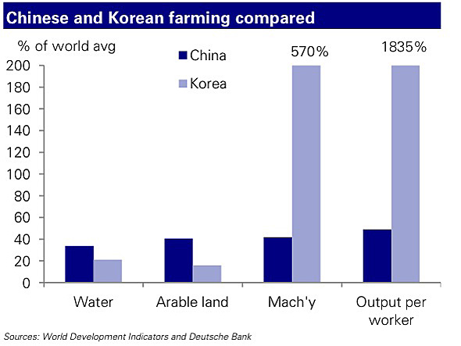
Outer China Farming

