Slide 1
Americans shift the balance in europe

Slide 2
The tide begins to turn in Europe
The combined British American forces invaded Sicily, Italy in July 1943

Slide 3
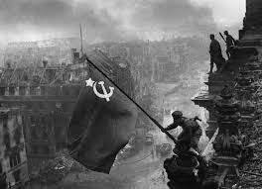
The tide begins to turn in europe
In the battle of Stalingrad, soviet forces captured or killed some 300,000 German troops.

Slide 4
D- day
The allies went attack the small port city instead of the major port. They believed that German army put heavy troops in the major port cities. The plan worked.

Slide 5
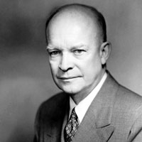
Normandy
On June 6 1944. general Dwight, the supreme allied commander, ordered more than 150,000 troops stormed the Normandy beach and the German army already set up the machine guns upon the cliffs.

