Slide 1
Child Labor
Sally
Soo Min
Julia

Slide 2
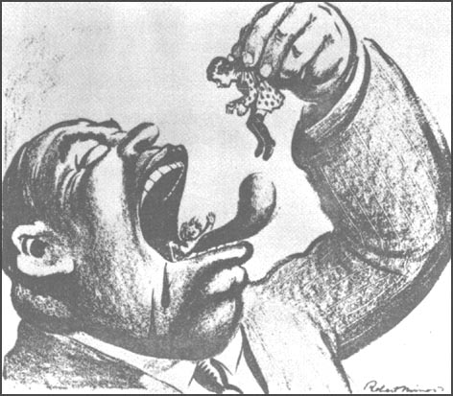
Causes of Child Labor
Lack of protection from government
Poverty
Parental illiteracy
Overpopulation
Unemployment of elders
Absence of parents(orphans)

Slide 3
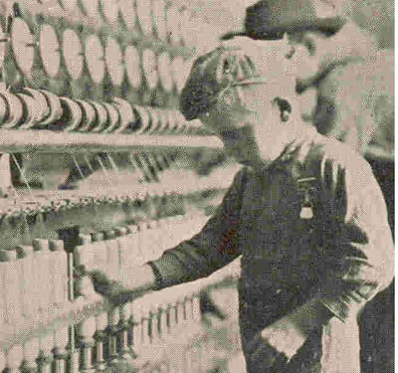
Jobs
Glass making
Matchgirls
Factories
Farm work
Mining
Prostitution
Chimney sweepers
Making roads
Shoe blacks
Errand boys
Flower selling
Newsies

Slide 4
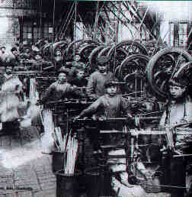
The Working Conditions
Minimal or often NO pay at all
Long working hours, up to 14-19 hours a day
One break, or not break at all
Safety neglected
Exposed to harmful chemicals
Worked with dangerous machines, resulting in injury or death
Well-being neglected
Often too tired to return home and slept in the
factory
No food or water provided
Abused(verbally or physically)
Punished harshly for small mistakes

Slide 5
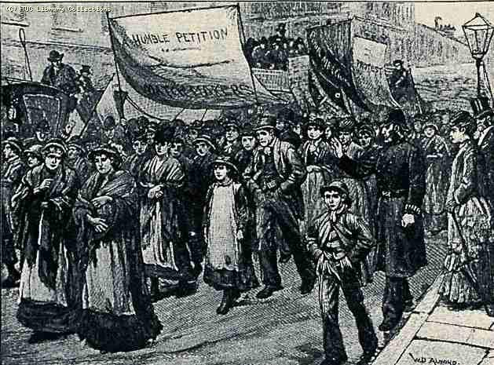
The Matchgirl Strikes of 1888
Caused by poor working conditions in the match factory
14hr work days, poor pay, excessive fines, sever health complications (white phosphorus)
Approximately 1,400 women and girls refused to work by the end of the first day (of the strike)
4 days after the start, the factory had stopped working all together
The Management of the company was nervous of the public and agreed to the new terms
Fines were abolished, meals to be taken in
Separate rooms (food could not be
contaminated by phosphorus)

Slide 6
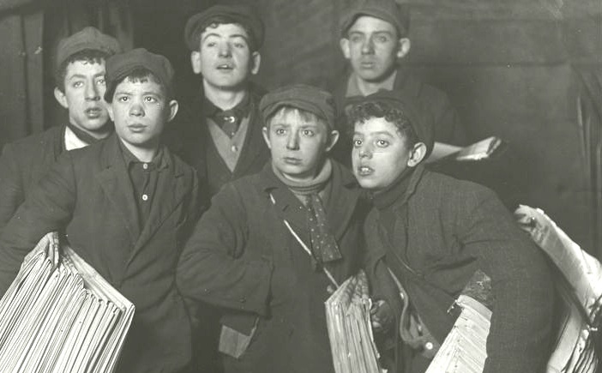
The Newsboy Strike of 1899
Strike lead by Kid Blink
So called because he was blind in one eye
Real name: Louis Ballatt
Demonstrated across Brooklyn Bridge, bringing traffic to a standstill
Lasted two weeks, reduced the circulation of the New York World from 360,000 to 125,000
Union disbanded when New York World
and New York Morning Journal agreed
to buy back all unsold papers

Slide 7
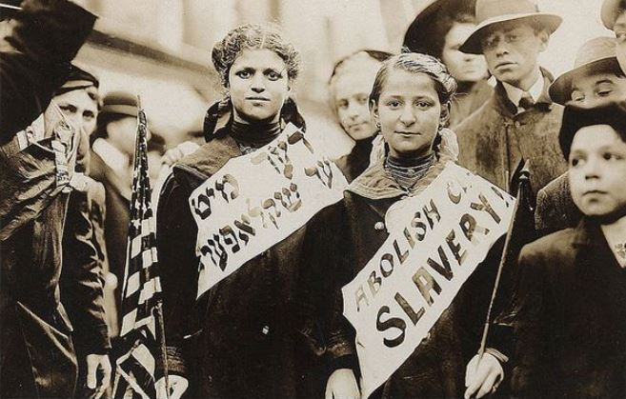
Child Labor Laws
Hired for nonagricultural employment must be at least fourteen.
Hours limited
-14 and 15 years of age :
School Day - 3 hours a day and 18 hours a week
No School - 8 hours a day and 40 hours a week
-16 and 17 years of age : Unlimited hours
Parents are prohibited from employing their child in manufactoring or in any of the occupations declared hazardous by the Secretary of Labor.
Any wage rate above the $4.25 minimum wage for youth an hour.
Paid to eligible workers during 90-day period.

Slide 8
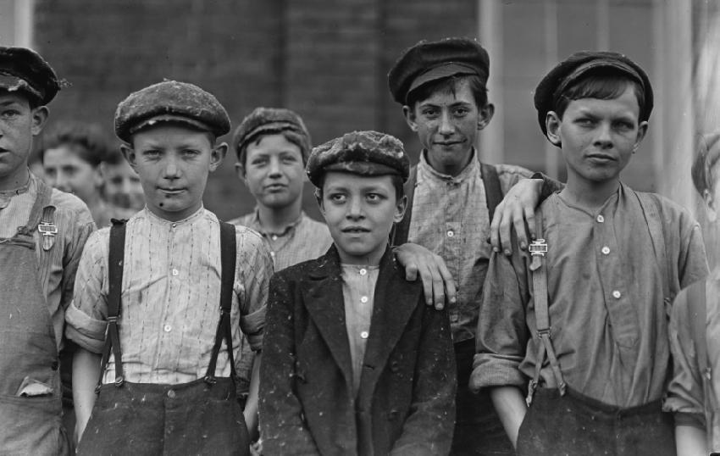
Child Labor Facts and Statistics
By 1810, about 2,000,000 school-age children were working 50- to 70-hour weeks.
The 1900 census counted 1.75 million individuals aged 10 to 15 who were gainful workers.
In 1900, 18 percent of all American workers were under the age of 16.
In southern cotton mills, 25 percent of the
employees were below the age of
fifteen, with half of these children
below age twelve.

Slide 9
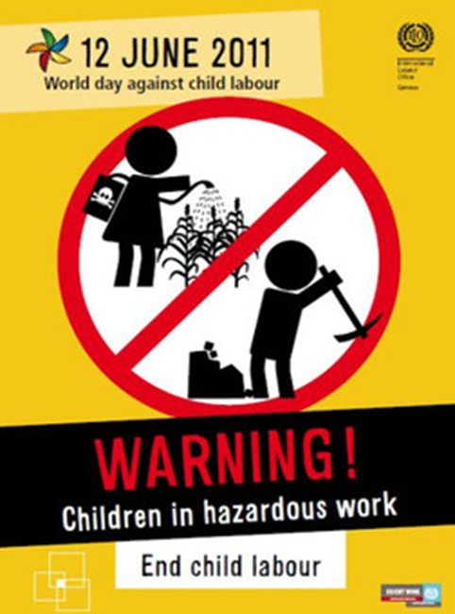
World Day Against Child Labor
June 12th
The International Labour Organization (ILO) launched the first World Day Against Child Labor in 2002.
Catalyst for the growing worldwide
movement
Against children labour $ to build the
capacity of domestic workers organizations
to address child labour.
Provides and opportunity to gain support
of individual governments

Slide 10
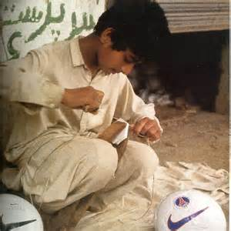
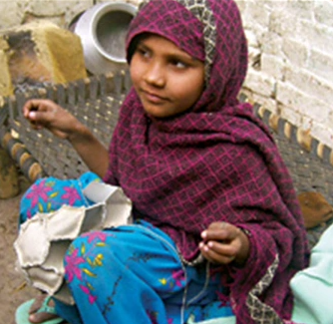
Current Child Labor Problems
More than 215,000,000 children who undergo ago of 5~14 are still suffering from child labor in more than 76 countries.
Earn average $3.3 per week
Bonded labor in Middle East(e.g. India, Saudi Arbia)
- work in textile(e.g. carpet), Silverwork, floriculture and cigarette industries
- to pay parent’s debts
Coffee and cocoa labor
- earn less than $1 per day
- get only 0.5 % of profit
Nike labor in Pakistan, Nepal
- exploited child labor to make
soccer balls in harsh condition

Slide 11
Child labor rate

Slide 12
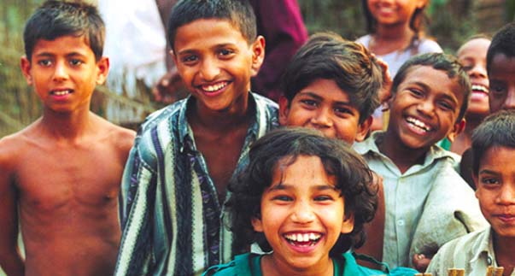
Ending Child Labor?
Buy fair trade items (e.g. Coffe, chocolate)
Hold more child care campaigns
Construct schools to support education
Give finical support regulary
Fully enforce human rights
More involvement from organisations(e.g. World vision, unicef, save the children)
Stronger punishment
for employers who hire
children

