Slide 1
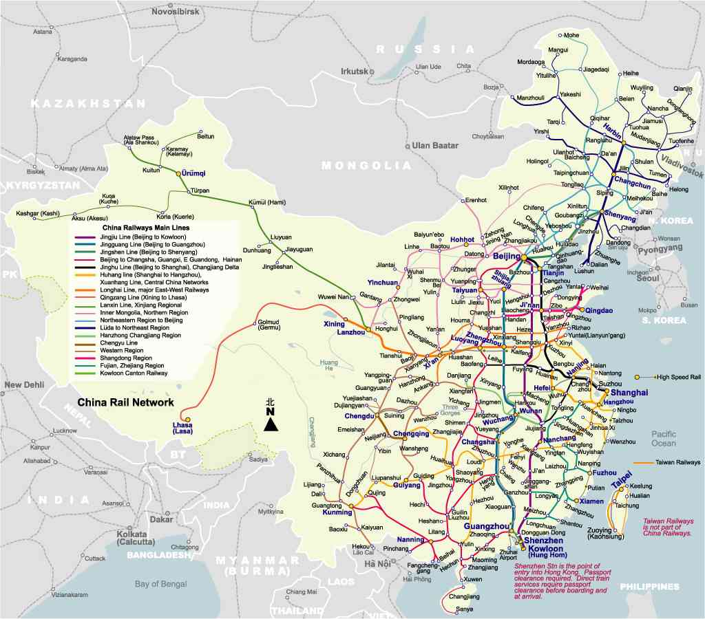
CHINA -River System
By.
SooMin & Jun

Slide 2
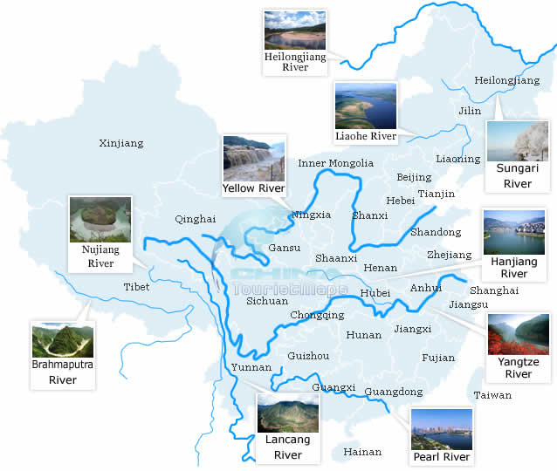
Rivers in China
1500 rivers cover an area of 100 squ-are kilometers.
64% of China’s land
Described as dragons
One main source of life
Flow from west to east

Slide 3
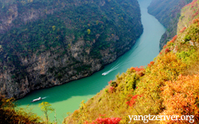
Yangtze River (Chang Jiang)
Longest river in Asia;
Third largest (longest) in the world
Originating from Qinghai
Dividing North and South
Place (plays) a large role in the history, culture and economy
Gorges Dam

Slide 4
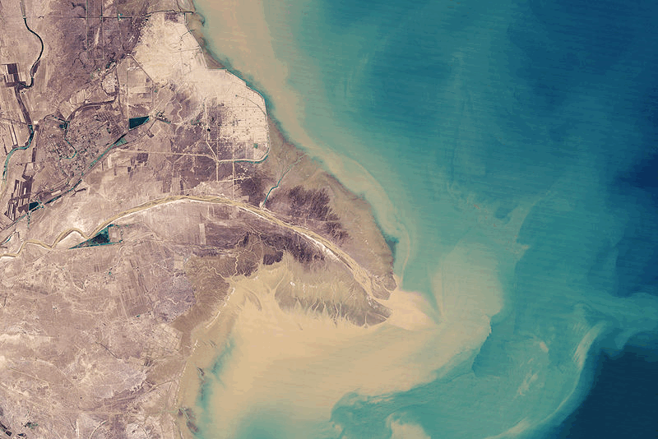
Yellow River (Huang He)
Mother river
Second longest in China
9 provinces and regions- what about it
Flow quietly, admiring by people for thousand of years

Slide 5
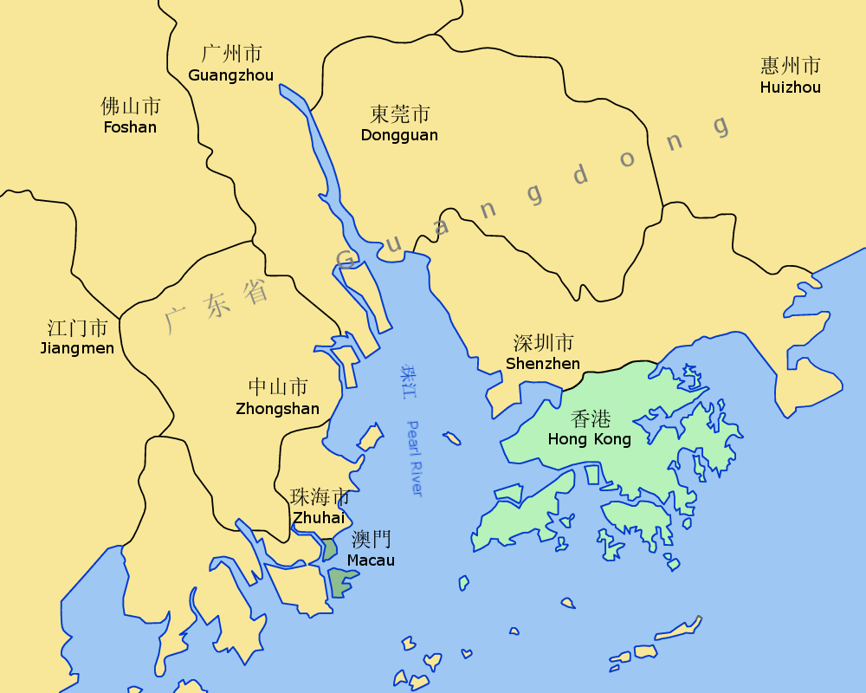
Pearl River
ZhuJiang
Third longest in China
Widest distributaries within the delta, although it is considerably short.
Zhu Jiang Kou
Pearl colored shells that lie at the bottom of the river

Slide 6
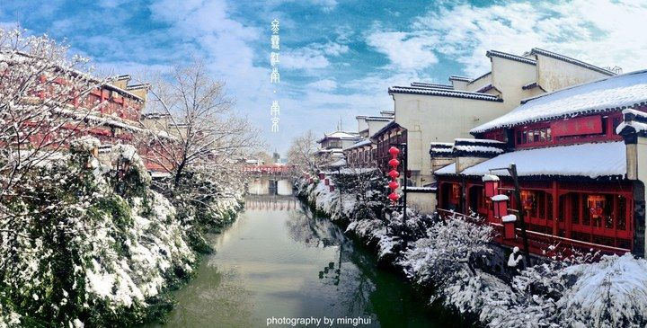
Huai River
Mid-way between the Yellow and the Yangtze
Flow enters the Yangtze River
Vulnerable to flooding
Originates in Tongbai Mountain; enters the Yangtze River
Pooled up into Lake Hongze

Slide 7
Come From..
http://www.travelchinaguide.com/river/
http://en.wikipedia.org/wiki/Yangtze_River#Geography
http://www.travelchinaguide.com/river/yellow/
http://en.wikipedia.org/wiki/Pearl_River_(China)
http://en.wikipedia.org/wiki/Huai_River

