Slide 1
Climate
Sun Ah and Liz Shi

Slide 2
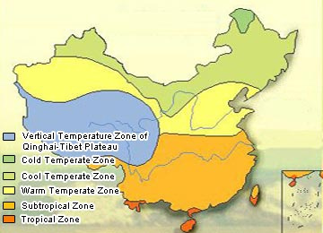

Slide 3
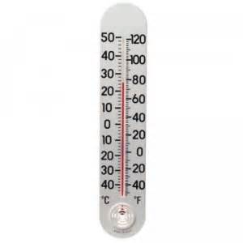
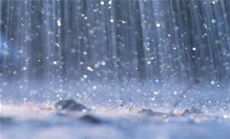
Climate in China
climate- the weather conditions of a region
How to tell one region’s climate from another is by how hot and cold it gets during the year and also by how much rainfall a country gets.

Slide 4
The Monsoon System
The Monsoon system is a big influence on China’s climate. Monsoon winds bring warm and humid weather as it sweeps north during the summertime. In the winter, winds sweep south and create colder, drier condition.

Slide 5
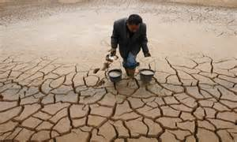
Climate of North China
North of the Huai River is where cold, dry winters, and hot dry summers happen.
Rainfall is sparse in the region and as a result often cause frequent droughts to occur.

Slide 6
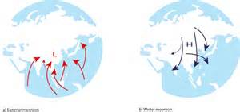
cont.
One of the main reasons this happens is due to the monsoon winds bringing the rainfall further north, where the Qinling mountain range cuts off the humid air.

Slide 7
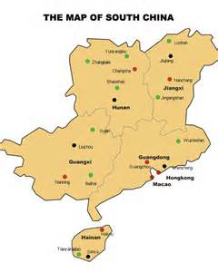
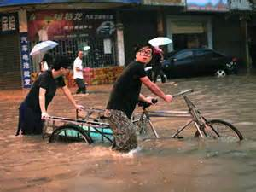
Climate of South China
South of the Yangzi region, rainfall is much more abundant compared to Northern China. Rainfall can reach up to 60 inches a year.

Slide 8
cont.
Summers have warmer temperatures and the winters usually have mild conditions.
The far south has tropical-like climate. For example the winters are often hot and humid.

Slide 9
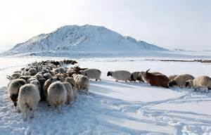
Climate in Outer China
China has very diverse climates.
The outer northern china often has harsh winters and short summers.
Tibet, with its high altitude has cold climates and almost no rainfall.

Slide 10
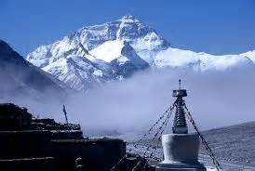
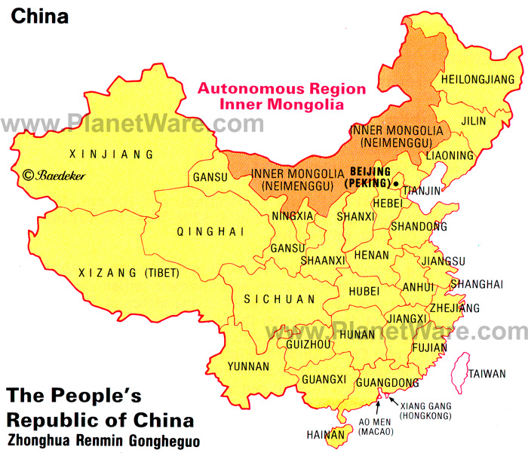
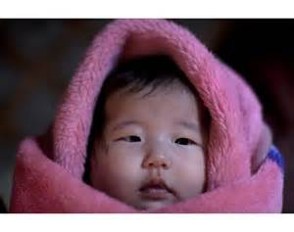
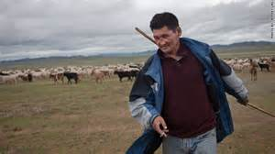

Slide 11
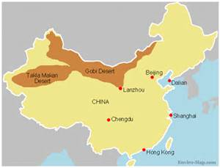
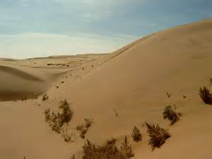
cont.
The Gobi and Taklimakan deserts, like many other desert climates, are very hot during the daytime and the night times are dramatically colder.

Slide 12
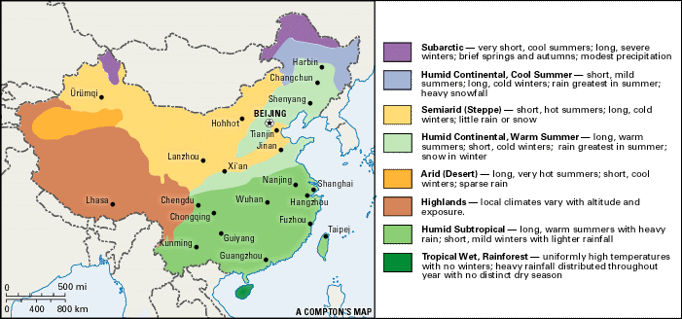
China’s Different Climates
Great variations in temperature and amount of rainfall a year leave China to be very different even in the same season.

