Slide 1
Development of Steam Engines
Early water power involved mills built over fast-moving streams and rivers
Early water power had problems
Not enough rivers to provide the power needed to meet growing demand
Rivers and streams might be far removed from raw materials, workers, and markets
Rivers are prone to flooding and drying

Slide 2
Steam Power
Humans tried harnessing steam power for millennia
Hero of Alexandria, Egypt – created a steam-driven device in the 1st century B.C.E.
Thomas Newcomen, England (1704)
Created a steam engine to pump water from mines
James Watt, Scotland (1769)
Improved Newcomen’s engine to power machinery

Slide 3
Steam Engines
By 1800, steam engines were replacing water wheels as sources of power for factories
Factories relocated near raw materials, workers, and ports
Cities grew around the factories built near central England’s coal and iron mines
Manchester, Liverpool

Slide 4
Coal and Iron
Vast amounts of fuel were required to smelt iron ore to burn out impurities
Abraham Darby (1709)
Discovered that heating coal turned it into more efficient coke
John Smeaton (1760)
Smelted iron by using water-powered air pumps to create steam blasts
Henry Cort (1783)
Developed the puddling process which purified and strengthened molten iron

Slide 5
Increases in Coal and Iron Production, 1770-1800
Coal production doubled
6 million to 12 million tons
Pig iron production increased 250%
1800 – 130,000 tons
Great Britain produced as much coal and iron as every other country combined

Slide 6
Bessemer Process and Steel
Prior to the Industrial Revolution, steel was difficult to produce and expensive
Henry Bessemer, 1856
Developed the Bessemer process
Brought on the “Age of Steel”
Steel is the most important metal used over the past 150+ years
Other improvements in steel production
Open-hearth furnace
Electric furnace
Use of other metals to produce various types of steel

Slide 7
Steel
With the invention of steel, buildings could be made much taller.
Steel was much harder than iron, which would bend if made too tall.
The steel industry created many new products, and led to the invention of the car.

Slide 8
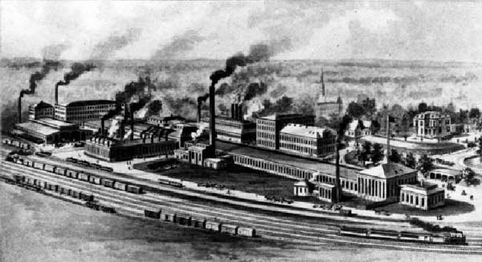
Smoke stacks of a factory

Slide 9
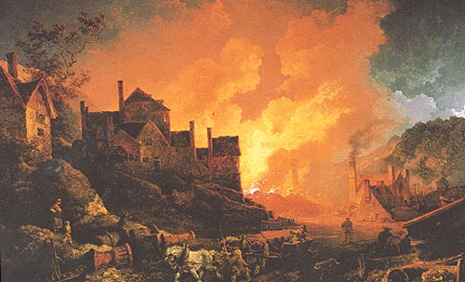
A melting plant

Slide 10
Pollution
One of the bad things about industrialization was pollution, as you could see in the earlier slides.

Slide 11
Transportation
Before the Industrial Revolution, people relied on the horse and their own feet to get around.
With the invention of the steam locomotive, transportation took a huge step forward.
The first two major railroad companies were the Union Pacific and Central Pacific Railroads.

Slide 12
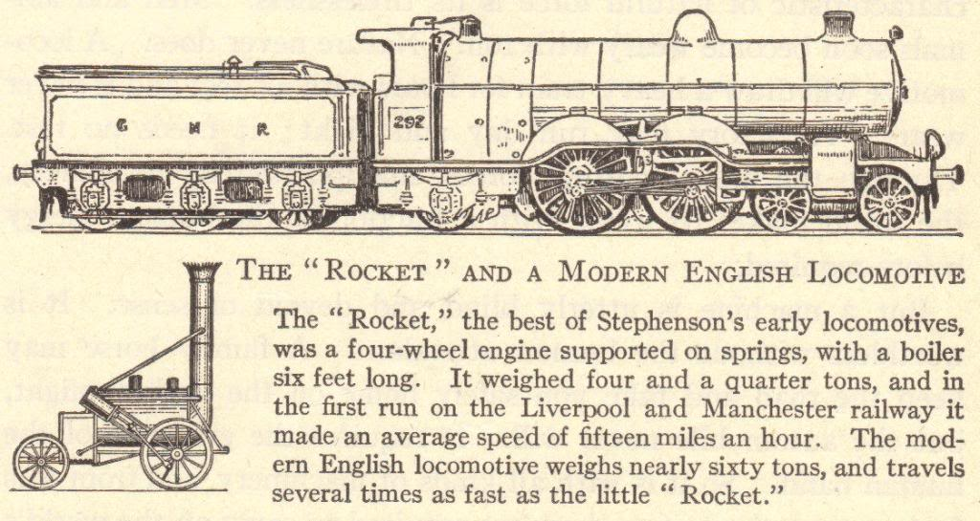
Transportation
Increased production
Search for more markets and raw materials
Better and faster means of transportation
Before the Industrial Revolution
Canal barges pulled by mules
Ships powered by sails
Horse-drawn wagons, carts, and carriages
After the Industrial Revolution
Trains
Steamships
Trolleys
Automobiles

Slide 13
Transportation Revolution
Robert Fulton (American)
Steamboat (1807)
Sped water transportation
Thomas Telford and John McAdam (British)
Macadamized roads (1810-1830)
George Stephenson (English)
Locomotive (1825)
Improved roads
Fast land transport of people and goods
Gottlieb Daimler (German)
Gasoline engine (1885)
Led to the invention of the automobile
Rudolf Diesel (German)
Diesel engine (1892)
Cheaper fuel
Orville and Wilbur Wright (American)
Airplane (1903)
Air transport

Slide 14
Steamboats
Robert Fulton invented the steamboat in 1807
The Clermont operated the first regular steamboat route, running between Albany and New York City
1819 – the Savannah used a steam engine as auxiliary power for the first time when it sailed across the Atlantic Ocean
1836 – John Ericsson invented a screw propeller to replace paddle wheels
1838 – the Great Western first ship to sail across the Atlantic on steam power alone, completing the trip in 15 days

Slide 15
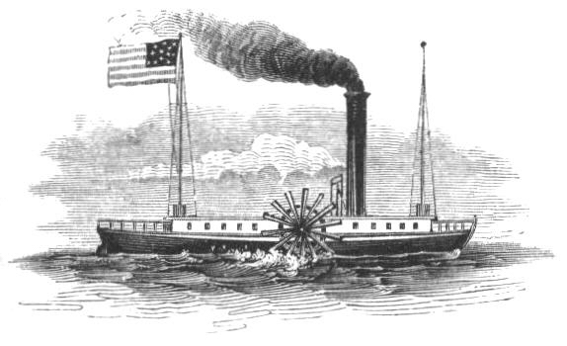

Slide 16
Macadamized Roads
Strong, hard roads invented by Thomas Telford and John McAdam
Improvement over dirt and gravel roads
Macadamized roads have a smooth, hard surface that supports heavy loads without requiring a thick roadbed
Modern roads are macadamized roads, with tar added to limit the creation of dust

Slide 17
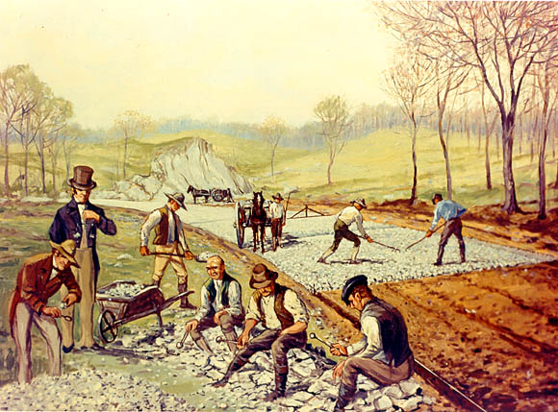

Slide 18
Railroads
1830 – Stephenson’s “Rocket” train traveled the 40 miles between Liverpool and Manchester in 1 ½ hours
1830-1870 – railroad tracks went from 49 miles to over 15,000 miles
Steel rails replaced iron rails
1869 – Westinghouse’s air brake made train travel safer
Greater train traveling comfort – heavier train cars, improved road beds, and sleeping cars

Slide 19
