Slide 1
Dynasties of China
Use any and all information on these slides to use in your poster presentations and on the class timeline

Slide 2
XIA (A.K.A. HSIA) DYNASTY (CA. 2070-CA. 1600 BCE)
China’s first dynasty
Founded by Yu
Built roads and irrigation projects

Slide 3
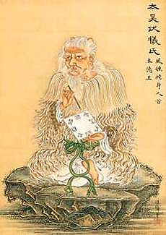
Xia Dynasty
The Xia family would have ruled China from around 2100 B.C.E. until around 1800 B.C.E. They are believed to have been Aryans, who migrated into the area, and who were able to conquer the local peoples using their superior weaponry and technology.

Slide 4
SHANG DYNASTY (CA. 1600-1046 BCE)
Writing began
Developed bronze, glazed pottery, and silk industries

Slide 5
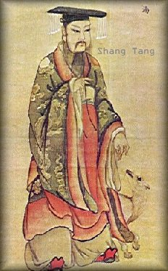
The Shang Dynasty
Like the Xia Dynasty, the Shang Dynasty was once thought to be only a myth or legend. It is now considered by all historians as a true dynasty. Because many historians do not consider the Xia Dynasty a true dynasty, the Shang Dynasty is often called the first true Chinese dynasty.

Slide 6
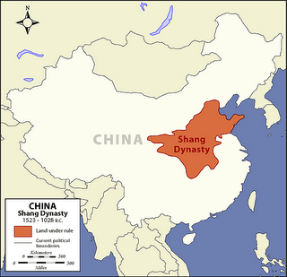
Shang Rule: 1500 – 1100 B.C.E.
The Shang Dynasty ruled China from around 1500 B.C.E. until 1100 B.C.E. During this 400 year period of history, Chinese tradition states that thirty separate kings ruled from a succession of seven different capitals.

Slide 7
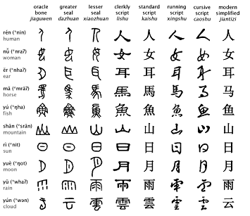
Invention of Writing
One of the most important contributions made during the period that the Shang Dynasty ruled China was the invention of writing. The earliest written records found in China come from this time period.

Slide 8
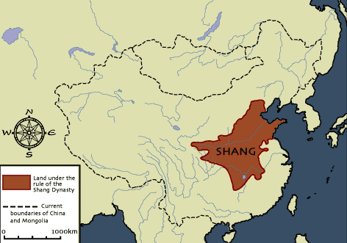
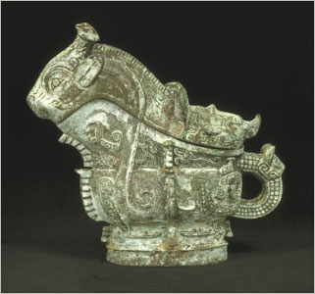
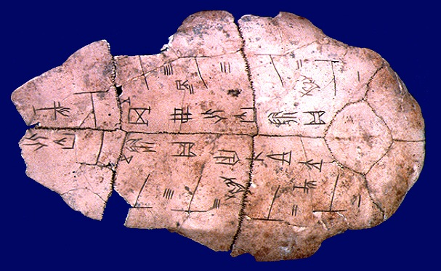
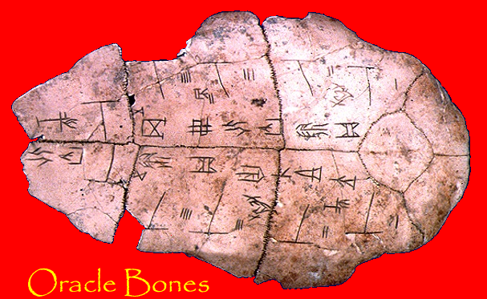
Shang Dynasty (1532-1027 BCE)
Begins civilization in China
The earliest written
records from China
were recorded on
Oracle Bones during
this period

Slide 9
ZHOU (A.K.A. CHOU) DYNASTY (1045-256 BCE)
Invaded China from the northwest
Set up a loose central government
Feudal power held by strong nobles
Philosophers
Confucius
Mencius (his follower)

Slide 10
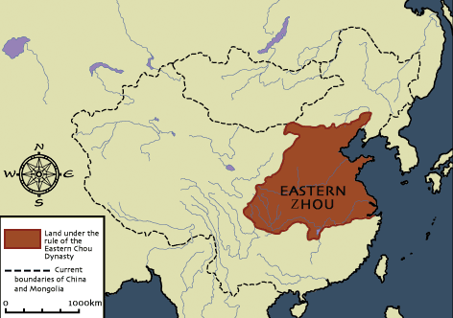
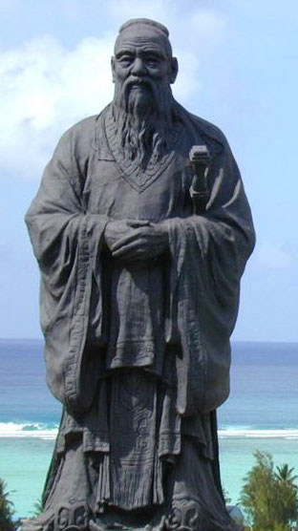
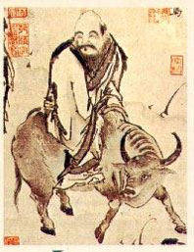
Zhou Dynasty
(1027 BCE-256 BCE)
and the Period of the
Warring States and the
Hundred Flowers of
Philosophy leads to
Taoism and Confucius
philosophy

Slide 11
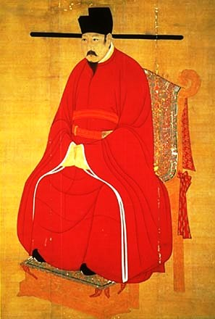
The Zhou Dynasty
The Zhou family was able to defeat and overthrow the last Shang Dynasty king in 1028 B.C.E. They claimed that the Shang Dynasty had lost the mandate of heaven due to their poor governing. The Zhou Dynasty would become the longest lasting dynasty in Chinese history, lasting over 800 years.

Slide 12
Zhou Expansion
The Zhou set up a new economy, rearranging the affairs of the kingdom. As they did so, the borders of their kingdom swelled, and they were able to maintain control over the people they conquered effectively.

Slide 13
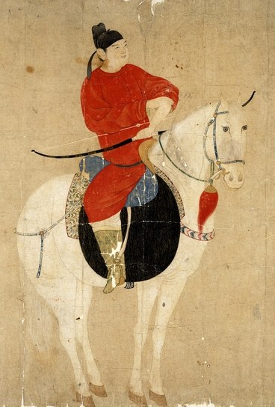
Zhou Regional Rulers
Zhou kings assigned nobleman, who were usually members of the royal family, to serve as regional rulers. These nobleman owned the land, and were given absolute authority over it. The peasants could not own land, but instead worked the land for the noblemen.

Slide 14
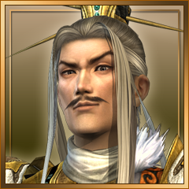
Noblemen Grew in Power
This form of government worked well for several hundred years. However, overtime the king slowly became less powerful, while the nobleman grew in power.

Slide 15
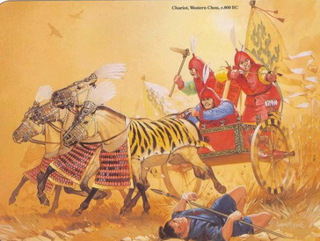
Zhou Dynasty Overthrown
In 771 B.C. while fighting against a rebellion, the Zhou armies suffered a terrible defeat. As a result, the Zhou Dynasty lost even more power to the noblemen. They managed to hang on to power for another 500 years. Then in 256 B.C.E. the Zhou Dynasty was finally overthrown.

Slide 16
EQ: What contributions did the Qin (chin) and Han Dynasties give to Chinese civilization?
Obj: Identify Qin dynasty’s contributions to Chinese history
Identify Qin dynasty’s contributions to Chinese history
Examine early dynasties
Distinguish differences and advancements between the two dynasties
Agenda: 1. View ppt
2. Take notes
Hw: 1. Read pages 79-87, take notes that will be used on your quiz on Tuesday
2. Bring in your Islam reading and graphic organizer to be used on semester final project

Slide 17
QIN (A.K.A. CHIN) DYNASTY (221-206 BCE)
Military dictatorship centralized China
Emperor Shih Huang Ti
Destroyed nobles’ feudal power
System of taxation
Established weights and measures
Great Wall (1500 miles)

Slide 18
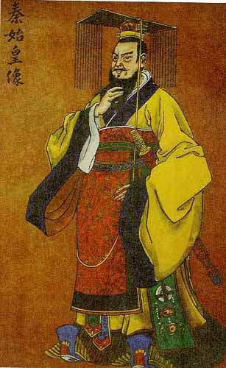
The Qin Dynasty
By 221 B.C.E. a man by the name of Qin had overthrown all remaining members of the Zhou Dynasty, and all other opposition, allowing him to place himself as the ruler of China.

Slide 19
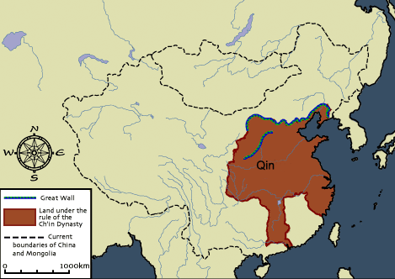
“China”: Derivative of “Qin”
The Qin Dynasty would only last about 11 years. Yet during these short years, this dynasty would make changes that would effect the history of China for thousands of years. So influential was Qin, that the name of the nation, China, is a derivative of his name.

Slide 20
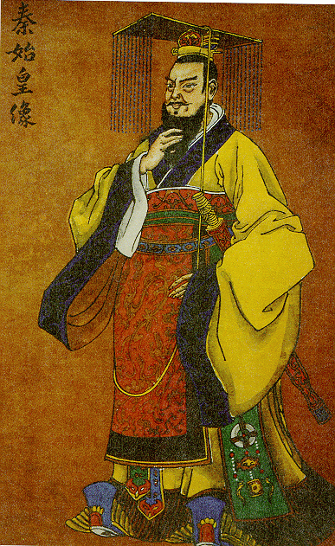
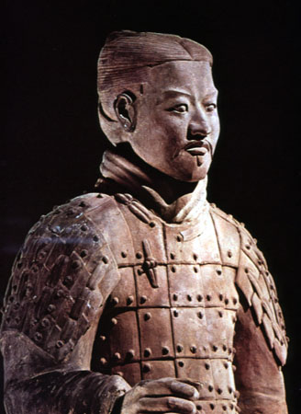
Shi Huangdi and the
Qin Dynasty
(221-202 BCE).
China’s most powerful
Emperor expands China
and ruthlessly centralizes
the government.

Slide 21
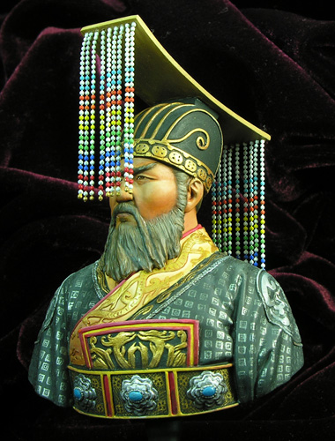
Qin Shihuangd
In order to show his importance and power, Qin added a new name to his own. He began calling himself Qin Shihuangdi, which means Qin, the first emperor of China.

Slide 22
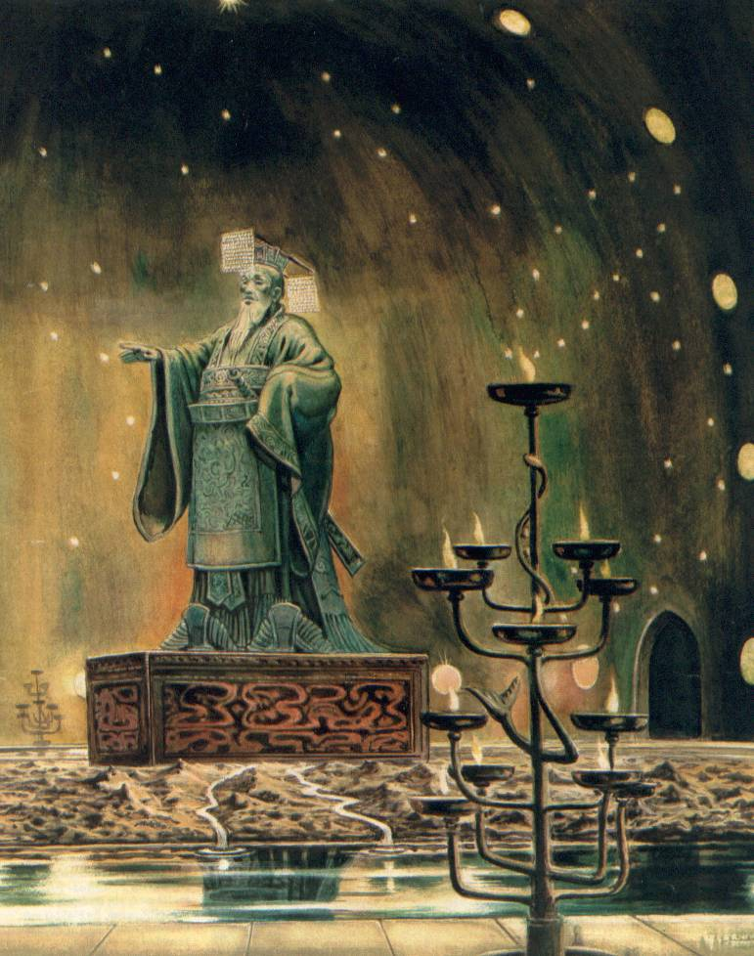
Centralization of Authority
Qin Shihuangdi again reorganized the affairs of China. Instead of a system of nobleman, Qin wanted everything to be under his direct authority and control.

Slide 23
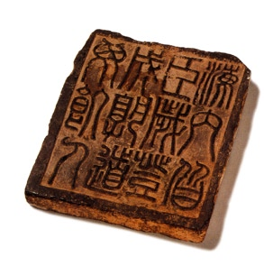
Written Laws
He established a strict set of written laws that were recognized throughout China, and setup military control in each region of China so that local nobleman could not rebel against the emperor.
All people are subject to me, Every field harvest, and Everyone can have enough food.

Slide 24
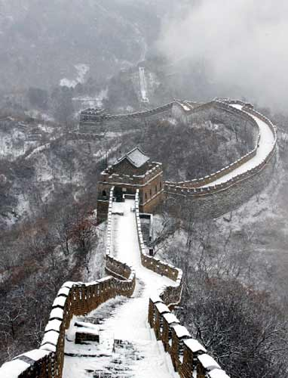
Qin Building Projects
To make China the most glorious nation on Earth, Qin needed labor. He used the peasants, forcing them to work under slave conditions, so that he could build roads, bridges, canals, buildings, and his most famous building project of all, the Great Wall of China.

Slide 25
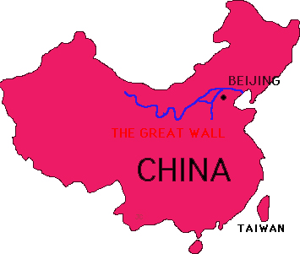
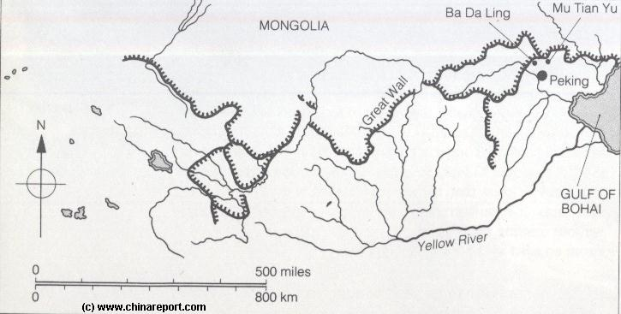
The Great Wall of China
Early emperors had built walls in the northern territories to protect their nation against attack from outside forces. These walls were spread across the landscape, and not connected. Qin ordered his people to connect the existing walls together, and to expand them, eventually covering a distance of over 4000 miles.
THE GREAT WALL

Slide 26
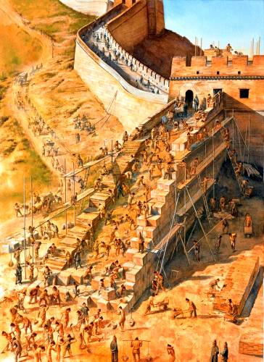
Peasant Labor
Over 300,000 peasants were forced to help build the Great Wall of China. Many of them died during the construction. After working for several years, the Great Wall of China was completed, and still stands today as one of the great building projects in human history.

Slide 27
HAN DYNASTY (206-220 CE)
Conquerors
Empire – central Asia to China Sea, Indochina to Korea
Trade
Chinese fruits, silks, and spices in Rome (1st century CE)
Buddhism came from India
Civil service system
First paper made

Slide 28
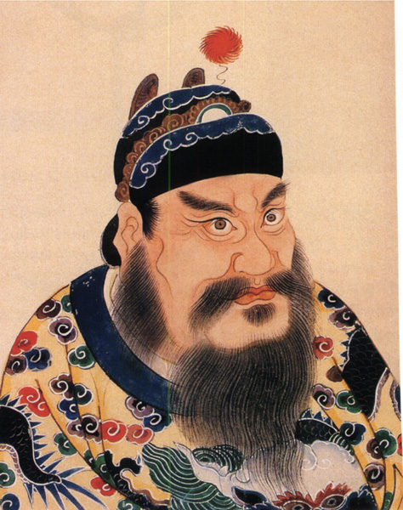
The Han Dynasty
In the year 207 B.C. a new dynasty began to rule China. This dynasty was led by a peasant whose name was Liu Bang. Liu Bang had grown tired of the brutal leadership of the Qin Dynasty. Many other people also were tired of the Qin
Peace thru war and plunder.

Slide 29
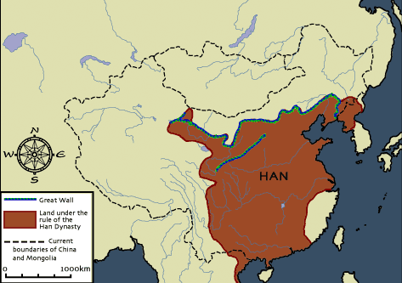
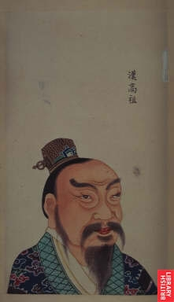
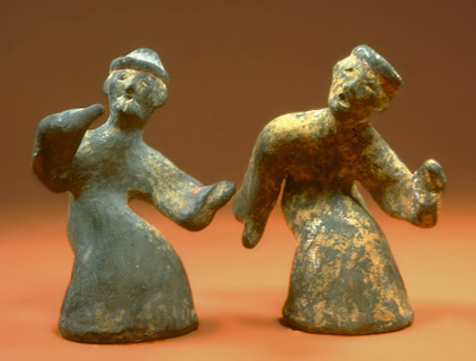
Long period of Peace and expansion leads to the Han
language of Chinese becoming the common language.
Today, the largest
ethnic group in
China calls itself
the “people of the
Han”
Han Dynasty
(202 BCE-220 CE),
Classical China

Slide 30
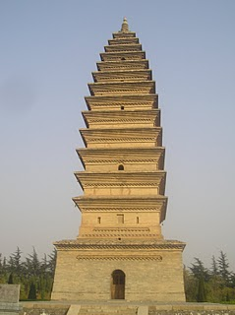
Mandate of Heaven
Liu Bang proclaimed that the Qin had lost the mandate of heaven, or the right to rule the nation. He was able to overthrow them, and establish himself as the new emperor of China, and the first emperor of the Han Dynasty.

Slide 31
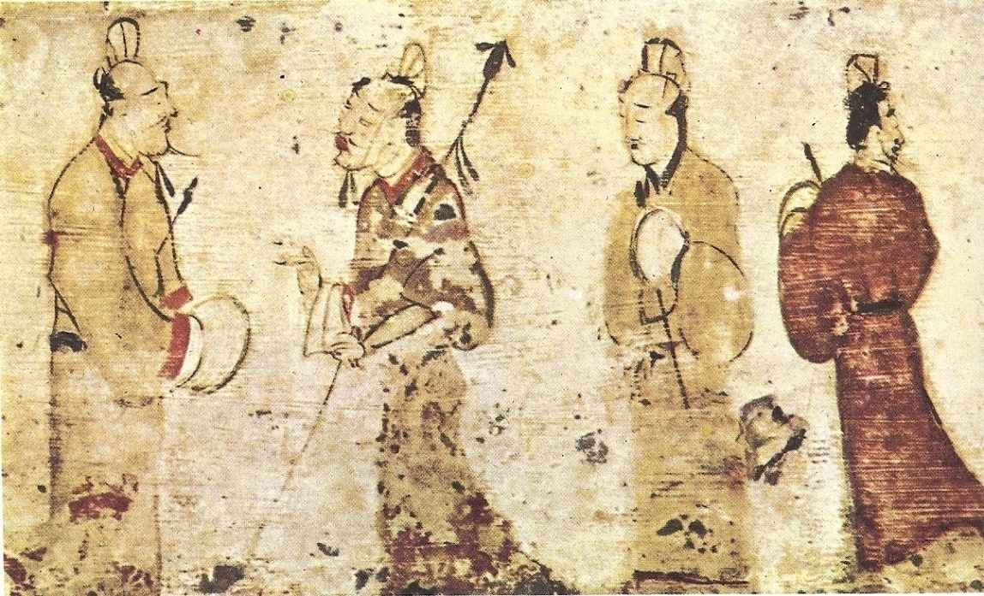
Four Hundred Year Rule
The Han Dynasty would rule China for the next 400 years. During this time period they would be one of the wealthiest and most powerful nations on Earth. Their achievements would only be surpassed by the Roman Empire.

Slide 32
Isolated from Rest of the World
Because of its location amidst high mountains and surrounded on many sides by water, China was isolated from much of the rest of the world. As their civilization flourished and their wealth increased, they were largely unaware of what advancements were taking place in the nations around them.

Slide 33
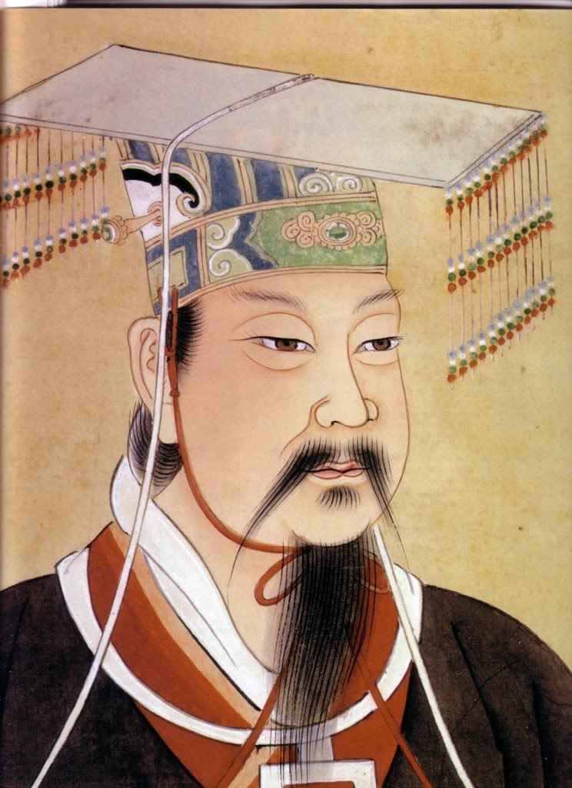
Chinese Exploration
In 139 B.C.E., a Han emperor by the name of Wudi sent out one of his generals, Zhang Qian, to explore other nations. This general and his army marched throughout distant regions visiting other civilizations and nomadic tribes.

Slide 34
Attacked by Nomadic Tribes
The armies of Zhang Qian were viewed as a threat by many of these nomadic tribes, as a result, these tribes attacked and destroyed many of Zhang Qian's men. Zhang Qian himself was captured and kept in bondage for a period of 10 years. After 13 years, Zhang Qian was finally able to return to the emperor and report.

Slide 35
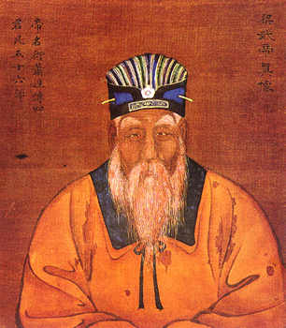
Wudi Aspires to Trade with West
He told Wudi about stories he had heard from the nomadic tribes of a great civilization to the West that equaled the glory of China. This was the first time Wudi had heard anything of any other civilizations. Wudi was a smart and wise ruler, who saw the potential for trade between the two cultures.

Slide 36
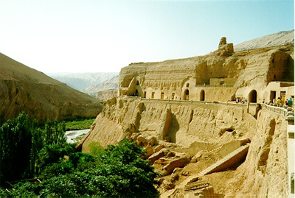
The Silk Road
In order to make trade possible , Emperor Wudi began to develop what has been called in modern times, the silk road. Following this route merchant traders took silk from China to the West, and brought glass, linen, and gold back to China.

Slide 37
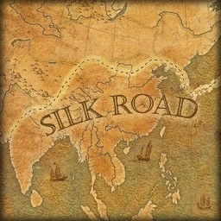
Trails, Roads, Bridges
The silk road consisted of trails, roads, bridges, and pathways that stretched across nearly 5000 miles of land and water. The silk road is not one long road, but rather many smaller roads and pathways that were connected, and worn by the use of thousands of travelers over a period of hundreds of years.

Slide 38
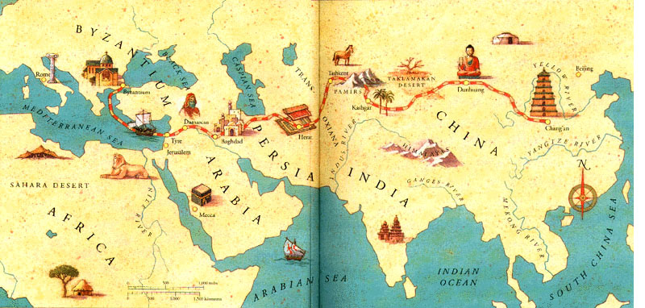
Expansion of Trade
The silk road would become instrumental in the development and expansion of trade, and the accumulation of wealth in both China and Rome, as well as in Egypt and other nations.

Slide 39
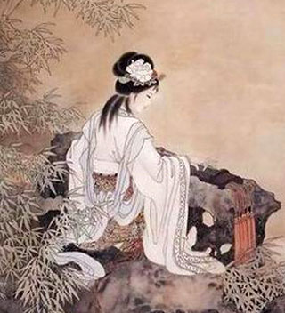
Pax Sinica
During the rule of the Han emperors, China enjoyed a 400 year period of peace and prosperity. During this time, the Han emperors established a strong central government that was designed to help the people, and protect them.

Slide 40
Food Reserves
One such innovation was the storage of food. During times of plenty, Han emperors would have great amounts of food put up into storage. Then during difficult times, they would sell these food stores, helping to stabilize food prices.

Slide 41
Merit-Based Appointments
The Han also abolished the practice of giving powerful government positions to members of the royal family. Emperor Wudi instituted a series of written exams. Anyone could take the tests. Those who received the highest scores were given posts in the government.

Slide 42
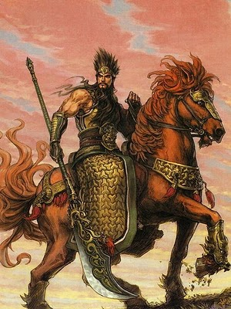
The End of the Han Dynasty
By C.E. 220 the Han Dynasty had fallen into a weakened state. Warriors from competing areas began fighting one another, throwing China into a period of civil war that would last for many years.

Slide 43
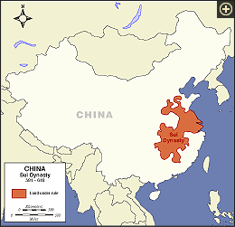
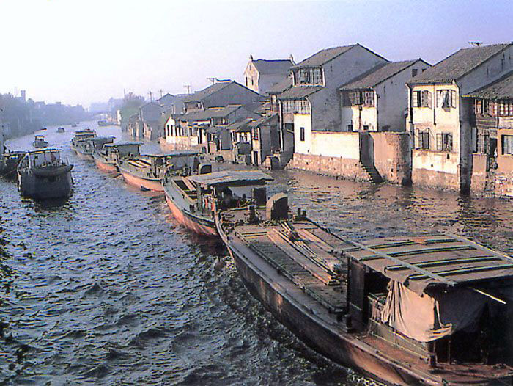
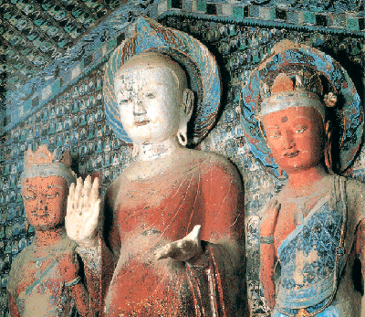
The short lived Sui Dynasty (589-618)
forces peasants to build the Grand Canal
linking northern and southern China.
Massive oppression leads to rebellion.

Slide 44
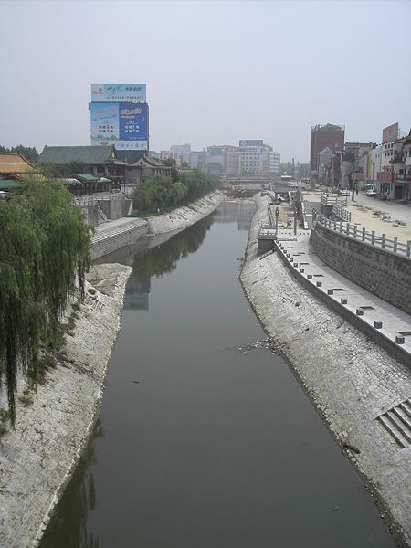
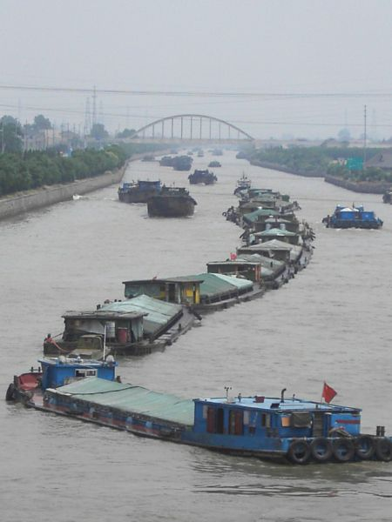
Today, the Grand Canal
remains a major waterway.
At 1,114 miles it is the
longest ancient built
canal in the world.

Slide 45
TANG DYNASTY (618-906 CE)
400 years of warfare between Han and Tang dynasties
Tang reunited China
T’ai Tsung
Emperor in 627 CE
Education and government reforms
Extended boundaries
Alliances and peace treaties with neighbors
Industry and trade
Jade porcelain, and silks to Arabia, India, Japan, and Persia

Slide 46
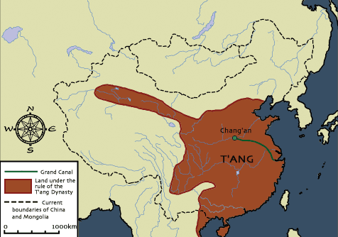
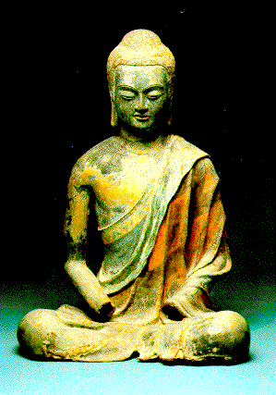
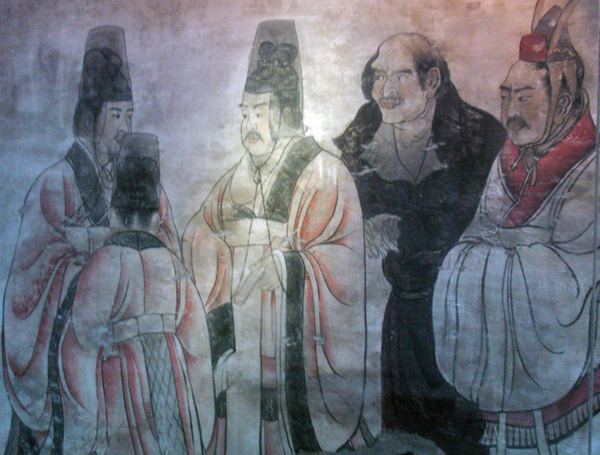
China’s Golden Age under the
Tang Dynasty (618-907) ruled by
Scholar-Officials

Slide 47
SONG (A.K.A. SUNG) DYNASTY (960-1279)
Disorder between Tang and Sung dynasties
Culture superior to that of medieval Europe
Powerful only in southern China

Slide 48
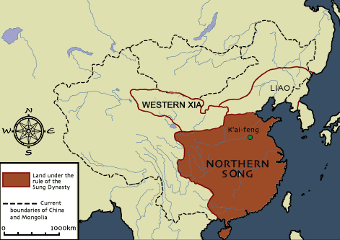
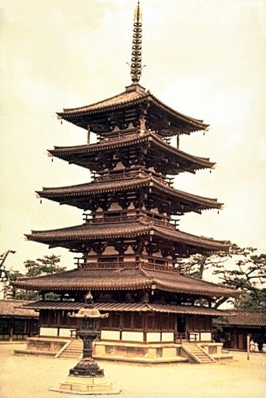
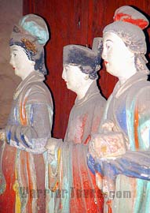
China’s Golden Age
continues under the
the Song Dynasty
(960-1279).

Slide 49
In the year 1000 CE,
China was the most
populous and most
advanced country
in the world. Under
the Song and Tang
Dynasties, China
produced significant
inventions.

Slide 50
During the Tang and Song Dynasties,
expanded Chinese trade and power extends
Chinese influence into surrounding areas such
as Japan, Korea, Thailand, Cambodia, Vietnam
parts of South Asia.

Slide 51
MONGOL RULE (1259-1368)
Central Asian nomads
Genghis Khan
Conquered Asia, including China
Kublai Khan
Grandson of Genghis
Visited by Marco Polo (Venetian)
Ruled for circa 100 years
Capital – Peking (Beijing)
Trade with Europe begun

Slide 52
In 1206 Genghis Khan united the
long warring nomadic tribes of
Mongolia. United, the tribes
burst out of central Asia and
conquered world history’s largest
land empire.

Slide 53
The Yuan Dynasty
(1279-1368)
brings foreign
Mongol rule to
China and a
visitor from Europe.

Slide 54
MING DYNASTY (1368-1644)
Overthrew Mongols
Chinese natives
Beautified Peking (Beijing)
Encouraged trade with Europe
Gave Europeans:
Gunpowder
Jade
Playing cards
Porcelain
Silk
Tea

Slide 55
Chinese rule re-established
under the Ming Dynasty
(1368-1644).
The Ming began with
a policy of exploration,
but ended in a policy of
Isolationism which
said the outside world
had nothing to offer China.

Slide 56
China’s 15th Century policy of Isolationism in reaction to
foreign rule is represented by the Forbidden City in which no
foreigners were allowed entry. Built by the Ming Dynasty in the 1400’s.
During the period of imposed isolation, China begins to decline as Europe rises.
In the 1600’s, Portuguese, Spanish and Dutch ships arrive in China seeking trade
contacts and dominance of the region.

Slide 57
QING DYNASTY (MANCHU RULE) (1644-1912)
Manchurians conquered China, Indochina, Korea, Mongolia, Tibet, eastern Turkestan
China prospered
Western pressure brought about Manchu overthrow in 1912
Ended with birth of Chinese Republic

Slide 58
Manchus from Manchuria
conquer China and
establish the Qing Dynasty
(1644-1906).
Rule China through
a period of expansion
and increased contact
with Europeans.

Slide 59
The Humiliation of China
As Europeans showed up
in China, the Qing attempted to
limit European influence and
control by restricting trade.
In 1838, this Chinese policy
led to war as the Chinese
attempted to ban the sale
of British opium in China.
The Opium Wars
(1838-1842)
led to military defeat
for China and the
signing of humiliating
treaties
Opium Treaties demanded:
China pay for the war
2. Unrestricted European access to ports
Island of Hong Kong goes to British
All Chinese documents to be written in English
British warships have unlimited access to
all navigable river in China

