Slide 1
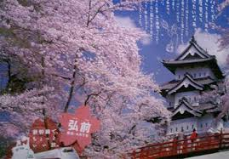
Early Japanese history
11 Woonhee Cho

Slide 2
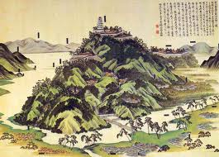
By the A.D. 700s, these rulers regarded keeping a detailed record of their people’s history as one of their major duties. The records combined myths with well-documented facts.

Slide 3
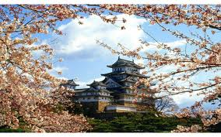
Later historians have been able to separate out the myths and legends that were included to build a reasonably accurate story of what actually happened in the early years of Japan’s history.

Slide 4
Questions
What is major region of Japan?
Which country did the monk visit?
Did Japan has a leader in establishing Buddhism?
How many Buddhist temples were built at Nara?
Did Buddhism influence in Japanese culture?

