Slide 1
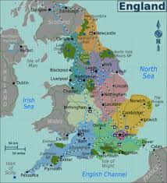
England Birthplace of the Industrial Revolution

Slide 2
EQ: What was it that made England the birthplace of the Industrial Revolution?
Objectives:
Determine the factors that contribute to England’s ability to
take the lead
Warm-up: List the resources England had to lead the way in the Industrial Revolution.
Agenda: 1. Hw: rev
2. OLR check
3. Invention Research check
4. Notes
5. Create a sales poster/ad introducing your invention
Homework:
1.Complete OLR and present on Monday bring in completed interviews and rubrics
2. Complete Industrial Revolution research present on Monday. Bring in completed research paper, poster and rubric

Slide 3
England: Birthplace of the Industrial Revolution
No concrete start date for the Industrial Revolution
Marked by gradual, slow changes
After 1750 – these changes were noticeable first in England

Slide 4
England’s Resources: Capital
The Commercial Revolution made many English merchants very wealthy
These merchants had the capital to invest in the factory system – money to buy buildings, machinery, and raw materials

Slide 5
England’s Resources: Colonies and Markets
Wealth from the Commercial Revolution spread beyond the merchant class
England had more colonies than any other nation
Its colonies gave England access to enormous markets and vast amounts of raw materials
Colonies had rich textile industries for centuries
Many of the natural cloths popular today, such as calico and gingham, were originally created in India
China had a silk industry

Slide 6
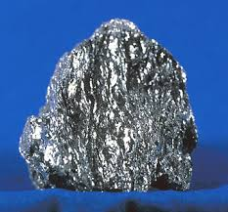
England’s Resources: Raw Materials
England itself possessed the necessary raw materials to create the means of production
Coal – vast coal reserves powered steam engines
Iron – basic building block of large machines, railroad tracks, trains, and ships

Slide 7
Why the Industrial Revolution Started in England
Capital for investing in the means of production
Colonies and Markets for manufactured goods
Raw materials for production
Workers
Merchant marine
Geography

Slide 8
England’s Resources: Workers
Serfdom and guilds ended earlier in England than other countries:
A guild is an association of artisans or merchants who control the practice of their craft in a particular town.
Serfdom is a person in a condition of feudal servitude, required to render services to a lord, commonly attached to the lord's land and transferred with it from one lord to another
English people could freely travel from the countryside to the cities
Enclosure Acts – caused many small farmers to lose their lands, and these former farmers increased the labor supply

Slide 9
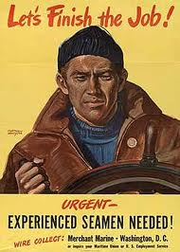
England’s Resources: Merchant Marine
World’s largest merchant fleet
Merchant marine built up from the Commercial Revolution
Vast numbers of ships could bring raw materials and finished goods to and from England’s colonies and possessions, as well as to and from other countries

Slide 10
England’s Resources: Geography
England is the political center of Great Britain, an island
Great Britain (as the entire island was called beginning in 1707) did not suffer fighting on its land during the wars of the 18th century
Island has excellent harbors and ports
Damp climate benefited the textile industry (thread did not dry out)
Government stable
No internal trade barriers

