Slide 1
EU commission
Rose, So Eun

Slide 2
EU Commission
Executive body of EU
28 commissioners
(one from each EU country)
- appointed every 5 years
Countries in EU Commission>
Belgium, Bulgaria, Czech Republic, Denmark, Germany, Estonia, Greece, Spain, France, Croatia, Ireland, Italy, Cyprus, Latvia, Lithuania, Luxembourg, Hungary, Malta, Netherlands, Austria, Poland, Portugal, Romania, Slovenia, Slovakia, Finland, Sweden, U.K.

Slide 3
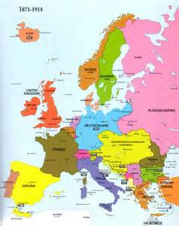
Responsibility of EU Commission
Set objectives and priorities for action
Propose legislation to Parliament and Council
Manage and implement EU policies and the budget
Enforce European Law
Represent the EU outside Europe (negotiating trade agreements between the EU and other countries)

Slide 4
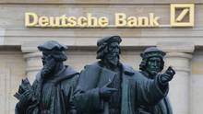
Recent Decision
6th Nov
To impose a huge fines on various banks for violation of antitrust rules.
JPMorgan Chase & Co. (NYSE:JPM), Deutsche Bank AG (FRA:DBK) and Royal Bank of Scotland Group plc (LON:RBS)

Slide 5
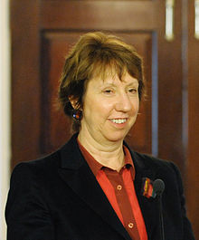
UK in EU Commission
Ashton, Catherine
(Vice-President)
High Representative of the Union for Foreign Affairs and Security Policy

Slide 6
UK’s RESPONSIBILITY IN THE eu COMMISSION
Speaking for the Commission as its voice in the UK.
Reporting back to the Commission in Brussels
Providing information about the European Union across the UK

Slide 7
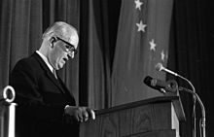
What is the head of the EU commission called
commission president

Slide 8
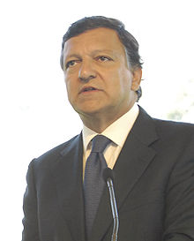
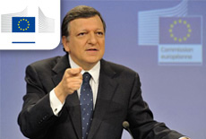
From where, name of the current person in position
Jose manuel Barroso
Portuguel

Slide 9
Relationship with other bodies
relations with the Council, the codecision procedure, and the Commission's participation in G8 meetings
Commission departments in Council bodies to ensure that the Commission's position is consistent and correct,
The SG is the contact point between the European Parliament and the Commission for the whole range of interinstitutional relations,
relations with the European Economic and Social Committee (EESC) and the Committee of the Regions (CoR).
relations with national parliaments in EU countries

Slide 10
Direction of decisions
Commission departments in council bodies ensures the commission’s position is consistent and correct

