Slide 1
EU Council

Slide 2
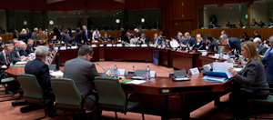
HOW MANY MEMBERS ARE IN EU COUNCIL?
28 members are elected from each member states
Germany | Spain | Greece | Hungary | Denmark | Croatia | Estonia
France | Poland | Belgium | Sweden | Slovakia | Lithuania | Cyprus
UK | Romania | Portugal | Austria | Finland | Slovenia | Luxembourg
Italy | Netherlands | Czech Republic | Bulgaria | Ireland | Latvia | Malta

Slide 3
WHAT IS THE RESPONSIBILITY OF THE GOVERNING BODY AND THEIR PRIMARY FUNCTION(S)?
PASSING EU LAWS:
The EU and Parliament share the final say on a new law
COORDINATING ECONOMIC POLICIES:
The fact that each country is responsible for their own economic policies is not changed. EU Council simply decided to set a common goal in order to learn from and help one another.
SIGNING INTERNATIONAL AGREEMENTS:
The EU Council signs agreements

Slide 4
WHAT IS THE RESPONSIBILITY OF THE GOVERNING BODY AND THEIR PRIMARY FUNCTION(S)?
APPROVING THE EU BUDGETU:
The money that the EU can spend for a year is decided by the Council and European Parliament
FOREIGN AND DEFENSE POLICY:
The EU Council is the center of the “Common Foreign and Security Policy”
JUSTICE:
The Council is responsible to ensure that the law and the EU courts in each EU countries are functioning properly

Slide 5
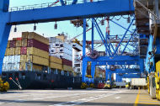
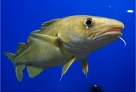
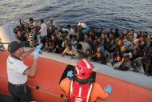
IS THERE ANY MAJOR DECISIONS THAT HAVE BEEN MADE RECENTLY IN THE BODY?
Council approves mandate to start negotiating investment agreement with China
In order to balance the import and export amount of EU-China trade
Agreement on fisheries in the Baltic Sea
Signed the Fishing Opportunities
Fishing Opportunities: TACs, Quotas, and Fishing Efforts
The Council adopts external border surveillance system
To reinforce the security system of EU
To prevent illegal immigration undetected by EU

Slide 6
WHICH COUNTRIES ARE CURRENTLY MEMBERS OF THE BODY?
Austria (1995)
Belgium (1952)
Bulgaria (2007)
Croatia (2013)
Cyprus (2004)
Czech Republic (2004)
Denmark (1973)
Estonia (2004)
Finland (1995)
France (1952)
Germany (1952)
Greece (1981)
Hungary (2004)
Ireland (1973)
Italy (1952)
Latvia (2004)
Lithuania (2004)
Luxembourg (1952)
Malta (2004)
Netherlands (1952)
Poland (2004)
Portugal (1986)
Romania (2007)
Slovakia (2004)
Slovenia (2004)
Spain (1986)
Sweden (1995)
United Kingdom (1973)

Slide 7
WHAT POSITION DOES UK HOLD?
UK is affiliated with two parties of EU
ALDE Party
Alliance of Liberals and Democrats for Europe Party
A party composed of 55 national-level liberal parties from across Europe
AECR
Alliance of European Conservatives and Reformists
A center-right Eurosceptic European political party, defending broader conservative and economically liberal principles.

Slide 8
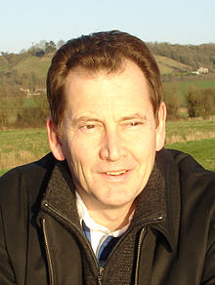
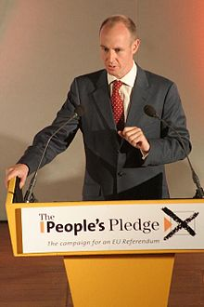
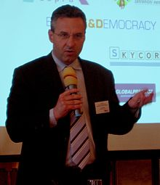
ALDE PARTY & AECR
 | ALDE PARTY | AECR
President | Sir Graham Watson (UK) | Jan Zahradil (CZ)
Secretary-General | --------------------------------------------- | Daniel Hannan (GB)
Sir Graham Watson
Nationality:
British
Daniel Hannan
Nationality:
British
Jan Zahradil
Nationality:
Czech

Slide 9
AECR
There is no specific party or group that requires AECR’s permission to make decisions
There is no specific party or group that AECR requires permission from to make decisions
AECR is cooperating with…
International Democrat Union (International)
European Conservatives and Reformists (European Parliament)

Slide 10
ALDE PARTY
EX-European Liberal Democrat and Reform Party (ELDR)
ALDE Party is cooperating with
Liberal International (International)
Group of the Alliance of Liberals and Democrats for Europe (European Parliament)

Slide 11
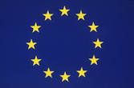
JOINING EU
The permission to join EU is also given by the Council
Therefore, a nation that wants to newly join EU must get allowance from the Council

Slide 12
PRESIDENCY OF THE COUNCIL OF THE EUROPEAN UNION
One of the member states becomes a Presidential state, rotating twice a year
The current Presidency belongs to Lithuania
2014: Greece / Italy
2015 Latvia / Luxemburg
2016: Netherlands / Slovakia
2017: Malta / UK
2018: Estonia / Bulgaria
2019: Austria / Romania
2020: Finland / ?

