Slide 1
European Parliament
James Park, Martin Lim, Sun Ah Park

Slide 2
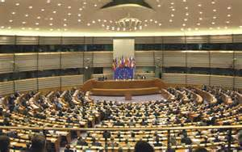
What is EU Parliament?
Directly elected by EU voters every 5 years
Members of the European Parliament (MEPs) represent the people
Parliament is one of the EU’s main law-making institutions, along with the Council of the European Union ('the Council').

Slide 3
What do they do?
3 MAIN ROLES
Debating and passing European laws, with the Council
Scrutinizing other EU institutions, particularly the Commission, to make sure they are working democratically
Debating and adopting the EU's budget, with the Council.

Slide 4
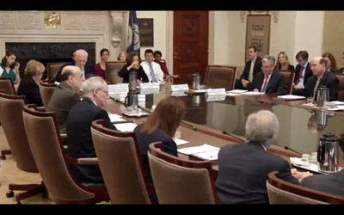
Responsibility of the governing body
the governing body in the European Parliament is Conference of Presidents of Major American Jewish Organizations.
The body is responsible for the organizations of Parliament, its administrative matters and agenda

Slide 5
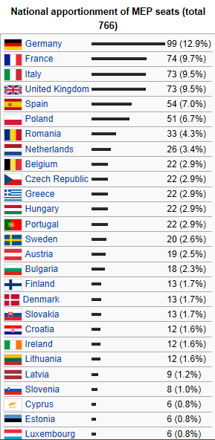
Which countries are currently members of the body
There are total 766 available seats in MEP.
Countries that are consisting this body are as
follows.
Germany, France, Italy, United Kingdom, Spain,
Poland, Romania, Netherlands, Belgium,
Czech Republic, Greece, Hungary, Portugal,
Sweden, Austria, Bulgaria, Finland, Denmark,
Slovakia, Croatia, Ireland, Lithuania, Latvia,
Slovenia, Cyprus, Estonia, Luxembourg, Malta

Slide 6
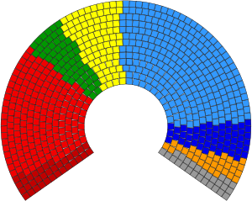
MEPs within the Parliament
European People's Party (265)
Progressive Alliance of Socialists and Democrats(184)
Alliance of Liberals and Democrats for Europe (84)
European Greens–European Free Alliance (55)
European Conservatives and Reformists (54)
European United Left–Nordic Green Left (35)
Europe of Freedom and Democracy (32)
Non-Inscrits (27)

Slide 7
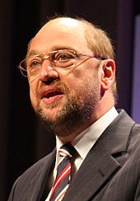
Any major decisions that have been made recently in the body
As the State’s intelligence agency’s collection of nation’s bank account had revealed, on October 23 2013, the European Parliament has adopted a suggestion and decided to cease sharing bank accounts with USA.
President Martin Schulz

Slide 8
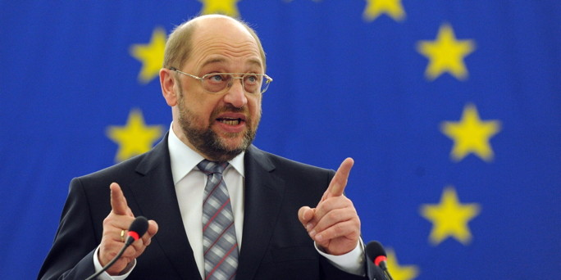
Martin Schulz – President of EU Parliament since January 2012
14 Vice Presidents
multi-party chamber: the Group of the European People’s Party (EPP), the Progressive Alliance of Socialists and Democrats (S&D)

Slide 9
The Commission presents a proposal to Parliament and the Council – three readings
First reading: Parliament send amendments to the Council - adopt those amendments / send back a "common position"
The position approved by Parliament / rejected by an absolute majority, or adopt further amendments by an absolute majority
If the Council does not approve, then a "Conciliation Committee" is formed.
The Committee is composed of the Council members + an equal number of MEPs who seek to agree a compromise
Once a position is agreed, it has to be approved by Parliament by simple majority

Slide 10
United Kingdom’s Role in EU Parliament
No difference
Should keep the lines
Boost economic growth
Develop a low-carbon economy
Try to cooperate with other MEPs

