Slide 1
Germany plans for war
Matthew

Slide 2
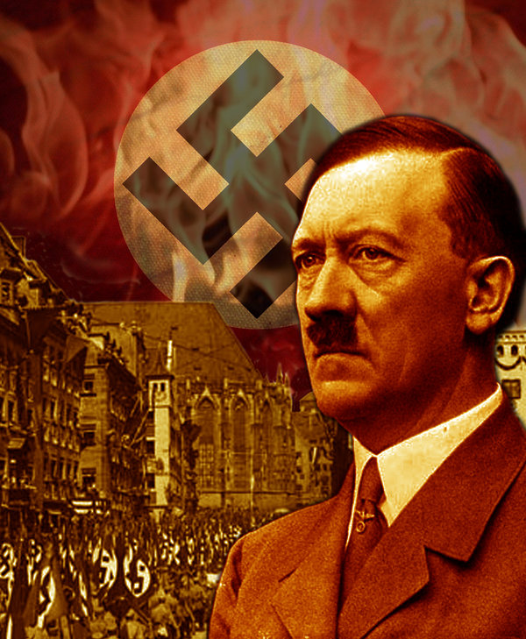
Adolf Hitler, in 1936 moved his troops into the demilitarised zones on either side of the Rhine River. Seeing that this would give a strategic advantage over France and Europe as a whole. With Japan and Italy as allies in the great war to come. Hitler also wanted the Soviet Union to remain friendly.

Slide 3
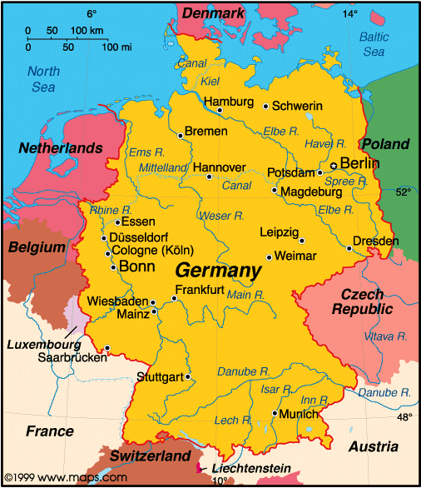
Hitler's grand plan was to unite all German speaking people under his power, and over Europe. A union of Austria and Germany. People in Austria were more than willing to follow the Nazis ideals. From Hitler's political pressure their government failed. From the take over of Austria’s government and country as a whole, Czechoslovakian’s boarders were surrounded, but taking control of this nation would be more difficult due to the alliances with Great Brittan and France. Because this country had over 3 million people of German descent, he demanded that it should be annexed to Germany.

Slide 4
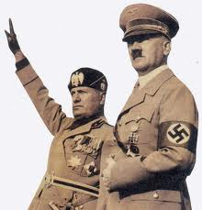
In 1938, Hitler, Mussolini, and the Prime ministers of Great Brittan and France met in Munich, to find a agreement of the settlement of Sudetenland. The two Prime ministers agreed to Sudetenland to be given to Germany to contain his aggression. In exchange he promised that he had no more intentions for further aggression.

Slide 5
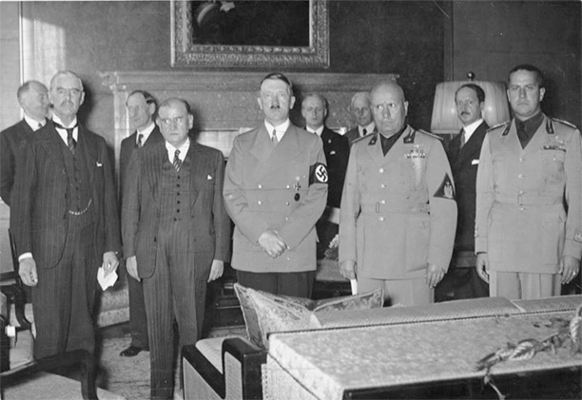
At the Munich conference, the four nations agreed that Czechoslovakia would remain independent, this policy continued to the policy of appeasement in which democratic Nations of Europe would give into Hitler's demands in exchange for peace.

Slide 6
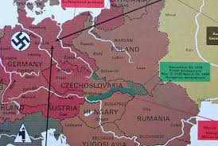
Chanberlain returned to Great Britain announcing peace in our time, but unfortunately he was mistaken.
Germany then moved straight into Czechoslovakia without Europe interference. As a result their factories were used against those very democracies that had negotiated for the independence of Czechoslovakia

Slide 7
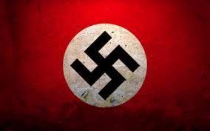
Hitler knew that he must fight his enemies one nation at a time, he has annexed Czechoslovakia and Austria, and he put off attacks from France and Britain at the Munich conference.

Slide 8
All nations were surprised by Hitler’s aggression and they akso thought Hitler was going to pull back after he got what he wanted. But unluckily for them he wasn’t close to finishing until after the next 6 years to come in the Great world war II.

Slide 9
Questions:
What happened in the Munich conference?
Who were Hitler’s allies? And who did he want to stay on good terms with? Why?
What near by nations did Hitler want to take control of?
What advantages of taking Czechoslovakia and Austria give Hitler?

