Slide 1
Presentation
Junhyung & Alex

Slide 2
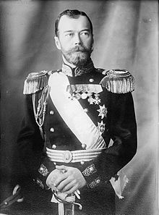
1910
1910
1917
Tsar Nicholas II heads an absolute monarchy that continues to resist the dilution of its power, which for the first time legalize political parties and establish an elected parliament. His promise of civil rights goes unfulfilled, and growing public discontent is channeled into left-wing revolutionary associations which seek to overthrow the system.
1921-1923
1924-1940
1941-1945
1953-1963
1985-1987
1988-1990
1991
2000-2001
2007

Slide 3
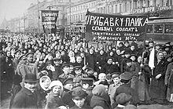
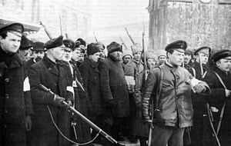
1910
1910
1917
A general strike, the “February revolution,” forces Nicholas II’s abdication and the monarchy’s end. Power falls into two camps: a largely socialist provisional government and the Petrograd Soviet (workers and soldiers).
1921-1923
1924-1940
1941-1945
1953-1963
(Putilov workers protesting in the streets)
1985-1987
1988-1990
1991
2000-2001
(Armed workers and soldiers escorting captured policemen. Petrograd, 1917)
2007

Slide 4
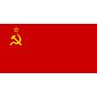
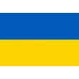
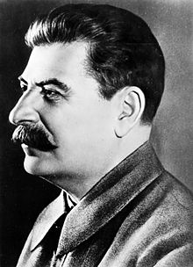
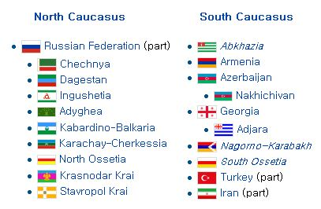
1910
1910
1917
The USSR initially comprises 4 countries, without real independence from the center. After less than a decade of independence, the Communist Party has suppressed and subsumed Russia’s trade union.
1921-1923
1924-1940
1941-1945
1953-1963
Joseph Stalin became secretary general in 1922.
1985-1987
1988-1990
1991
2000-2001
2007

Slide 5
1910
1910
1917
After Lenin’s death in 1924, Stalin argues against the need for international revolution for the USSR ’s survival. He moves against rivals in the Party, and in 50th birthday in 1929, his dictatorship and cult of personality in fully established.
1921-1923
1924-1940
1941-1945
1953-1963
1985-1987
1988-1990
Leon Trotsky, Grigori Zinoviev, Lev Kamenev and Nikolai Bukharin
1991
2000-2001
2007

Slide 6
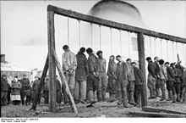
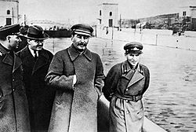
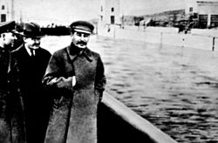
1910
1910
(Soviet partisans hanged by German forces in January 1943)
1917
1921-1923
To raise morale and rally the people to Russia’s defense for the “Great Patriotic War,” Stalin moderates Soviet policy. Class warfare is temporarily forgotten, and the terror of mass purges brought to an end.
1924-1940
1941-1945
In this famous image, Nikolai Yezhov is shown with Voroshilov, Molotov, and Stalin inspecting the White Sea Canal
1953-1963
1985-1987
1988-1990
In this second image, Yezhov, having been purged, has been replaced by a stretch of the canal bank and canal
1991
2000-2001
2007

Slide 7
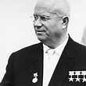
1910
1910
1917
1921-1923
1924-1940
1941-1945
1953-1963
1985-1987
1988-1990
By the time of Stalin’s death in 1953, the political dictatorship has reached maturity, backed by the world’s largest secret police. Nikita Khrushchev denounces Stalinism, but he keeps his dictatorship. His aggressive foreign policy results in the Berlin Wall’s erection and the Cuban missile crisis.
1991
2000-2001
2007

Slide 8
1910
1910
1917
1921-1923
1924-1940
1941-1945
1953-1963
1985-1987
1988-1990
With perestroika, Gorbachev aims to restructure and improve the Soviet system without building a new one. Article 6 of the constitution, enshrining the Party’s leading force in society, is removed.
1991
2000-2001
2007

Slide 9
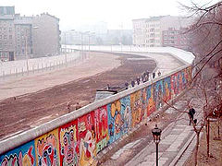
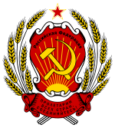
1910
1910
1917
1921-1923
1924-1940
1941-1945
1953-1963
1985-1987
1988-1990
1991
Gorbachev’s push to democratize the Soviet system leads to the creation of a Congress of People’s Deputies. The dramatic change in Soviet politics is marked by the lac of military response and the Party’s importance in the face of Poland’s free elections and the fall of the Berlin Wall.
2000-2001
2007

Slide 10
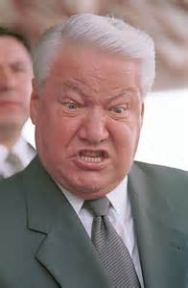
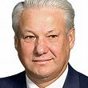
1910
1910
1917
1921-1923
1924-1940
1941-1945
1953-1963
1985-1987
1988-1990
1991
Boris Yeltsin becomes president of the Russian Republic in the first-ever election of a Russian leader, after the collapse of USSR.
2000-2001
2007

Slide 11
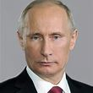
1910
1910
1917
1921-1923
1924-1940
1941-1945
1953-1963
1985-1987
1988-1990
Vladimir Putin is elected president. He vows to strengthen Russia’s standing in the world and increase the state’s authority at home, while continuing to move toward a market economy.
1991
2000-2001
2007

