Slide 2
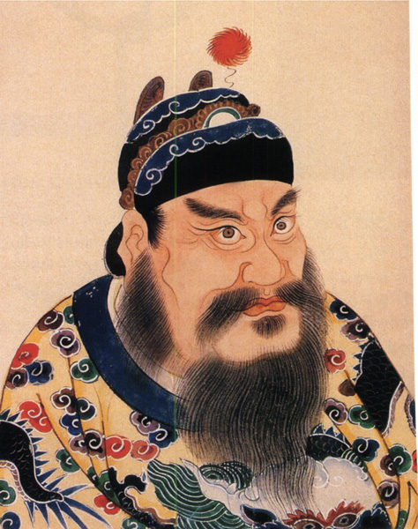
The Han Dynasty
In the year 207 B.C. a new dynasty began to rule China. This dynasty was led by a peasant whose name was Liu Bang. Liu Bang had grown tired of the brutal leadership of the Qin Dynasty. Many other people also were tired of the Qin
Peace thru war and plunder.

Slide 3
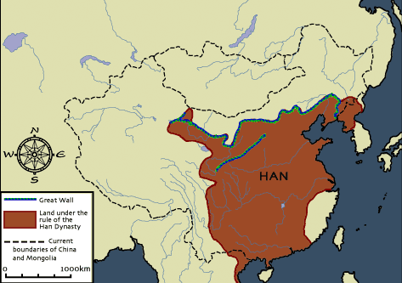
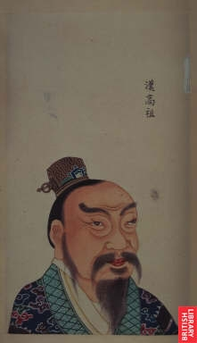
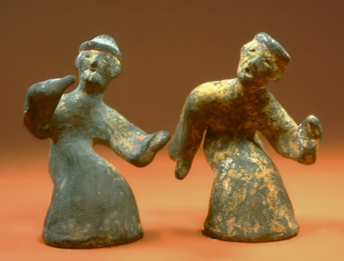
Long period of Peace and expansion leads to the Han
language of Chinese becoming the common language.
Today, the largest
ethnic group in
China calls itself
the “people of the
Han”
Han Dynasty
(202 BCE-220 CE),
Classical China

Slide 4
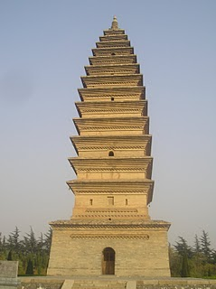
Mandate of Heaven
Liu Bang proclaimed that the Qin had lost the mandate of heaven, or the right to rule the nation. He was able to overthrow them, and establish himself as the new emperor of China, and the first emperor of the Han Dynasty.

Slide 5
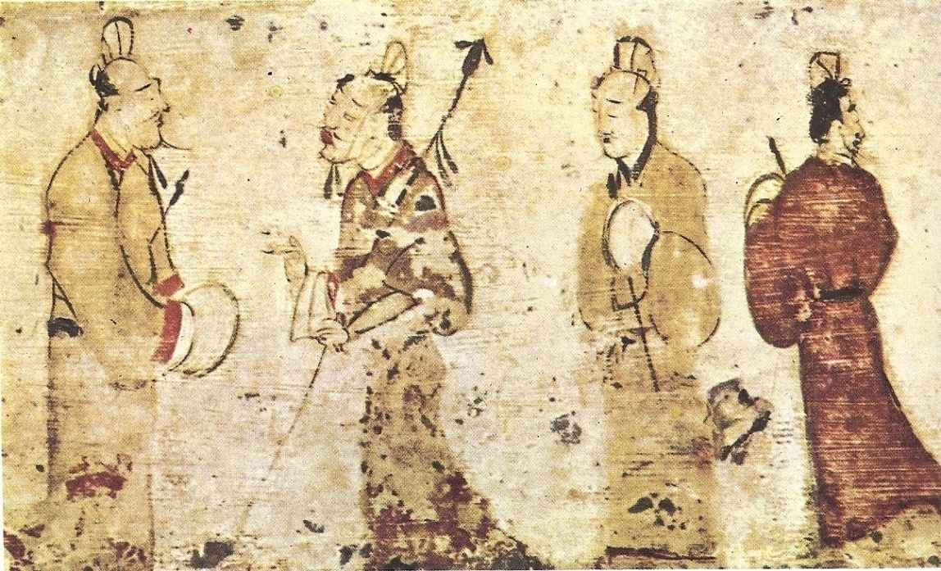
Four Hundred Year Rule
The Han Dynasty would rule China for the next 400 years. During this time period they would be one of the wealthiest and most powerful nations on Earth. Their achievements would only be surpassed by the Roman Empire.

Slide 6
Isolated from Rest of the World
Because of its location amidst high mountains and surrounded on many sides by water, China was isolated from much of the rest of the world. As their civilization flourished and their wealth increased, they were largely unaware of what advancements were taking place in the nations around them.

Slide 7
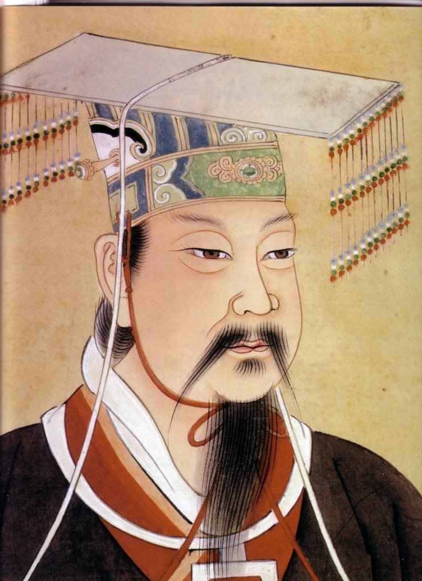
Chinese Exploration
In 139 B.C.E., a Han emperor by the name of Wudi sent out one of his generals, Zhang Qian, to explore other nations. This general and his army marched throughout distant regions visiting other civilizations and nomadic tribes.

Slide 8
Attacked by Nomadic Tribes
The armies of Zhang Qian were viewed as a threat by many of these nomadic tribes, as a result, these tribes attacked and destroyed many of Zhang Qian's men. Zhang Qian himself was captured and kept in bondage for a period of 10 years. After 13 years, Zhang Qian was finally able to return to the emperor and report.

Slide 9
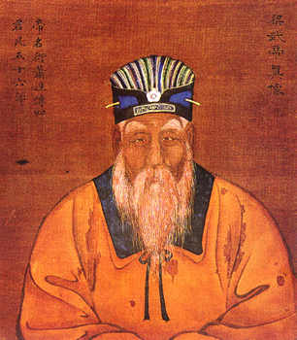
Wudi Aspires to Trade with West
He told Wudi about stories he had heard from the nomadic tribes of a great civilization to the West that equaled the glory of China. This was the first time Wudi had heard anything of any other civilizations. Wudi was a smart and wise ruler, who saw the potential for trade between the two cultures.

Slide 10
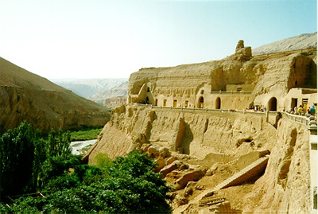
The Silk Road
In order to make trade possible , Emperor Wudi began to develop what has been called in modern times, the silk road. Following this route merchant traders took silk from China to the West, and brought glass, linen, and gold back to China.

Slide 11
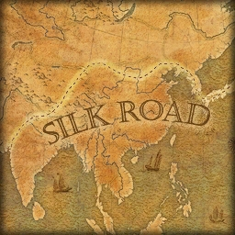
Trails, Roads, Bridges
The silk road consisted of trails, roads, bridges, and pathways that stretched across nearly 5000 miles of land and water. The silk road is not one long road, but rather many smaller roads and pathways that were connected, and worn by the use of thousands of travelers over a period of hundreds of years.

Slide 12
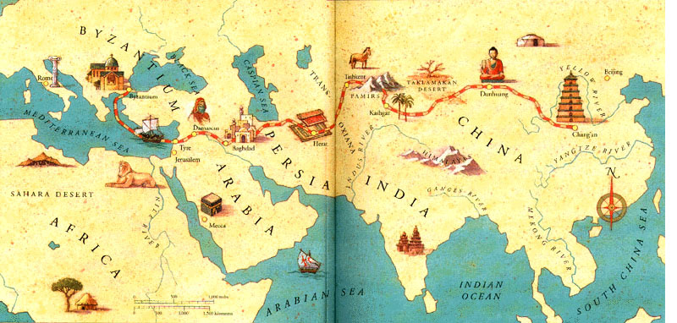
Expansion of Trade
The silk road would become instrumental in the development and expansion of trade, and the accumulation of wealth in both China and Rome, as well as in Egypt and other nations.

Slide 13
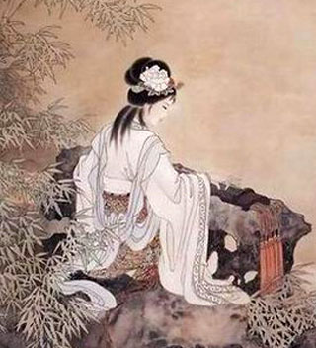
Pax Sinica
During the rule of the Han emperors, China enjoyed a 400 year period of peace and prosperity. During this time, the Han emperors established a strong central government that was designed to help the people, and protect them.

Slide 14
Food Reserves
One such innovation was the storage of food. During times of plenty, Han emperors would have great amounts of food put up into storage. Then during difficult times, they would sell these food stores, helping to stabilize food prices.

Slide 15
Merit-Based Appointments
The Han also abolished the practice of giving powerful government positions to members of the royal family. Emperor Wudi instituted a series of written exams. Anyone could take the tests. Those who received the highest scores were given posts in the government.

Slide 16
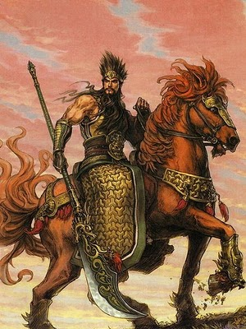
The End of the Han Dynasty
By C.E. 220 the Han Dynasty had fallen into a weakened state. Warriors from competing areas began fighting one another, throwing China into a period of civil war that would last for many years.

