Slide 1
Imperialism
Societies have sought to dominate weaker neighbors as long ago as ancient Mesopotamia and Egypt (Darwinism)
Reasons
to obtain natural resources
to subdue enemies
to accrue wealth
to win power and glory
How
combination of sea power
centralized governments
industrialized economies

Slide 2
Why
Driven by the need to provide raw materials for their industrial capacity
Types of goods exchanged were determined by that need
To build national wealth

Slide 3
TYPES OF IMPERIALISM
Colonial imperialism - This form of imperialism is virtual complete takeover of an area, with domination in all areas: economic, political, and socio-cultural. The subjugated area existed to benefit the imperialist power, and had almost no independence of action. In this era, almost all of Africa and southern and southeastAsia were colonized.
Economic imperialism - This form of imperialism allowed the area to operate as its own nation, but the imperialist nation almost completely controlled its trade and other business. For example, it may impose regulations that forbid trade with other nations, or imperialist companies may own or have exclusive rights to its natural resources. During this era, China and most of Latin America were subjected to economic imperialism.

Slide 4
TYPES OF IMPERIALISM
Political imperialism - Although a country may have had its own government with natives in top political positions, it operated as the imperialist country told it to. The government was sometimes a relatively permanent "puppet government," as happened in late Qing China, and other times the control was temporary, as occurred in the Dominican Republic when the United States ran its government until it got out of debt.
Socio-cultural imperialism - The dominating country deliberately tried to change customs, religions and languages in some of the countries. A good example was British India, where English was taught in schools, Indian soldiers dressed British-style, and western trading rules were set up. Generally, the imperialist countries assumed their cultures to be superior, and often times they saw themselves as bringing about improvements in the society.

Slide 5
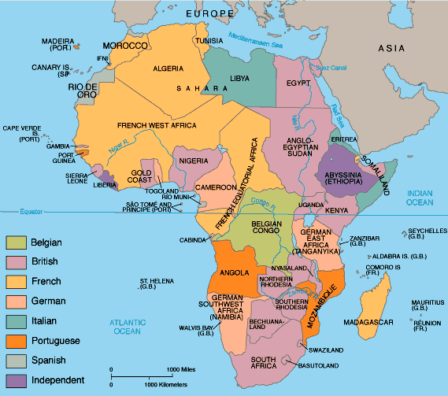
IMPERIALISM IN AFRICA

Slide 6
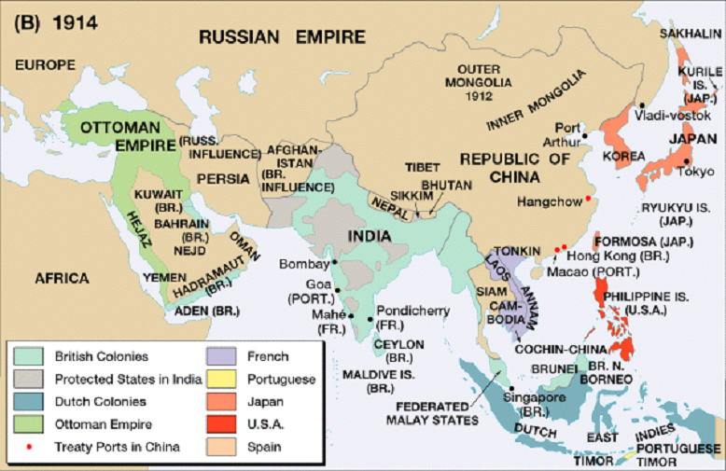
Imperialism in Asia

Slide 7
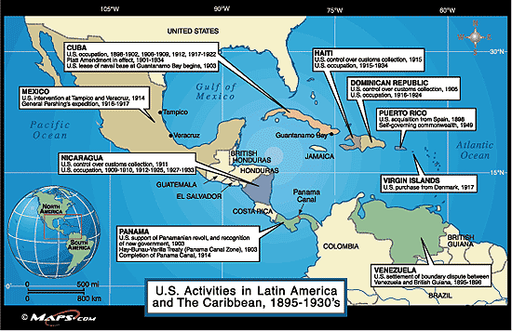
Imperialism in Central and South America

Slide 8
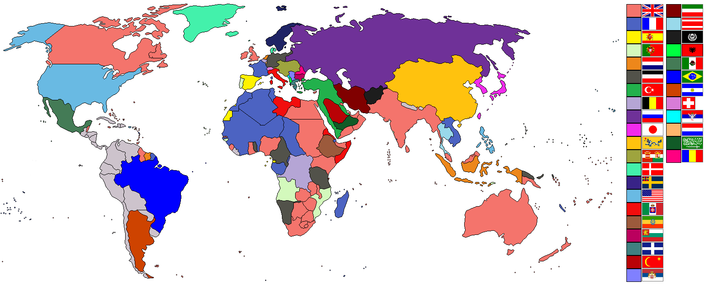
World of Imperialism

