Slide 1
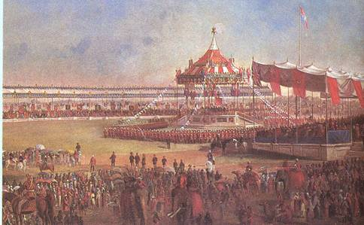
India
What do you think is happening here?

Slide 2
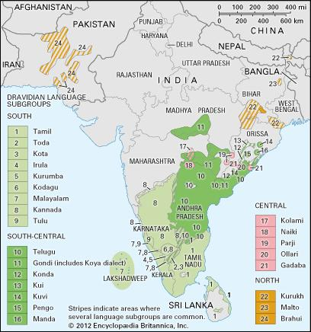
British Imperialism in India
Diversified
Leader
16 different languages
Six major religions
Not unified individual states ruled independently
India is ruled by a maharaja (emperor or king)

Slide 3
East India Trading Company
A business venture set up to increase and protect trade
Operated in India and the East Indies
Grew too powerful and operated outside of government authority
Parliament establishes a governor general to enforce Britain policy

Slide 4
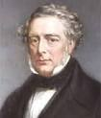
British Control of India
Unified three main post Bombay, Calcutta and Madras
G.B. gains control over most of India
Governor General Lord Dalhousie created the “Three great engines of social improvement”
Railways-to move military quickly
Postal system-for quicker and efficient communications
Telegraph-communications between the three largest cities

Slide 5
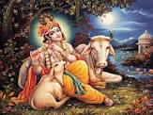
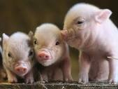
Sepoys
Indian born soldiers fighting under the British
They were Muslims and Hindus
New rifle introduced, bullet cartridges were lined with cow or pig fat
Hindus consider cows sacred
Muslims don’t consume pork
Led to the Sepoy Mutiny
After the mutiny Parliament took control over the military away fro EIC

Slide 6
Indians Under the Raj
Brits did not interfere with everyday life in India
Indians felt the Brits were not allowing them to industrialize
English becomes the official language
Upper class
Government
Some Indians became very wealthy
Cotton, textiles, steel, coal and etc…

Slide 7
The Indian National Congress
Mainly Hindus (1885)
All-India Muslim League (1906)
Push for independence
Mohandis K. Gandhi
Studied law in London
Moved to South Africa (another British colony)
Civil rights for laborers in S. Africa
Led the fight for independence using nonviolent protests
Martin Luther King Jr. used Ghandi’s method during the United States Civil Rights Movement

