Slide 1
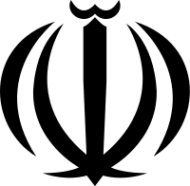
IRAN
Islamic Republic of Iran

Slide 2
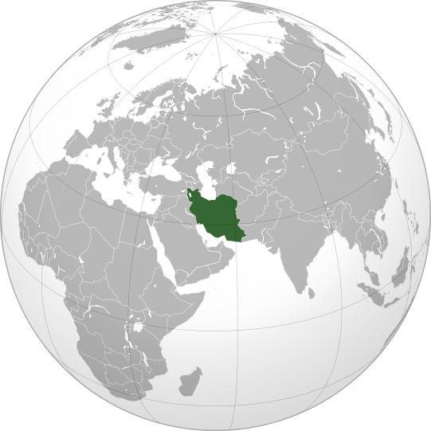
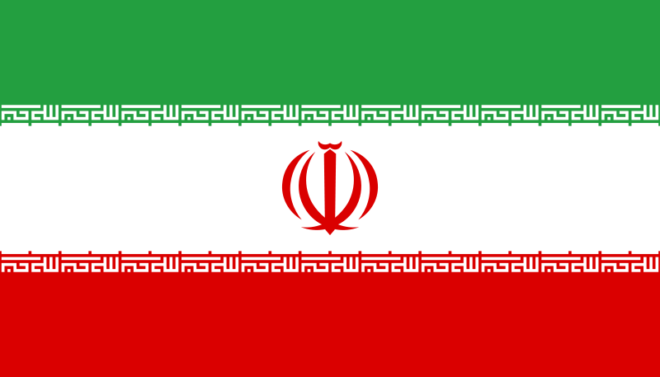

Slide 3
Theocratic Republic
Theocratic
a system of government in which priests rule in the name of God or a god
Republic
supreme power is held by the people through elected representatives
elected or nominated president rather than a monarchy

Slide 4
Iranian Constitution
Made in 1979 after monarchy was overthrown by a revolution
Amended in 1989
Expanded powers of the presidency
Eliminated the Prime Minister and created the Vice President

Slide 5
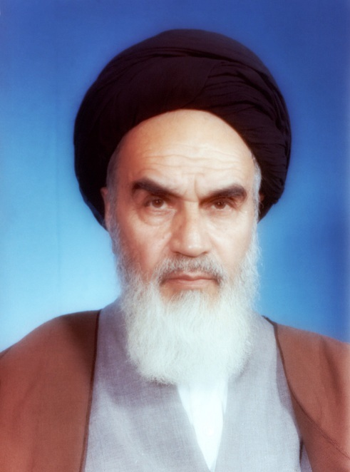
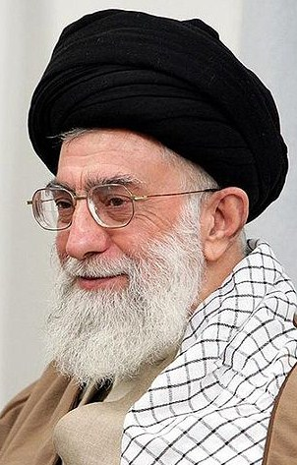
Executive Branch
Khomeini
Chief of State – Supreme Leader
Leader of the Revolution
Ruhollah KHOMEINI (since 1979)
Ali Hoseini-KHAMENEI (since 1989)
Appointed for life by the Assembly of Experts
Commander-in-Chief of armed forces
Controls military intelligence and security operations
Sole power to declare war or peace
Khamenei

Slide 6
Executive Branch
Head of Government – President
Most powerful after Supreme Leader
President Mahmud AHMADI-NEJAD (since 2005)
Elected by popular vote for a four-year term
Can only re-elect for one term
Candidates must be approved by Guardian Council (more info on slide 13)
Implements constitution and exercises executive powers
Coordinates government decisions, selects policies to be placed before legislature
Vice President
First Vice President Mohammad Reza RAHIMI (since 2009)
8-12 Vice Presidents (including First Vice President)
Appointed by President to lead organization related to Presidential affairs

Slide 7
Executive Branch
Cabinet – Council of Ministers
Selected and led by the president with legislative approval
Advises the president only
Supreme Leader has some control over appointment to the more sensitive ministries
Minister of:
Agriculture, Commerce, Communication and IT, Cooperatives, Culture, Defense & Logistics, Economy and Finance Affairs, Education, Energy, Foreign Affairs, Health & Medical Education, Housing and Urban Development, Industries and Mines, Intelligence, Interior, Justice, Labor & Social Affairs, Petroleum Supervision, Roads & Transportation, Science & Research & Technology, Welfare & Social Security…
Government Spokesman
Governor of the Central Bank of Iran

Slide 8
Legislative Branch
Islamic Consultative Assembly
The Iranian Parliament or People’s House
1979-1999: 270 seats
2000-2011: 290 seats
2012- : 310 seats
Members elected by popular vote
Four-year terms

Slide 9
Legislative Branch
Conservatives (195)
Reformists (51)
Independents (39)
Religious minorities (5)
(see slide 14 for more info on political parties)

Slide 10
Judicial Branch
The Supreme Court & the Four-Member High Council of the Judiciary
Overlapping responsibilities
Supervises the enforcement of all laws
Establish judicial and legal policies together
Head of judiciary is a “just Mujtahid” (Islamic Scholar) appointed by the Supreme Leader
Serve a period of five years
Lower Courts
Special Clerical Court: handles crimes committed by clerics
Revolutionary Court: national security, narcotics smuggling, acts that undermine the Islamic Republic
Public Court

Slide 11
Oversight Bodies
Assembly of Experts
Body of 86 Mujtahids (Islamic scholars)
Responsible for electing, supervising, and removing the Supreme Leader (if necessary)
Public elects from government-screened list
Eight-year terms
“Whenever the Leader becomes incapable of fulfilling his constitutional duties, or loses one of the qualifications mentioned in the Constitution, or it becomes known that he did not possess some of the qualifications initially, he will be dismissed.” (Constitution of the Islamic Republic of Iran, Article 111)

Slide 12
Oversight Bodies
Expediency Council/Council for the Discernment of Expediency
Exerts supervisory authority over the three branches
Advisory role to the Supreme Leader
Resolves legislative issues between the the Consultative Assembly (Parliament) and the Council of Guardians
Since 1989 – advise national religious leaders on matters of national policy
Since 2005 – act as supervisory body for the government

Slide 13
Oversight Bodies
Council of Guardians of the Constitution/Guardian Council
12 members: 6 Islamic faqihs (law experts) appointed by the Supreme Leader and 6 jurists appointed by Parliament
Determines whether proposed legislation is constitutional and faithful to Islamic law
Makes careful and critical examination of candidates in popular elections for suitability
Supervises national elections

Slide 14
Political Parties
Conservatives Alliance
extremist & ultra-religious right-wing parties
Combatant Clergy Association (Supreme Leader, head of Judiciary)
Alliance of Builders (President)
Islamic Society of Engineers (Speaker of Parliament)
Reformists Coalition
Moderate religious right-wing parties
Executives of Construction Party (Chairman of the Expediency Discernment Council and Chairman of the Assembly of Experts)
2011 – only the Conservatives parties can carry out political and cultural activities

Slide 15
Economy
Transition Economy: changing from a centrally planned to a free market
Purchasing Power Parity: 18th…predicted to be 12th in 2015
more than 30% of central government spending has religious foundations
sanctions because of nuclear program
most export: oil & gas

Slide 16
Strengths
Combination of religion and politics
98% of Iranians are Islamic
2% are other with a majority being Christians, Jews, and Zoroastrians (religion of Iran before Islam was introduced), they are recognized and protected by the government
Changed system in 1979 from monarchy to republic
Working on democratic government
Separation of Powers
Increase in women rights
Female Parliament members

Slide 17
Weaknesses
Limited Media control
“Eye for an Eye”
Political Instability
2009 – supporters of the non-elected president candidate questioned the validity of the election and suspected fraud & corruption
Fierce competition (63% vs. 33%)

Slide 18
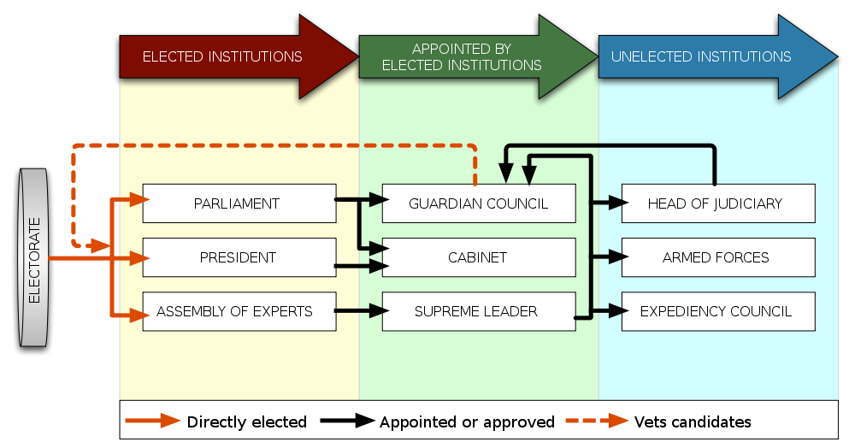
Conclusion

