Slide 1
29-31
Jay Song

Slide 2
The Role of the Emperor
Symbolic leader
Japan’s spiritual leader and the symbol of government.
Unify the Japanese people and anchored their sense of identity
Notes:
His people during much of the country’s history
Still remained as
Helped

Slide 3
Continued Chinese influence
Continued to mold Japanese society and its culture (6th-9th)
Writing system Kana
Creation of Japanese literature
Art
Buddhism
In the end, Japan adapted these borrowing cultures.

Slide 4
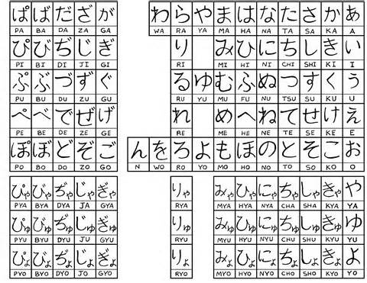
KANA

Slide 5
The Yamato Legacy
People’s rank were fixed at birth
Appearance of a warrior class
Uji played role both in religious way and political way
Uji and noble families helped foresee the difficulties that the future rulers would have to face.
Succeed of adopting ideas(culture borrowing) and changing them into part of their own culture
Notes:
military power Played a Crucial role in Japanese society and government

Slide 6
Classical of Japan
After the Yamato Period ended, a new historical Period(the period of Classical Japan) began which lasted for the next 400 years.
Japan established a truly unique civilization.

Slide 7
Questions
Emperors in this period were all-powerful rulers T/F
What’s the name of the Japan’s writing system?
Japan only borrowed China’s culture in religion T/F
Write the name of the period that followed after the Yamato Period ended
Promoting to a high rank was achievable for everyone if work hard T/F

