Slide 1
Labour Unions
“The folks tat brought you the weekend, child labour laws, overtime, minimum wage, injury protection, workmen's compensation insurance, pension security, right to organise.. Etc”

Slide 2
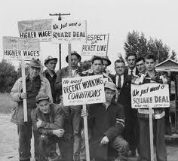
What is a labour Union ?
A Labour Union a organisation of workers that have banded together to achieve better and greater things for their working environment, for their wages and for their working hours. From the 1800’s to the 1950’s hundreds of occurred, hundreds of people died for their cause and a whole lot more suffered with serious injuries all to accomplish what they want

Slide 3
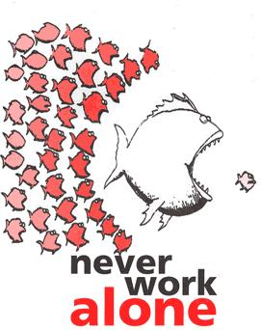
How did the labor Union's start ?
Essentially, labor unions are associations of workers who are banded together for the purpose of improving their employment conditions and protecting themselves and their coworkers from economic and legal exploitation. Members of labor unions engage in collective bargaining with their employers, as well as general political activism.

Slide 4
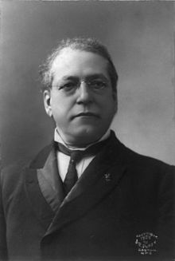
Samuel Gompers
Samuel Gompers was an English born, who grew up in America. Who because a key figure in the history of Labour Unions. Gompers founded, and was President the American Federation of labours (AFL) from 1886 to 1894 and from 1895 to his death in 1924.
Gompers brought much peace and success to the workers, he was a brilliant and thoughtful man who helped thousands of people.
http://www.youtube.com/watch?v=pdu2wrOZVsY

Slide 5
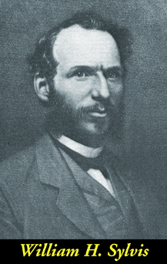
The National labour Union
The National labour Union was the first National Labour federation in the United States. Founded in 1866 to 1873. It was lead by William H. Sylvis . The National labour Union sought to help in those areas where there was no stable organisation to try to form an eight-hour day to create a national federation that can press for labour reforms.
The new Organisation preferred arbitration ( a dispute) over strikes, to try to settle the matter in a more civil manner .

Slide 6
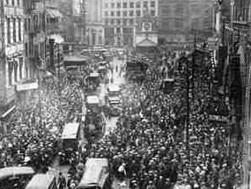
Strikes !
Strikes were the way the working man got himself involved the fight against, the government and the mass factories. Strikes were effective because the factories needed people in them to work in them and if all the workers are striking against work and only willing to go back into work if they are given what they want, normally more money and less hours.

Slide 7
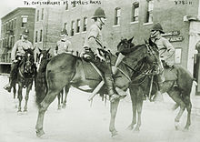
Risks of striking
When men and women left heir homes and headed to the streets to join their fellow workers in a strike, they went out their knowing of the casualties that might occur
ON the 13th of January 1874 the Tomkins Square Riot in NY, unemployed workers demonstrated their hate, a detachment of mounted police charged into the crowd beating men, women, and children indiscriminately with billy clubs and leaving hundreds of causalities in their wake.

Slide 8
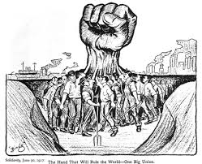
Why we need the labour Union?
Without Labour unions the common workers would have to work the same long hours and get the same tiny amount of pay and working in unsafe environments. But if the workers come together as one and fight for what they want they would be so venerable and as weak as before , so as coming together as a unified legal committee will for sure get them something. Even though they walked out with squat nothing, it would encourage others to do the same.

Slide 9
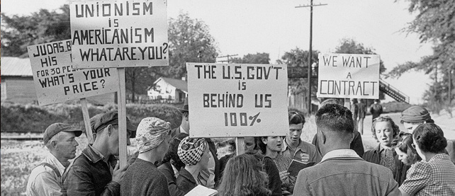
Positive affects of the Labour Unions
Workers began a strike as part of the 10 hour movement, outlining their demands and seeking assistance from other trades people. From this the 1835 Philadelphia General strike occurred, in which workers successfully struck for shorter working hours and increased wages.
This was not the first and will not be the last as long as there are Labour unions to fight for the workers rights

Slide 10
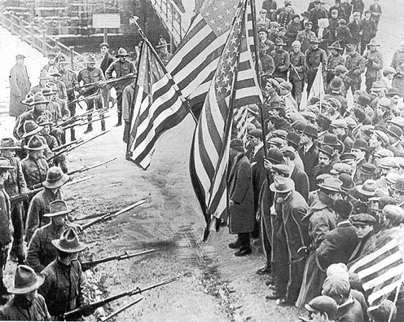
Negatives of Labour unions
With the rises in payment, the bosses will rise the pay and then lower the staff so that they are not loosing any money by paying them.
The owners set the their business to run efficiently, if they give out lees working hours and a rise in payment the factory wouldn’t be able to produce as much, so they would also be loosing money, and then soon after that the business would be bankrupt and then once again the people without work.
People also seriously hurt while putting their life on the line during massive strikes.

Slide 11
Xia Xia !!!! <3

