Slide 1
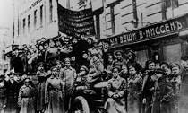
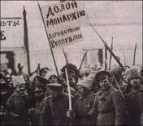
March Revolution
After Nicholas II a new provisional government
Supported continued fighting in WWI
Army poorly equipped, malnourished and millions killed or wounded
Lost support of the people
Armies wouldn’t fight, ignored orders from military leaders

Slide 2
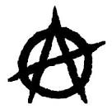
Between Revolutions
Unstable government
Continued war with Germany
A state of Anarchy
Peace, land and bread!!!

Slide 3
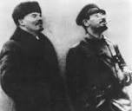
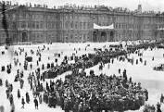
November Revolution
Lenin and Trotsky/Bolsheviks coup
Armed workers, soldiers, sailors overthrow government
Bloodless Revolution
Now called communist
Took private land from rich gave to the majority
Workers given control of factories and mines

Slide 4
Civil War/Lenin’s Leadership
Civil War
Lenin’s Leadership
Treaty of Brest-Litovsk
White Army (Czar Loyalists)/Red Army (Lenin’s Communists)
3 years of fighting
Allies supported the White Army
Communists win making Russia first Communist state
Allowed farmers to keep farmland
Communist government took control of businesses and industry
Controlled almost all Russia’s economy

Slide 5
Views on Communism Became known as Marxism/Leninism
Karl Marx
Vladimir Lenin
Workers in control of production
No capitalism
Under government control by the proletariat
Seize control by violent revolutions
A classless society
Agreed with much of Marx beliefs
Small group should lead
An all powerful government

