Slide 1
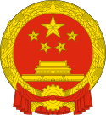
PRC Chinese government
What is prc?
The top official
Three branches in prc

Slide 2
PRC
People’s republic of China
Current president: xi jinping
Current premier: Li keqiang
Back to Title >>

Slide 3
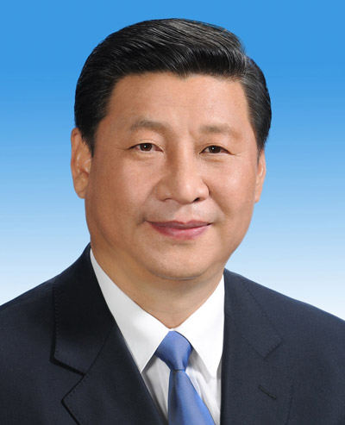
Top official
Xi jinping
Head of state of china
Ceremonial office (limited powers)
5 years / term
Maximum 2 consecutive terms
More responsibilities…
Back to Title >>
Sources:
Wikipedia.org / CIA World Fact Book

Slide 4
Responsibilities
Promulgate laws
Laws adopted by NPC or its standing committee go into effect only after being promulgated by the president
Issue orders
The appointment and removal of the premier of the state council
the issue of the order of special amnesty
the proclamation of martial law
a state of war and general mobilization can only be made or announced by the president
Since 1959, the president has issued the order of special amnesty on six occasions.
Appoint or remove officials constitution the state council
Confer state honor
Back to Title >>
Sources:
Wikipedia.org / CIA World Fact Book

Slide 5
Three branches in prc
Executive – state council
Legislative – National people’s congress
Judicial – supreme people’s court / supreme people’s procuratorate
Back to Title >>

Slide 6
executive
President: xi jinping
5 years / term
Have right to appoint and dismiss officials including premier and cabinet members
Have right to claim a war, martial law, and mobilization order
Other Branches >>
Back to Title >>
Sources:
Wikipedia.org / CIA World Fact Book

Slide 7
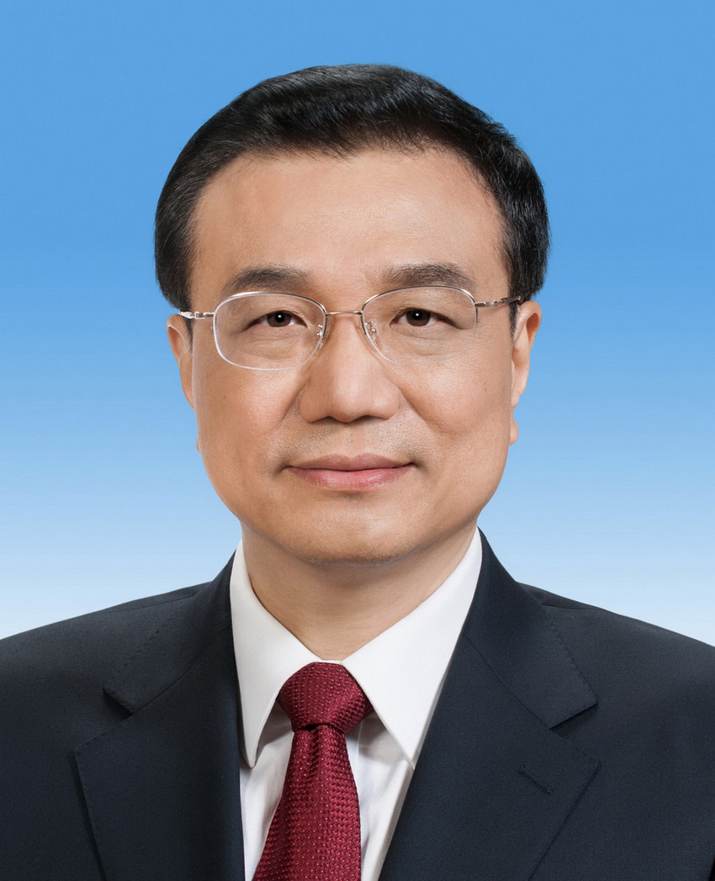
legislative
Premier: Li keqiang
5 years / term
2987 seats
Responsible for all small branches and frequently report their work to executive branch
Other Branches >>
Back to Title >>
Sources:
Wikipedia.org / CIA World Fact Book / indexmundi.com

Slide 8
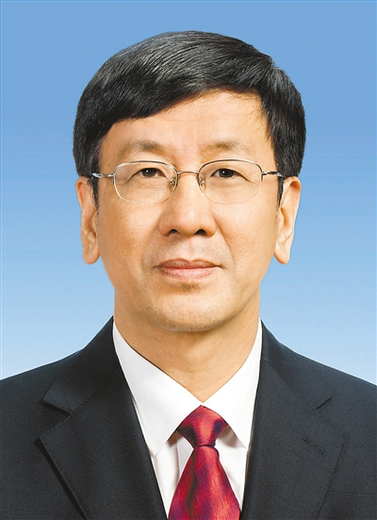
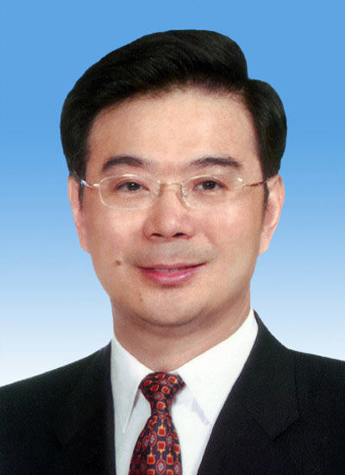
judicial
Supreme people’s court – Chief justice: Zhou Qiang
Over 340 seats
Supreme people’s procuratorate – agency executive: cao jianming
Other Branches >>
Back to Title >>
Sources:
Wikipedia.org / CIA World Fact Book / indexmundi.com

