Slide 1
Communist Party of China
http://en.wikipedia.org/wiki/File:Flag_of_the_Chinese_Communist_Party.svg
Soo Jeong , Jeff, James, Yoon Min

Slide 2
EXECUTIVE
LEGISLATIVE
General Secretary
Top official (Meng Jianzhu)
Secretariat(10 people)
Standing Committee of Politburo
Party Bureaucracy
Politburo(25 people)
Province Committees
Central Committee(204 people)
Local Committees
National Party Congress (2000 people)

Slide 3
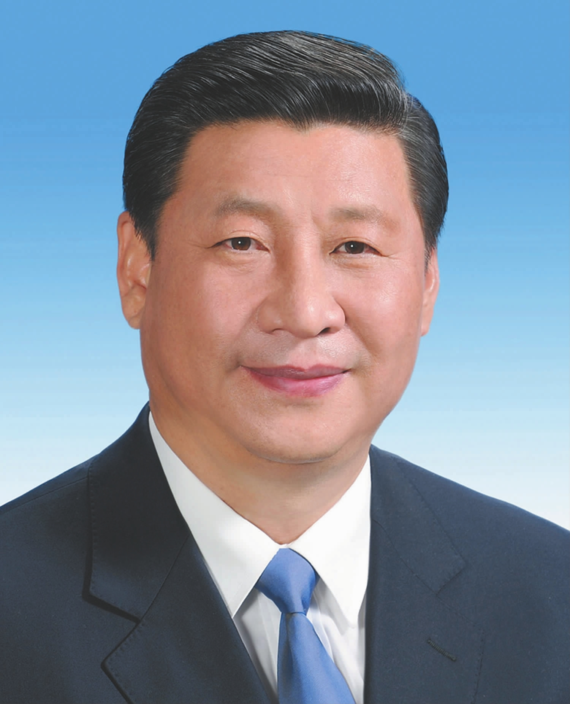
Xi Jin Ping
Top Official :Xi Jin Ping
Term of office: 5 years (2 cons terms)
Responsible for nominating the Premier
Total member:82.6 million
http://dantomozei.ro/2013/03/14/xi-jinping-a-fost-ales-noul-presedinte-al-chinei/

Slide 4
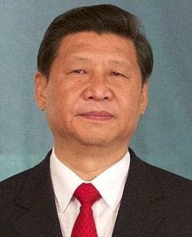
Executive
General Secretary
Xi Jin Ping
Highest ranking official within CPC
De facto top decision-making body
Usually became the leader of the PRC
http://en.wikipedia.org/wiki/General_Secretary_of_the_Communist_Party_of_China

Slide 5
Executive
Secretariats
Consists of 10 people
Makes personnel decisions in both the party and state (but not the military)
Permanent bureaucracy
Manages the work of the Central Politburo and its Standing Committee
Involved in coordination of the party structure
Does not have policy-making influence
Elected / appointed by Standing Committee

Slide 6
Executive

Slide 7
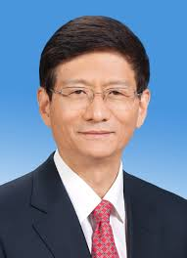
Top Official
Meng Jian Zhu
5 years term
Responsible for:
1. making laws
2. setting government budget
3. Oversighting implementation of law
http://news.xinhuanet.com/english/special/18cpcnc/2012-11/15/c_131977340.htm

Slide 8
Standing Committee of Politburo
2nd highest committee of legislature
Top leaders of CPC
Make most powerful decision
7~9 people

Slide 9
Politburo
Serve same function
25 people
7-9 members of this committee comprises the Standing Committee of Politburo

Slide 10
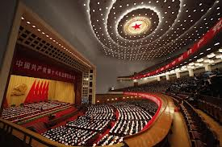
Lower bodies
Central Committee National Party Congress
204 people 2000 people
http://www.heraldsun.com.au/news/world/china-keeps-rare-communist-transfer-of-power-in-shadows/story-fnd134gw-1226513398833

