Slide 1
Responses to the Nazi Threat
Jun

Slide 2
United States became involved in the growing conflicts abroad.
The American people wanted to follow a policy of isolationism
When European allies of the United states, came under attack, U.S. public opinion began to shift

Slide 3
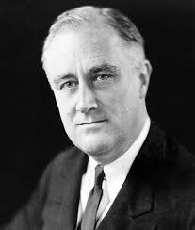
Franklin D. Roosevelt
32th American president(January 30, 1882 – April 12, 1945)
-Wanted to help the Allies without going against the nation’s isolationist policies.

Slide 4
Lend-Lease Act and the Atlantic Charter
In March 1941, he persuaded the U.S. Congress to pass the Lend-Lease Act.
In August 1941, Roosevelt met with Winston Churchill for a secret conference.
Atlantic Charater
- Strengthened the relationship between the United States and Great Britain.

Slide 5
Resistance Movements
- Poland, Freance, Belgium and other European nations were under Hitler’s control.
-Secret nature of their activities, resistance groups were often referred to as the “underground”.
-De Gaulle inspired the French underground movement by sending messages over British radio.
-In other occupied countries, and even in Nazi Germany, resistance took the form of work stoppages, spying, and sabotage.

Slide 6
Women in the War
During the war, millions of men left their jobs at factories and farms and entered the armed forces.
Many women wokred in factories, making airplanes, ships, tanks, and other military supplies.

