Slide 1
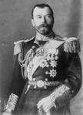
Russian Revolutions
Czar or Tsar Nicholas II
Romanov family
Weak ruler
Little control over the armies and unconcerned with the plight of the people
Autocrat

Slide 2
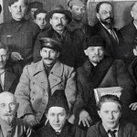
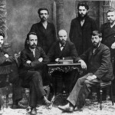
Party Creation
Inspired by Karl Marx theories
Creation of Russian Social Democratic Labor Party
Bolsheviks v. Mensheviks
Bolsheviks led by Lenin
Russo-Japanese War-major defeat of Russia

Slide 3
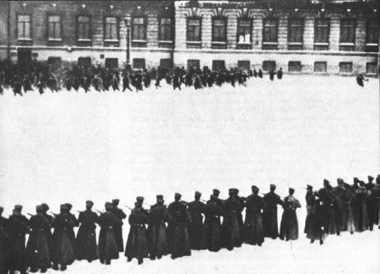
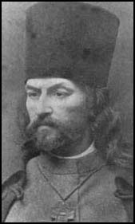
Bloody Sunday
Revolution of 1905
Led by Russian Orthodox Priest
Peaceful protest that the tsars army fired on
Hundreds killed
Creation of the Duma (legislature)
Duma given more power to oppose the soviet
Father Gapon

Slide 4
March Revolution
Believed to be a mystic
Rasputin had tsar’s wife confidence
gave her bad advice when making appointments in government
Tsar Nicholas II lost the support of the people
Rasputin

Slide 5
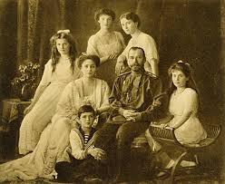
March Revolution
During WWI
Russian losses were heavy
Rioting over food and coal
Tsar Nicholas forced to abdicate
Citizens divided on WWI
Entire family executed

