Slide 1
The Legacy of Early Japan
Queenie Jeong

Slide 2
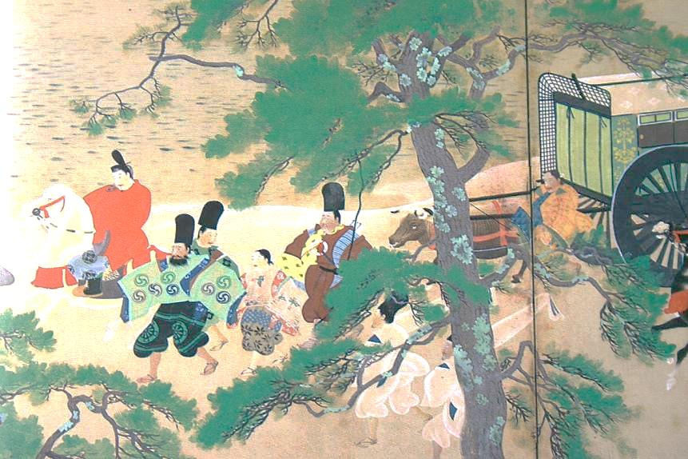
The Yamato Period
Rivalries among the uji led to conflicts.
By 400, one of the most powerful uji, the Yamato, had become dominant power.
Based on the Yamato, or Nara, Plain, they became leader of a coalition, or union.
They invaded Korea and occupied land there.
The ruler of tenno uji, one of the most powerful of the Yamato group, became the first emperor of Japan
Shinto- the ways of the gods.
Shinto religion was widely practiced in Japan.
Believers in Shinto worshipped many gods, called kami

Slide 3
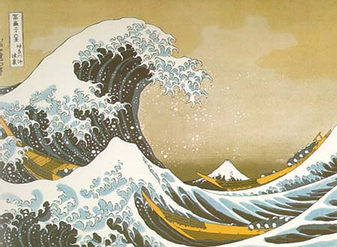
Contacts with China
From the 4th century through the mid 6th century, the Yamato were in close touch with southern Korea.
From the 5th century on, Japan was deeply influenced by the culture of China.
Chinese civilization played an increasingly vital role in shaping Japanese culture.
The introduction of Buddhism by monks and scholars from China about 552
- helped shape Japans religious tradition
- Chinese learning and philosophy as well as Chinese style in art and literature
Shinto rituals continued to be observed, and Shinto ceremonies were carried out alongside Buddhist rites.
Prince Shotoku, the most important Yamato ruler. He set the country on the road to a centralized state, and also begin the imperial policy of cultural borrowing from China.

Slide 4
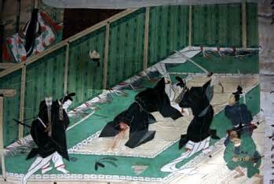
The Taika Reforms
The influence of Chinese ways on Japan was intensified when the powerful Fujiwara family gained control of the imperial court in 645.
Taika Reforms, or “Great Changes”, which adopted the min features of Chinese system of taxation, land ownership,.
To ensure the success of the reforms, the Fujiwara and their supporters overcame those uji that were opposed to these changes. They also forced the uji to recognize the Yamato ruler as emperor of all Japan.
The most important of the Taika Reforms was to set up stronger central government under the emperor with power over the uji.

Slide 5
Japan’s government was organized into ministries with high officials responsible to the emperor. Equally important, a large bureaucracy, or group of government officials was appointed to help administer government laws and decrees
Unlike China, Japan members of the noble court families were asked to administer the government.
Japan was divided in to 66 provinces. These provinces the lands that were the home of the uji, were to be ruled by officials sent by the central government.
All land in Japan was declared the property of the imperial government, and it was to be divided equally among people.

Slide 6
Questions
Which group was the Japanese first emperor?
What is Kami?
What are Prince Shotoku’s great achievements?
What is Taika Reform?
What are differences between China government and Japan government?

