Slide 1
How did the Mongol Empire conquer so much territory?
Obj: Identify the contrast between pastorial nomads to fierce warriors
Agenda: 1. Turn in Bibliographies
2. PPT notes
3. Group work
-Read h/o answer discussion questions
-write 1 paragraph summary
Hw: 1. Continue research and presentation preparations

Slide 2
The Mongol Empire
Evaluating Mongol Rule and its Legacy

Slide 3
What do you think when you see this picture?

Slide 4
Central Questions
What was the main short-term and long-term impact of Mongol rule?
What were some of the advantages of the cultural diffusion that Mongol rule promoted?
How can we describe the religious diversity within the Mongol khanates?
What were the positive and negative consequences of Mongol rule?

Slide 5
The Mongol Empire
The Mongols built a vast empire across much of Asia, founded the Yuan dynasty in China, and opened China and the region to greater foreign contacts and trade.

Slide 6
The Mongols came from Central Asia in the 1200s and created the largest land empire in history.
Nomads from the Steppe
Vast steppes, grasslands, stretch across north-central Eurasia, home to nomadic peoples
Steppes too dry for farming
Nomads relied on herds of domesticated animals
Often traded; but also swept down on settlements, took what they wanted
Fierce Warriors
Like Huns, Turks, the Mongols emerged as powerful nomadic people on Central Asian steppes
Herded sheep, goats
Skilled with horses
Accustomed to living in harsh environment, competing for scarce resources
Tough people, fierce warriors

Slide 7
The Universal Ruler
Separate Clans
Mongols divided into separate clans, each led by a khan, chief
Khans rose to power through military skills, ability to lead
1100s, Temujin, powerful khan, began to conquer rivals, unite Mongol clans
Genghis Khan
1206, Temujin completed task, took name Genghis Khan, “Universal Ruler”
Set out to build empire, organized Mongols into powerful military machine
Strict discipline, demanded loyalty, rewarded those who pleased him
Campaign of Conquest
Mongol forces began bloody campaign of conquest; highly mobile armies
Employed brutality, psychological warfare; burned towns, killed inhabitants
Sent agents ahead to instill fear; soon people surrendered without a fight

Slide 8
The Mongol Empire
The Mongol Empire
Genghis Kahn led Mongols in conquering much of Asia
Mongols learned art of siege warfare, gunpowder in fights against Chinese, Turks
At Genghis Kahn’s death, 1227, Mongols controlled much of northern China, Central Asia
Sons, grandsons took up challenge of world conquest
Khanates
Genghis Kahn’s empire divided into four khanates, heir ruled each region; new Great Khan ruled over whole empire
Grandsons resumed efforts to complete conquests of China, Korea, Persia
1236, Golden Horde, or Tartars, began conquering Russia, Poland, Hungary

Slide 9
Horse Warriors

Slide 10
The Khanate of The Golden Horde
Devastated Eastern Europe in the 1220s
When grandson Batu learned of Great Kahn’s death, he and his armies suddenly turned back
India, Western Europe escaped
Most of Eurasia devastated
Millions had died, entire cities annihilated: Moscow, Kiev, Baghdad, etc.

Slide 11
Conquests

Slide 12
Could there be a balance between the negative and positive affects of the mongol conquests?
Obj: Compare and contrast the negative and positive impacts of Mongul rule
Agenda: 1. PPT/notes
2. Break into groups and discuss the readings you were assigned Tuesday
-Share information from your readings
-Take notes from other group members information
- Groups will create a 1-2 slide PPT based on your
individual reading and do a group presentation tomorrow
Hw: Prepare your slides to be presented tomorrow. Use information from readings and provide pictures

Slide 13
Pax Mongolica
The Mongol Peace
Mongols built empire with brutality, ruled peacefully
Tolerated local beliefs, ways of life, allowed local rulers to stay in power as long as they paid tribute to Mongols
Some Mongols adopted aspects of more civilized cultures; Mongols in Central Asia, Persia, adopted Islam
Stability in Asia
Mongol Empire established peace, stability across Asia
Some historians call period Pax Mongolica, “Mongol Peace”
Guarded trade routes across Asia, allowed trade to increase; people, goods, ideas flowed across Asia
Some believe Black Plague spread from Asia to Europe during period

Slide 14
Important Question:
How were the Mongols able to build a vast empire across much of Eurasia?

Slide 15
The Yuan Dynasty
Great Khan
1260, Kublai Khan became Great Kahn of Mongol Empire
Determined to complete conquest of China begun in 1235
Southern Song
Mongols ruled northern China
Southern Song dynasty ruled in south, fiercely resisted Mongols
1279, Song defeated; Kublai Khan created Yuan dynasty
Kublai Khan Rules China
As emperor, Kublai Khan tried to gain loyalty of Chinese subjects
Adopted Chinese practices, gave dynasty Chinese name
New Capital
Kublai Khan moved capital to near what is now Beijing
Built Chinese-style walled city, lavish palace, adopted Chinese court ceremonies

Slide 16
Kublai Khan Rules China
Mongol Identity
Kublai Khan tried to rule as Chinese emperor
But took care to see Mongols not absorbed into Chinese culture
Mongols lived apart from Chinese, had little in common
Separation
Individual friendships between Mongols, Chinese discouraged
Mongols forbidden to marry Chinese
Different laws, taxes for Chinese; could not own weapons, serve in military
Limited Power
Kublai Khan distrusted Chinese, limited power
Chinese officials served at local level, could not hold high government posts
Mongols invited foreigners to hold government office

Slide 17
Taxes to Trade
Mongols burdened Chinese with heavy taxes
Large part of taxes supported public-works projects
Chinese laborers built new roads, extended Grand Canal
Improvements made shipping rice, other goods from southern China to northern China easier, more reliable
Peace
Foreign Trade
Mongols posted soldiers throughout China to keep peace
Feared rebellions, particularly in south where many Chinese remained loyal to Song dynasty
Foreign trade increased
Pax Mongolica made land travel safer for merchants
Sea trade improved; foreign merchants welcomed to China’s ports

Slide 18
Europeans to China
As a result of Kublai Khan’s foreign trade policies, many merchants, travelers and missionaries came to China. Most were from Southwest Asia and India. However a few came from Europe as well. One of the most famous of these Europeans was Marco Polo.
Marco Polo in China
Accounts of China
Marco Polo, Italian trader visited Yuan court
Kublai Kahn sent Polo on several missions; traveled in, around China for 17 years
1295, Polo imprisoned in Venice, recounted tales to fellow prisoner
Polo’s tales published as book
Book fascinated many Europeans
Polo described grand palace, with walls covered in silver, gold
Noted efficiency of postal system, use of paper money
Awed by size, splendor of cities
Some scholars question whether Polo reached China or just related stories he heard in his travels, but his tales increased interest in China.

Slide 19
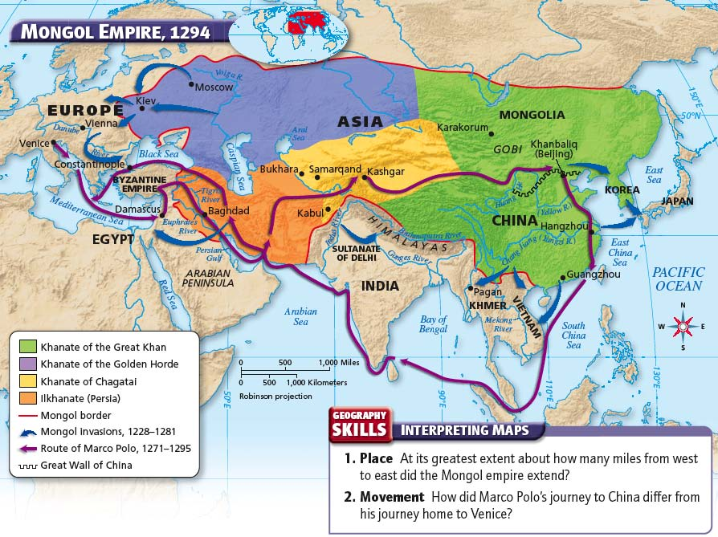

Slide 20
Important Question:
How did Mongol rule in the Yuan Dynasty affect life for the Chinese?

Slide 21
End of the Yuan Dynasty
The Yuan dynasty weakened during the last part of Kublai Khan’s reign. One cause was a number of military defeats. All of his invasions into Southeast Asia failed, and Mongol armies suffered huge losses.
Japan
Attacks
Kamikaze
Kublai Khan had set sights on conquering Japan
Tried to invade Japan twice
Disastrous results each time
First attempt: 900 ships attacked Japan, storm destroyed fleet
Second attempt: Khan sent larger fleet, severe storm again wiped out fleet
After two fleets destroyed by storms, Mongols never attempted Japanese invasion
Japanese called storms that saved them kamikaze, “divine wind”

Slide 22
Military and Monetary Losses
Weaknesses
End of Dynasty
Huge military losses in Japan weakened Mongol forces that controlled, protected China
Large amounts spent on public-works projects weakened economy
Weaknesses, Chinese resentment of Mongols, left empire ripe for rebellion
1294, Kublai Khan died, power struggles erupted; Khan’s successors lacked talent for leadership
Floods, rising taxes further increased discontent
1300s, Chinese rebelled, defeated Mongols
Mongols fled to Manchuria, ending foreign rule in China

Slide 23
Important Question:
What factors led to the end of the Yuan dynasty?

