Slide 1
Weapons during World war II
By: flappy person

Slide 2
Weapon lists
Landing Vehicle Tracked/(Armored) (LVT/(A))
Half-track Car M2
Carrier, Personnel, Half-track M3
Carrier, Personnel, Half-track M5
Scout Car M3
M8 Greyhound
Guns & Artillery[edit]
M3 37 mm Anti-Tank Gun
M1 57 mm Anti-Tank Gun
M5 3-Inch Anti-Tank Gun
M1 37 mm Anti-Aircraft Gun
M1 40 mm Bofors Anti-Aircraft Gun
M1918 3-Inch Anti-Aircraft Gun
M1 90 mm Anti-Aircraft Gun
M1 75 mm Pack Howitzer
M2 105 mm Howitzer
M3 105 mm Howitzer
M1 155 mm Howitzer
M2 155 mm Field Gun
M1 8-Inch Howitzer (203 mm)
M1 8-Inch Gun
M1 240 mm Howitzer
Other
Rocket Launcher M1/M1A1/M9 (Bazooka)
M2-A1 Flamethrower
M18 recoilless rifle
Mk.2 Fragmentation Hand Grenade
Boys anti-tank rifle
Tanks[edit]
M2 Light tank
M2 Medium Tank
M3 Stuart
M5 Stuart
M3 Grant Also known as M3 Lee
M4 Sherman
M26 Pershing
M6 (Prototype)
T29 (Prototype)
T30 (Prototype)
Self Propelled Artillery[edit]
M7 Priest
M12
T92 (Prototype)
Self-Propelled Guns/Howitzers/Mortars[edit]
37mm Gun Motor Carriage M6
75mm Gun Motor Carriage M3
105mm Howitzer Motor Carriage T19
105mm Howitzer Motor Carriage M7
75mm Howitzer Motor Carriage M8
3in Gun Motor Carriage M10
155mm Gun Motor Carriage M12
Multiple Gun Motor Carriarge M15
Multiple Gun Motor Carriage M16
76mm Gun Motor Carriage M18
90mm Gun Motor Carriage M36
155mm Gun Motor Carriage M40
81mm Mortar Carrier M4
81mm Mortar Carrier M21
Armored Vehicles[edit]
Landing Vehicle Tracked/(Armored) (LVT/(A))
Half-track Car M2
Carrier, Personnel, Half-track M3
Carrier, Personnel, Half-track M5
Scout Car M3
M8 Greyhound
Guns & Artillery[edit]
M3 37 mm Anti-Tank Gun
M1 57 mm Anti-Tank Gun
M5 3-Inch Anti-Tank Gun
M1 37 mm Anti-Aircraft Gun
M1 40 mm Bofors Anti-Aircraft Gun
M1918 3-Inch Anti-Aircraft Gun
M1 90 mm Anti-Aircraft Gun
M1 75 mm Pack Howitzer
M2 105 mm Howitzer
M3 105 mm Howitzer
M1 155 mm Howitzer
M2 155 mm Field Gun
M1 8-Inch Howitzer (203 mm)
M1 8-Inch Gun
M1 240 mm Howitzer

Slide 3
MOREEE
Carrier, Personnel, Half-track M3
Carrier, Personnel, Half-track M5
Scout Car M3
M8 Greyhound
Guns & Artillery[edit]
M3 37 mm Anti-Tank Gun
M1 57 mm Anti-Tank Gun
M5 3-Inch Anti-Tank Gun
M1 37 mm Anti-Aircraft Gun
M1 40 mm Bofors Anti-Aircraft Gun
M1918 3-Inch Anti-Aircraft Gun
M1 90 mm Anti-Aircraft Gun
M1 75 mm Pack Howitzer
M2 105 mm Howitzer
M3 105 mm Howitzer
M1 155 mm Howitzer
M2 155 mm Field Gun
M1 8-Inch Howitzer (203 mm)
M1 8-Inch Gun
M1 240 mm Howitzer

Slide 4
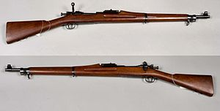
The gun called Springfield.
The M1903 Springfield, formally the United States Rifle, Caliber .30-06, Model 1903, is an American clip-loaded, 5-round magazine fed, bolt-action service rifle used primarily during the first half of the 20th century.
It was officially adopted as a United States military bolt-action rifle on June 19, 1903, and saw service in World War I. It was officially replaced as the standard infantry rifle by the faster-firing semi-automatic 8 round M1 Garand starting in 1937. However, the M1903 Springfield remained in service as a standard issue infantry rifle during World War II, since the U.S. entered the war without sufficient M1 rifles to arm all troops. It also remained in service as a sniper rifle during World War II, the Korean War, and even in the early stages of the Vietnam War. It remains popular as a civilian firearm, historical collector's piece, and as a military drill rifle

Slide 5
M1 Garand
The M1 Garand (officially designated as United States Rifle, Caliber .30, M1, later simply called Rifle, Caliber .30, M1, also abbreviated as US Rifle, Cal. .30, M1) is a semi-automatic rifle chambered for the .30-06 Springfield rifle cartridge. It was the first standard-issue semi-automatic rifle. Called "the greatest battle implement ever devised" by General George S. Patton, the Garand officially replaced the bolt-action M1903 Springfield as the standard service rifle of the United States Armed Forces in 1936 (although the switch-over was not instantaneous) and was subsequently replaced by the selective fire M14, starting in 1957. During World War II, the M1 gave U.S. forces a distinct advantage in firefights against their Axis enemies, as their standard-issue rifles were slower-firing bolt-action rifles. The M1 continued to be used in large numbers until 1963 and to a lesser degree until 1976. Like its predecessor, the M1 originated from the Springfield Armory.

Slide 6
M1941 Johnson rifle
The M1941 Johnson Rifle was an American short-recoil operated semi-automatic rifle designed by Melvin Johnson prior to World War II. The M1941 competed unsuccessfully with the U.S.

Slide 7
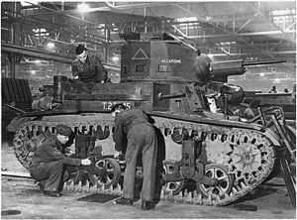
Light tank
The Light Tank M2 was an American pre-World War II light tank that saw combat with the US Marine Corps 1st Tank Battalion on Guadalcanal in 1942, during World War II. Its service with the 1st Tank Battalion during the Pacific War was its only U.S. combat use during the war; however, it is believed that M2A4s served in Burma and India with the British 7th Hussars and 2nd Royal Tank Regiment during their engagements with the IJA 14th Tank Regiment. The M2A4 was the immediate predecessor of the M3 Stuart series of light tanks, which saw widespread combat throughout the war, and the M2 Medium Tank, which was itself an unsuccessful design but served as predecessor for the M3 Lee and M4 Sherman

Slide 8
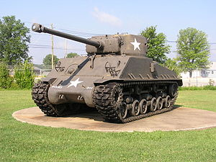
M4 Sherman
The M4 Sherman, officially the Medium Tank, M4, was the primary battle tank used by the United States and the other Western Allies in World War II, and proved to be a reliable and highly mobile workhorse, despite being outmatched by heavier German tanks late in the war. Thousands were distributed to the Allies, including the British Commonwealth and the Soviet Union, in the lend-lease program. The M4 was the second most produced tank of the World War II era, after the Soviet T-34, and its role in its parent nation's victory was comparable to that of the T-34. The tank took its name from the American Civil War General William Tecumseh Sherman.

Slide 9
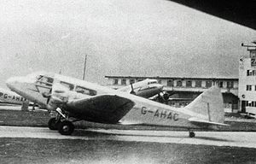
Airspeed Envoy
The Envoy was designed by A. H. (Hessell) Tiltman as a twin-engined development of his earlier Courier. It used the same wooden construction, outer wing panels and innovative retracting main undercarriage.
The Envoy was a twin-engined low-wing cabin monoplane of all-wood construction apart from fabric covered control surfaces. It had a rearward retracting main undercarriage with a fixed tail wheel. The aircraft was built in three series, the Series I was the initial production variant which did not have trailing-edge flaps, seventeen built. Thirteen Series II variants were built with split flaps and the Series III (19-built) was similar but had detailed improvements. Each series of the Envoy was sold with a choice of engines including the Wolseley Aries, Armstrong Siddeley Cheetah V or Armstrong Siddeley Lynx IVC radial engines. These different engines were housed under a variety of cowlings, mostly short chord Townend rings but also wider chord cowlings with and without blisters for cylinder heads.

Slide 10
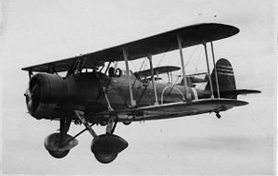
Aichi D1A
The Aichi D1A or Navy Type 94/96 Carrier Bomber (Allied reporting name "Susie") was a Japanese carrier-based dive bomber of the 1930s. A single-engine, two-seat biplane based on the Heinkel He 50, the D1A was produced by Aichi for the Imperial Japanese Navy, remaining in service as a trainer at the time of the attack on Pearl Harbor. The D1A was produced in two variants, the D1A1 (Navy Type 94 Carrier Bomber), and the D1A2 (Navy Type 96 Carrier Bomber, sometimes referred to as the D2A.)

Slide 11
French submarine Africaine (Q196)
Africaine (Q196) ("African") was an Aurore-class submarine of the French navy.
Still incomplete, she was captured by the Germans in June 1940. She was renamed UF-1 on 13 May 1941 by the Kriegsmarine, but never completed during the German occupation of France.
She was recaptured, completed under her original name, and launched on 7 December 1946. The Africaine was taken out of service in 1961 and was stricken on 28 February 1963 as the Q334.

Slide 12
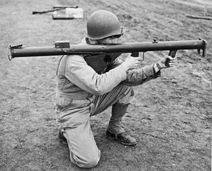
Bazooka during WW2
Also referred to as the "Stovepipe", the innovative bazooka was among the first-generation of rocket propelled anti-tank weapons used in infantry combat. Featuring a solid rocket motor for propulsion, it allowed for high-explosive anti-tank (HEAT) warheads to be delivered against armored vehicles, machine gun nests, and fortified bunkers at ranges beyond that of a standard thrown grenade or mine. The Bazooka also fired a HESH round, effective against buildings and tank armor. The universally-applied nickname arose from the M1 variant's vague resemblance to the musical instrument called a "bazooka" invented and popularized by 1930s U.S. comedian Bob Burns.
During World War II, German armed forces captured several bazookas in early North African and Eastern Front encounters and soon reverse engineered their own version, increasing the warhead diameter to 8.8 cm (among other minor changes) and widely issuing it as the Raketenpanzerbüchse "Panzerschreck" ("Tank terror").

Slide 13
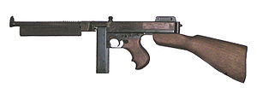
Thompson
The Thompson (named Thompson submachine gun by the maker) is an American submachine gun, invented by John T. Thompson in 1918, that became infamous during the Prohibition era. It was a common sight in the media of the time, being used by both law enforcement officers and criminals. The Thompson was also known informally as: the "Tommy Gun", "Trench Broom", "Trench Sweeper", "Chicago Typewriter", "Chicago Piano", "Chicago Style", "Chicago Organ Grinder", and "The Chopper“.
The Thompson was favored by soldiers, criminals, police and civilians alike for its ergonomics, compactness, large .45 ACP cartridge, reliability, and high volume of automatic fire. It has since gained popularity among civilian collectors for its historical significance.

Slide 14
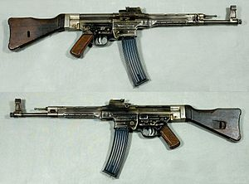
StG44
The StG44 (abbreviation of Sturmgewehr 44, "assault rifle 44") is a German assault rifle developed during World War II that was the first of its kind to see major deployment and is considered by many historians to be the first modern assault rifle. It is also known under the designations MP 43 and MP 44 (Maschinenpistole 43, Maschinenpistole 44 respectively), which denote earlier development versions of the same weapon with some differences like a different butt end, muzzle nut, shape of the front sight base or with an unstepped barrel, all only visible with close inspection

Slide 15
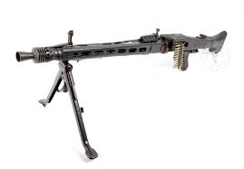
MG 42
The MG 42 (shortened from German: Maschinengewehr 42, or "machine gun 42") was a 7.92×57mm Mauser general purpose machine gun that was developed in Nazi Germany and entered service with the Wehrmacht in 1942. It supplemented, and, in some instances, replaced the MG 34 general-purpose machine gun in all branches of the German Armed Forces, though both weapons were manufactured and used until the end of the war.

Slide 16
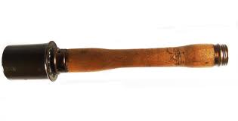
M24 grenade
The Model 24 Stielhandgranate was the standard hand grenade of the German Army from the end of World War I until the end of World War II. The very distinctive appearance led to its being called a "stick grenade", or a "potato masher" in British Army slang, and is today one of the most easily recognized infantry weapons of the 20th century.

Slide 17
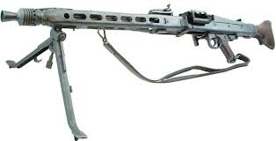
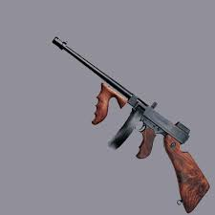
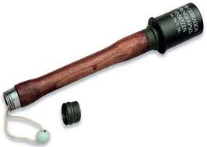
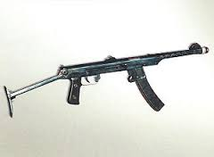
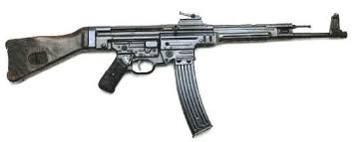
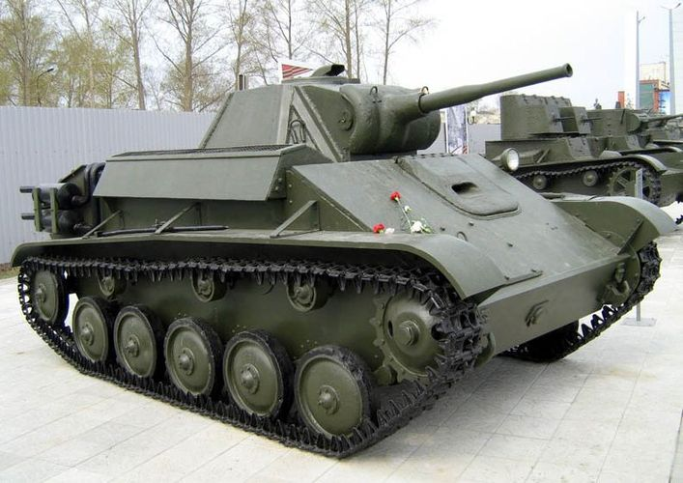
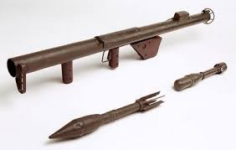
2
3
1
4
5
6
7
8

