Slide 1
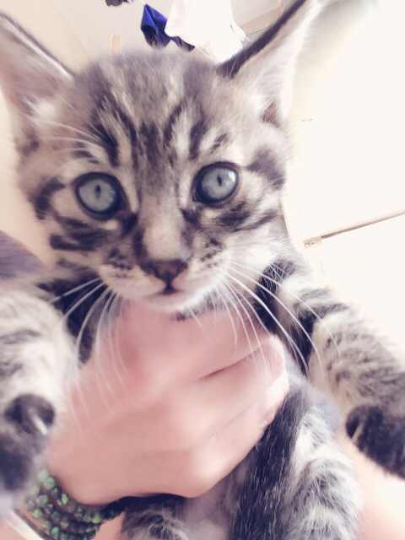
Welcome Back
Adorable
kitten
Ready
For
Adoption

Slide 2
Advisory
Be on time-goes towards house points
Attendance
FOCUS for the day
Planned advisory activities-Tarp
No food-house points
No technology-house points
English only-house points

Slide 3
Comparative Government
Be on time-house points
Be prepared-house points
This means if presentations are due you will not have time to print, adjust, or finish up unless told you can
No food-There have been two breaks added to your schedule so food can be eaten outside of class
No technology-house points-Unless I direct you to use it. When in use students will sit to the inside of tables so that work can be monitored
English only-house points-Except for points of clarification
Material information
Activities-discussion, Government and government responsibilities

Slide 4
Model United Nations (MUN)
Be on time-house points
Be prepared-house points
This means if presentations are due you will not have time to print, adjust, or finish up unless told you can
No food-There have been two breaks added to your schedule so food can be eaten outside of class
No technology-house points-Unless I direct you to use it. When in use students will sit to the inside of tables so that work can be monitored
English only-house points-Except for points of clarification
Activities-Discussion, United Nations and their responsibility and effectiveness
HW. Download a copy of How to Prepare

Slide 5
World History III
Be on time-house points
Be prepared-house points
This means if presentations are due you will not have time to print, adjust, or finish up unless told you can
No food-There have been two breaks added to your schedule so food can be eaten outside of class
No technology-house points-Unless I direct you to use it. When in use students will sit to the inside of tables so that work can be monitored
English only-house points-Except for points of clarification
Book check out
Look over your units starting at ch. 22 and determine which will be your favorite chapter to study. Write a 1 paragraph (5 sentences) as to why that topic interests you.

