Slide 1
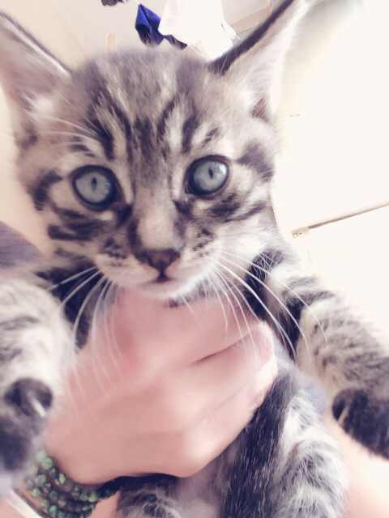
Advisory
If an Upper School student MUST change bus, the student must call parent before 3:00 PM in the Upper School Office in the presence of, and verified by Jessie Li. Jessie will then inform Cady, our transportation coordinator. If there are students who need to change buses in the afternoon....then we need a written or verbal notification from parents.
RIP Robin Williams
Activity: Wednesday has been designated for TOEFL and SAT practice.
Something of benefit to everyone

Slide 2
Welcome Back
Adorable
kitten
Ready
For
Adoption

Slide 3
Asian Studies
Be on time-house points
Be prepared-house points
This means if presentations are due you will not have time to print, adjust, or finish up unless told you can
No food-There have been two breaks added to your schedule so food can be eaten outside of class
No technology-house points-Unless I direct you to use it. When in use students will sit to the inside of tables so that work can be monitored
English only-house points-Except for points of clarification
Book check out
Activity: History, List what you know about China, Korea, and Japan
Hw: View PPT on weebly and answer questions that accompany. Due Friday

Slide 4
World History III
EQ: What is history and why should we study it?
EU: Students will develop an understanding of what history is and why we study it.
Agenda:
1. Homework review
2. Introduce primary/secondary sources-PPT
3. Partner interviews
4. Develop parent questions- questions relating them to a primary source
Hw: Interview parents-interviews presented on Friday

