Slide 1
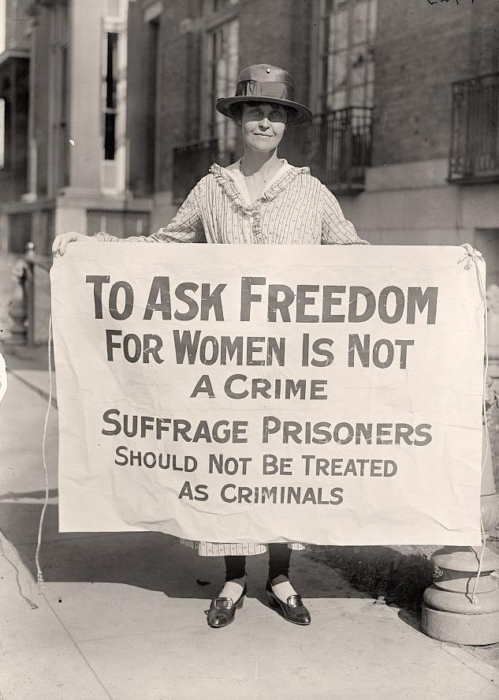
Women Suffrage
Brian Kang, Jun Park 10th

Slide 2
What is Women Suffrage
Woman suffrage is the right of women to vote and to stand for office. Limited voting rights were gained by women in Sweden, Finland and some western U.S. states in the late 19th century. International organizations were formed to coordinate efforts, especially the International Woman Suffrage Alliance (1904).

Slide 3
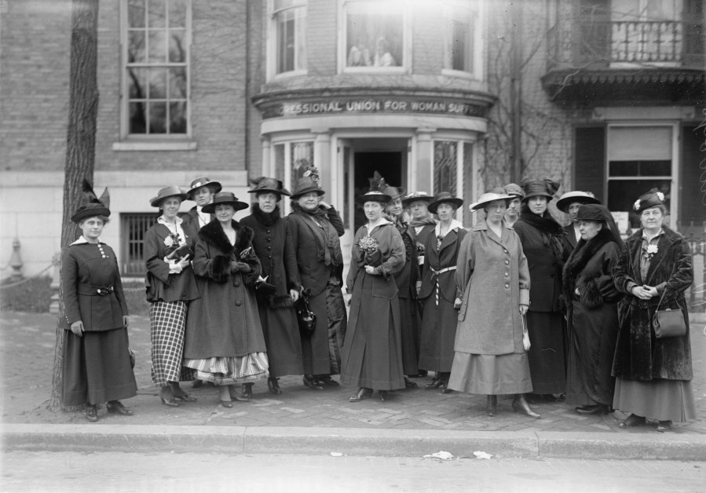
Timeline of woman suffrage
1776
Abigail Adams writes to her husband, John Adams, asking him to "remember the ladies" in the new code of laws. Adams replies the men will fight the "despotism of the petticoat.“
1777
Women lose the right to vote in New York.
1780
Women lose the right to vote in Massachusetts.
1784
Women lose the right to vote in New Hampshire.
1787
US Constitutional Convention places voting qualifications in the hands of the states. Women in all states except New Jersey lose the right to vote.
1792
Mary Wollstonecraft publishes Vindication of the Rights of Women in England.

Slide 4
The situation before women suffrage
Before the Women's Suffrage Movement women were looked down upon socially, economically, and politically. Socially women were viewed as less superior to white males therefore they were denied of many rights. People believed that their sole purpose in life was to cook, clean, and take care of the family. Also, there was little educational opportunities for women.
Economically, women were discriminated against and given very few options for jobs and their salary were very low. Politically, women were denied of many rights such as the right to vote. Once women started becoming apart of the reform movements they realized that they should be fighting for their rights to. This drove the women to fight for equal rights amongst all Americans, female or male, black or white.

Slide 5
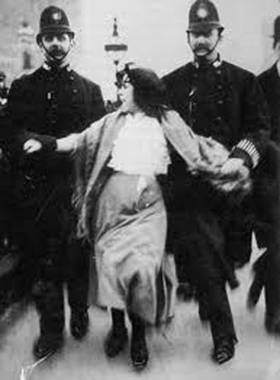
Trigger of Woman Suffrage
In 1832, even though election law was reformed, women could not receive suffrage whether or not they possessed property.

Slide 6
Pioneers of the Women's Suffrage Movement
Over the course of the growing women's suffrage movement, many influential pioneers contributed to the cause, including notable figures, such as Alice Paul, Susan B. Anthony, Elizabeth Cady Stanton, Lucy Stone, Henry Blackwell, Lucy Burns, Ida B. Wells, Julia Ward Howe,.

Slide 7
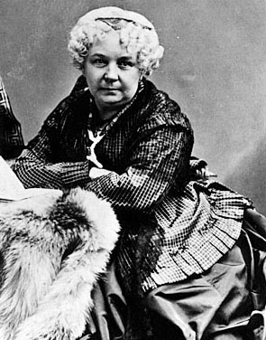
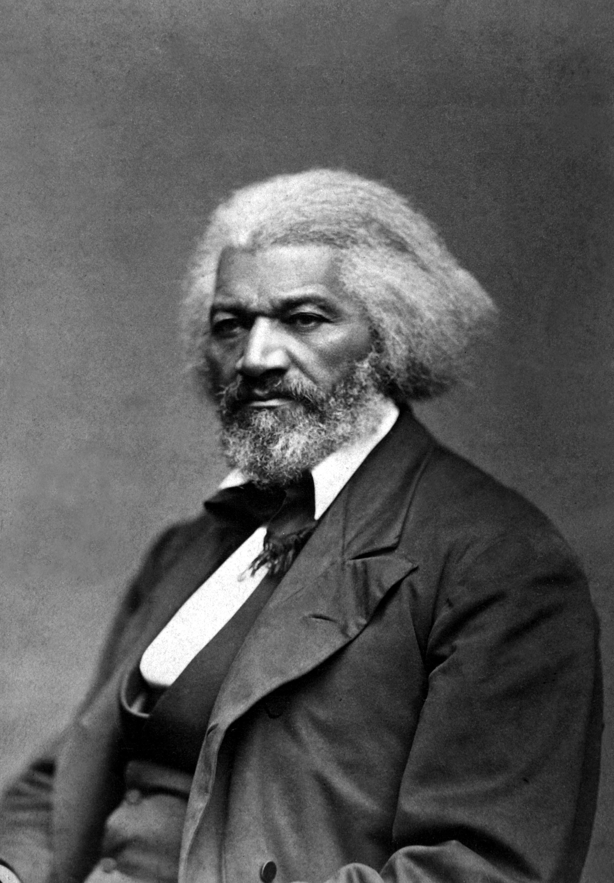
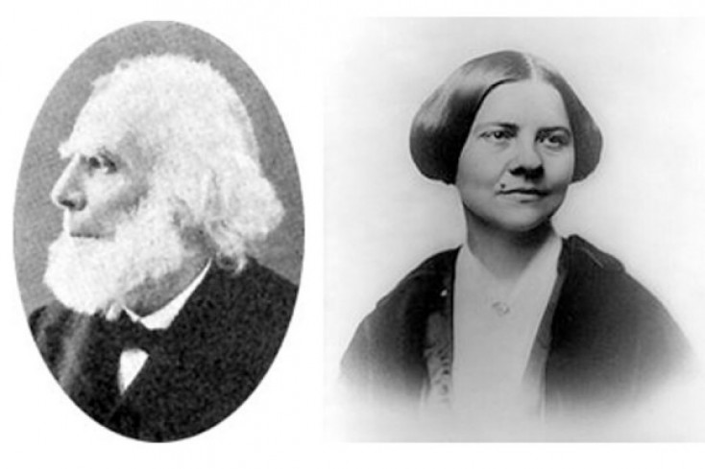
The people who influenced a lot
Elizabeth Cady Stanton, a Freethinking Political Strategist: Elizabeth Cady Stanton initiated the call for the Seneca Falls Convention, which sparked the women's suffrage movement and ultimately led to women's equality.
Henry Blackwell, Husband of Lucy Stone: A social and economic reformist, was one of the founders of the Republican Party and the American Woman's Suffrage Association.
Frederick Douglass, an Abolitionist, Civil and Women's Rights Activist: Douglass, like Stanton, was a pioneer of the early women's suffrage movement that started in 1848.

Slide 8
What did they demand?
The citizens were demanding for the right of women. The right for women to vote to participate in the society.
Also the working opportunity for women to work

Slide 9
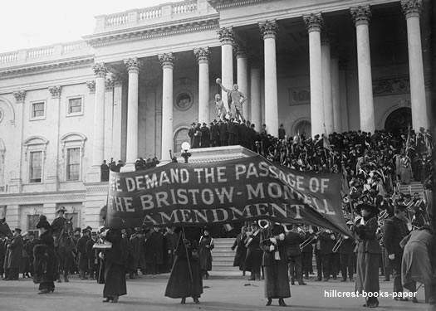
What did citizens do for what they wanted
They usually filed a petition to the member of a legislative and did demonstration a lot. They also organized Women's Social and Political Union and Woman Suffrage Association to accomplish their requirement.

Slide 10
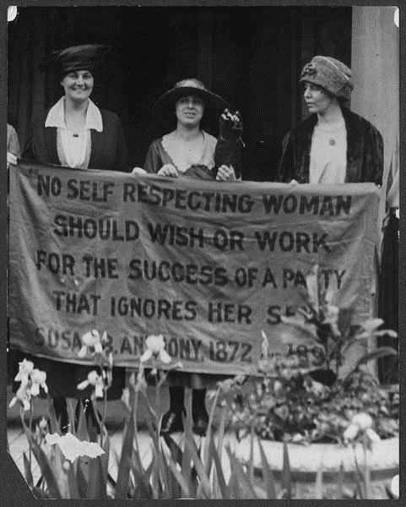
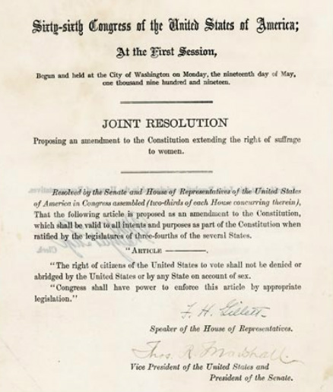
Impact of Women Suffrage
The suffrage movement created higher expectations for women.
women's economic roles increased in society.
economic and social effects were similar however the political effects were different. Economically and socially both movements gained women more rights/privileges. For instance, economically they achieved a greater variety in job choices and higher salaries. As for social, both movements were able to help society see women as strong, hardworking

Slide 11
Video
http://www.youtube.com/watch?v=IYQhRCs9IHM

Slide 12
Thank You!

