Slide 1
World War II Begins
Julia Kuttig

Slide 2
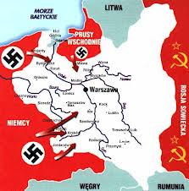
Invasion of Poland
Hitler attacked Poland on September 1, 1939
Two days after the invasion, Great Britain and France declared war against Germany
Formation of the Allied Powers
During invasion, used new military strategy: „blitzkrieg“
Bombs dropped by warplanes, attacks with fast-moving tanks and trucks
Poland overwhelmed, western Poland under German control
September 17, Soviet Union came from the East
Poland divided according to Nonaggression Pact
What caused the formation of the Allied Powers?

Slide 3
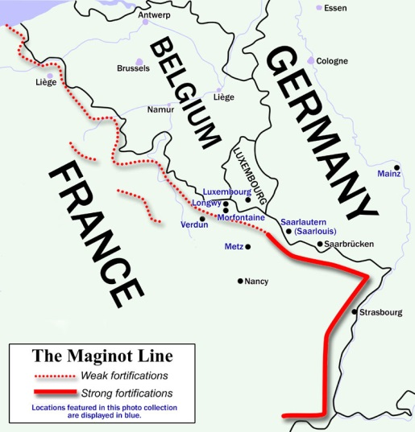
The Move West
No further German movement until 1940, however Russia took Lithuania, Latvia, a part of Finland and Estonia
April 1940, Hitler launched suprise attacks on Denmark (a day) and Norway (two months)
Next, blitzkrieg overcame Luxembourg and Holland, and the invasion of France began
Germany did not attack the Maginot line, like France and Britain had planned for.
German went through the Ardennes Forest to Belgium, the smaller country surrendered on May 28, 1940
What were France and Britain expecting
Germany to do?

Slide 4
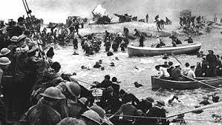
The Miracle at Dunkirk
After Belgiums defeat, much hope was lost
Britain called for ships to rescue soldiers, soldiers fought their way to Dunkirk, a French coastal city.
May 1940, British ships rescued as many as 350,000 soldiers, was named the „Miracle at Dunkirk“
Who picked up the soldiers at
Dunkirk?

Slide 5
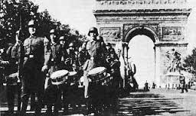
The Fall of France
June 1940, Germany began making its way across France
Taken by suprise by Germany‘s Luftwaffe, or air force
No plan of defense
Italy also began invading France on June 10
Paris taken June 14, a week after, Marshal Phillipe Pértain, head of France, surrendered
Who was the head of France
at the time?

Slide 6
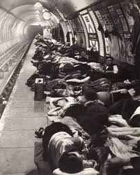
The Blitz in Britain
Neville Chamberlai resigned May 10 and Winston Churchill took his place
When Hitler realized Britain would not make an alliance against the Soviet Union because they believed it to be the bigger threat, like he expected, he began bombing
First British air bases, then British cities in what became the Battle of Britain, or the „Blitz“
The Blitz lasted for 57 days
Citizens camped out in bomb shelters and
underground railway stations
In London, about 14,000 people were killed
by the bombings
Why did Hitler begin bombing Britain?

