Slide 1
Separation of Powers
What is it and how does it work
http://www.rogerdarlington.me.uk/USvsUK.html

Slide 2
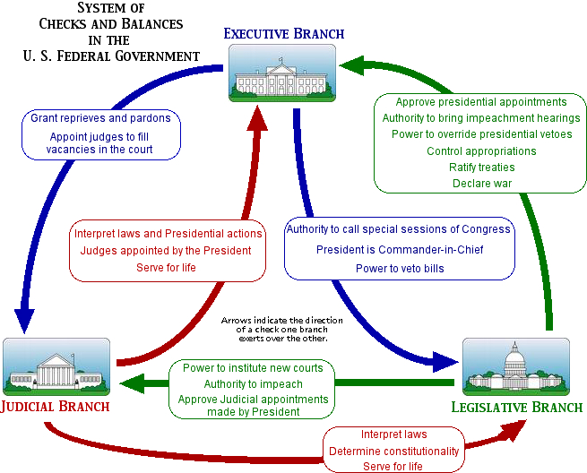

Slide 3
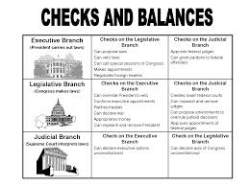
Checks and Balances

