Slide 1
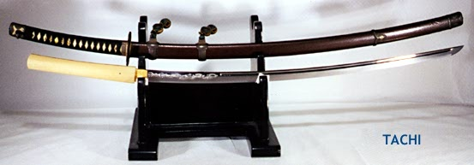
Fujiwara Rule
858-1159
Heian period

Slide 2
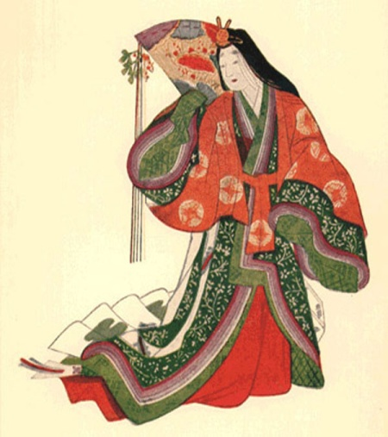
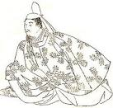
Fujiwara Rule
Ruled for over 300 years
Owned more private lands than any other family/clan
Took over Japanese Imperial Government through marriages

Slide 3
Weakness of the Emperor
Emperors were weak during this period
Power was controlled by aristocratic families
Families of warriors and a military aristocracy
Families established military might to control provinces

Slide 4
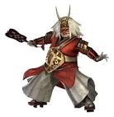
Warrior Class
Families were usually of lower nobility
They owned much land spending a lot of money building terrace rice fields
Families became more powerful than local governments
No longer paid taxes
Powerful families were called samurai
Large families controlled provinces
Some families banned together to create large samurai warrior forces

Slide 5
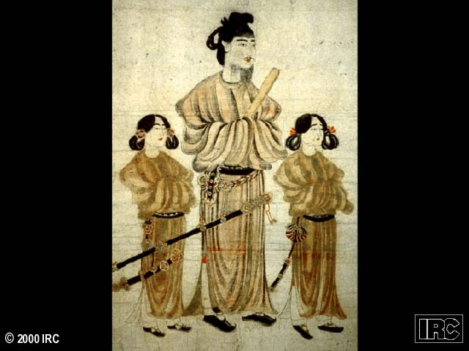
Move from China’s Roots
Military aristocrats started a long period of change different from China’s
Moved to a new form of governing
Also saw a movement in art, society and religion
A move toward Feudalism

